Slide 1


WORKING WITH THE LGBTQ COMMUNITY
March 2019

Slide 2
Overview
This course is designed to enhance understanding of youth who identify as LGBTQ, common stereotypes about them, and some of the challenges and obstacles they face.
It will also focus on how to interact with youth who identify as LGBTQ in ways that are both courteous and supportive.
LGBTQ 0.2

Slide 3
AGENDA
Unit 1:
Acronyms, Terms, and Definitions
Unit 2:
Basic Gender Concepts
Unit 3:
LGBTQ Facts and Statistics
Unit 4:
LGBTQ Issues
Unit 5:
Supporting Youth Who Identify as LGBTQ
LGBTQ 0.3

Slide 4

Unit 1:
Acronyms, Terms, and Definitions
LGBTQ 1.1

Slide 5
Learning Objectives
Define the acronym LGBTQ.
Define the terms gay, lesbian, bisexual, and transgender.
Define the acronym SOGIE.
Define the terms sexual orientation, gender identity, and gender expression.
LGBTQ 1.2

Slide 6

INTRODUCTION
LGBTQ 1.3

Slide 7
LGBTQ(IA)
Lesbian
Gay
Bisexual
Transgender
Questioning
Intersex
Asexual
LGBTQ 1.4

Slide 8
SOGIE
Sexual Orientation
Gender
Identity
Expression
LGBTQ 1.5

Slide 9
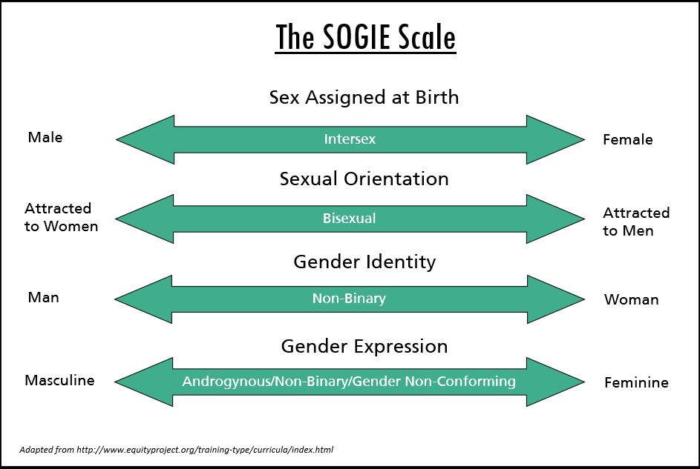
LGBTQ 1.6

Slide 10
Sexual Orientation vs
Gender Identity
Gender identity and sexual orientation are two different things.
A person’s gender identity has
no inherent relationship to their sexual orientation.
LGBTQ 1.7

Slide 11
Gender Identity vs
Gender Expression
Gender identity is a person’s internal sense of being a man, woman, both, or neither. It refers to how people see and identify themselves rather than their sex assigned at birth.
Gender expression is not binary. People can express as one gender, a mix of genders, or try to express no gender at all.
LGBTQ 1.8

Slide 12
Gender Identity vs
Gender Expression, cont.
Gender nonconforming refers to a person who does not follow social ideas or stereotypes about how they should look or act based on their sex or gender identity.
Gender questioning refers to a person who is questioning their gender identity or experimenting with different genders.
LGBTQ 1.9

Slide 13

Unit 2:
Basic Gender Concepts
LGBTQ 2.1

Slide 14
Learning Objectives
Define the terms sex and gender.
Identify the difference between cisgender and transgender.
LGBTQ 2.2

Slide 15

SEX
A person’s sex is determined by biological traits associated with being either male or female, such as sexual organs, genetic makeup, hormone production, and the like.
LGBTQ 2.3

Slide 16
Sex Assigned
at Birth
The phrase “sex assigned at birth” is designed to be inclusive of all natural human variation.
Most people are born with a single set of sexual organs and are “assigned” to the corresponding gender when they are born.
LGBTQ 2.4

Slide 17

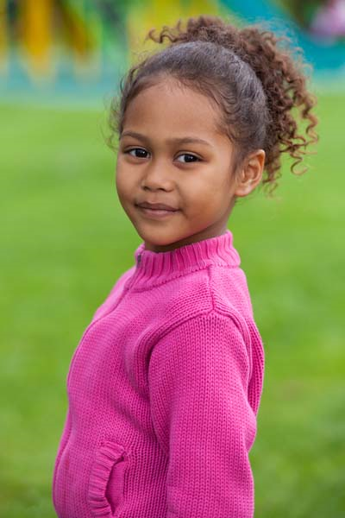
GENDER
Gender refers to the collection of roles, behaviors, activities, attributes, attitudes, and prohibitions that a society considers normal and appropriate for men and women.
While sex is binary, gender is more of a spectrum, and all individuals express and identify with aspects of both femininity and masculinity to varying degrees.
LGBTQ 2.5

Slide 18

Cisgender and Transgender
Cisgender refers to someone whose gender identity and biological sex assigned at birth align, i.e., someone who feels like they are the same gender as their biological sex.
Transgender refers to a person whose gender identity does not match the sex assigned to them at birth.
LGBTQ 2.6

Slide 19
ACTIVITY A:
SOGIE Faces
While looking at the SOGIE Scale in the Participant Guide, guess/point out the sex, gender identity, gender expression, and sexual orientation of each celebrity.
Discuss your observations with the class.
LGBTQ 2.7

Slide 20

George Clooney
LGBTQ 2.8

Slide 21

Ellen Degeneres
LGBTQ 2.9

Slide 22
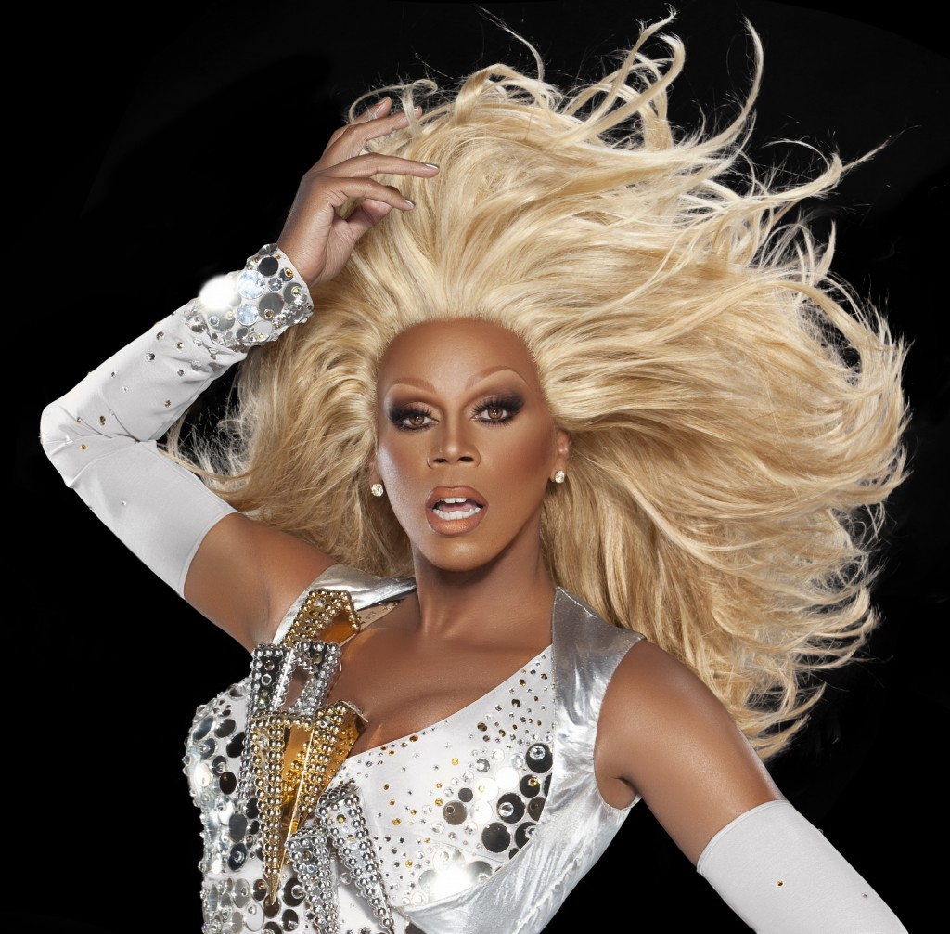
RuPaul
LGBTQ 2.10

Slide 23

Jazz Jennings
LGBTQ 2.11

Slide 24
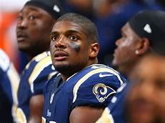
Michael Sam
LGBTQ 2.12

Slide 25

Unit 3:
LGBTQ Facts and Statistics
LGBTQ 3.1

Slide 26
Learning Objective
Employ statistics to show the how LGBTQ youth are overrepresented in the Child Welfare and Juvenile Justice Systems.
LGBTQ 3.2

Slide 27

FACTS AND STATISTICS
There are more than 7.3 million gay and bisexual Americans.
Studies from other nations over a number of years have found that between 1.2 and 6.8 percent of adults identify as LGBTQ.
LGBTQ 3.3

Slide 28
Transgender Facts and Statistics
The transgender population is less well-studied. In fact, we still do not know for sure how many Americans identify as transgender.
Research shows that youth who identify as transgender are significantly overrepresented in both social services and juvenile justice settings, and that they face additional challenges because of their gender identity.
LGBTQ 3.4

Slide 29
ACTIVITY B:
“Rites of Passage”
In your assigned group, think about rites of passage during that stage of life.
Tape your examples on the wall.
Discuss and then identify how each answer may be different if a person identifies as LGBTQ.
LGBTQ 3.5

Slide 30

Unit 4:
LGBTQ Issues
LGBTQ 4.1

Slide 31
Learning Objective
Identify common stereotypes about people who identify as LGBTQ and the discrimination they face.
LGBTQ 4.2

Slide 32
STEREOTYPES AND MISCONCEPTIONS
People who identify as LGBTQ are found in every social, economic, racial, ethnic, and religious group.
Everyone has perceptions or preconceived ideas about what it means to be LGBTQ.
There was a time in this country when homosexuality was considered a mental illness.
It is important to understand that an individual’s SOGIE is only a small part of who they are.
LGBTQ 4.3

Slide 33
DISCRIMINATION AND HARASSMENT
Intersectionality focuses on the intersection of different forms of discrimination or oppression. There are many aspects of identity that people discriminate against on a regular basis.
Although we may examine different types of prejudice independently, people do not experience them independently.
LGBTQ 4.4

Slide 34
DISCRIMINATION AND HARASSMENT, cont.
According to the 2017 National School Climate Survey:
60% felt unsafe due to sexual orientation
45% felt unsafe due to gender expression
70% verbally harassed due to sexual orientation
59% verbally harassed due to gender expression
LGBTQ 4.5

Slide 35
DISCRIMINATION AND HARASSMENT, cont.
According to the 2017 National School Climate Survey:
29% physically harassed due to sexual orientation
25% physically harassed due to gender expression
12% assaulted due to sexual orientation
11% assaulted due to gender expression
LGBTQ 4.6

Slide 36
DISCRIMINATION AND HARASSMENT, cont.
According to the 2017 National School Climate Survey:
55% did not report harassment or assault
60% said no action was taken when it was reported
35% reported missing at least one full day of school in the past month
LGBTQ 4.7

Slide 37

Unit 5:
Supporting Youth Who Identify as LGBTQ
LGBTQ 5.1

Slide 38
Learning Objectives
Identify the importance of being sensitive to youth who identify as LGBTQ.
Identify local resources for youth who identify as LGBTQ.
LGBTQ 5.2

Slide 39

EDUCATION
Education about key issues that people who identify as LGBTQ face is paramount in assisting the LGBTQ community in a meaningful way.
LGBTQ 5.3

Slide 40
Personal Bias and Prejudice
You should not assume that all of the young people you work with are heterosexual.
Regardless of your own beliefs and biases, you must be professional and not discriminate on the basis of sexual orientation, gender identity, or gender expression.
It is important to treat youth who identify as LGBTQ with the same dignity as anyone else.
LGBTQ 5.4

Slide 41
Bias and Prejudice
in Others
When adults demonstrate bias or prejudice, young people will notice how other adults respond. This can greatly affect their relationship with young people, especially when the adult is supposed to be protecting the young person.
LGBTQ 5.5

Slide 42
NON-DISCRIMINATION
Let youth who identify as LGBTQ know you are willing to listen and talk about anything.
Support their freedom of expression and show respect for their choices.
If you make a mistake, apologize and move on.
LGBTQ 5.6

Slide 43
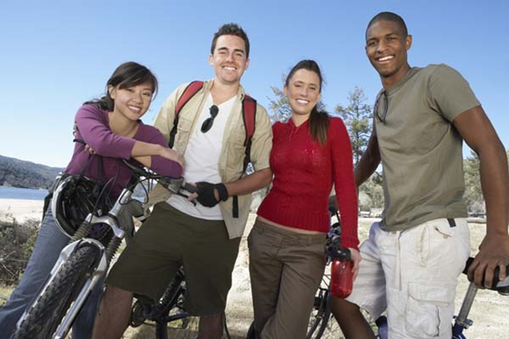
USE OF LANGUAGE
Be aware of your language, body language, and other non-verbal communication.
Language/communication is the first step to building trust.
LGBTQ 5.7

Slide 44
USE OF LANGUAGE, cont.
There are a few word choices that may be considered offensive and should be avoided. These include:
Lifestyle
Choice
Friend
Homosexual
Incorrect names and pronouns
LGBTQ 5.8

Slide 45
ACTIVITY C:
Non-Gender Specific Dating Conversation
Discuss the last date you had using non-gender specific language.
Do not use the following words: He, she, his, her, boy, girl, man, woman.
Discuss the difficulties you experienced while talking without using the specific words.
LGBTQ 5.9

Slide 46

CONFIDENTIALITY
Child Welfare Professionals have a legal responsibility to protect confidential information regarding youth in their care. This includes information about a youth’s gender identity.
LGBTQ 5.10

Slide 47
CONFIDENTIALITY, cont.
One particular confidentiality concern deals with the act of coming out.
Coming out is the process of disclosing one’s sexual orientation or gender identity to others.
LGBTQ 5.11

Slide 48
CONFIDENTIALITY, cont.
Youth who identify as LGBTQ experience many different feelings.
The reactions of others can have a profound effect.
There are different levels of outness, which makes it a complicated process.
LGBTQ 5.12

Slide 49
CONFIDENTIALITY, cont.
If a young person comes out as LGBTQ, it is important to recognize that the decision to do so took great courage.
If they disclose to you, use it as an opportunity to show unconditional support.
LGBTQ 5.13

Slide 50
CONFIDENTIALITY, cont.
Assist young people who identify as LGBTQ in deciding to whom, where, when, and how to come out.
Disclosure of information should be limited to information necessary to achieve a specific beneficial purpose for that youth.
LGBTQ 5.14

Slide 51
ACTIVITY D:
Imagine This
Listen to the scenarios and answer the associated questions as a group.
LGBTQ 5.15

Slide 52
PSYCHO-SOCIAL NEEDS
Family and Friends
Youth tend to try different things in an attempt to fit in with friends or establish a sense of who they are in a particular peer group. It may take some time to develop one’s particular personal identity.
LGBTQ 5.16

Slide 53

School and Activities
School can be a difficult place to navigate for a youth who identifies as LGBTQ. Many face pervasive harassment and violence from peers, teachers, and administrators within schools.
There is a major correlation between harassment and unsafe schools in school dropout, truancy charges, and other school-related offenses.
LGBTQ 5.17

Slide 54

PHYSICAL NEEDS
Medical Care
It is important to provide developmentally appropriate information and resources about sexuality and sexual health, including about LGBTQ issues.
LGBTQ 5.18

Slide 55
RISK FACTORS
A 2013 study by the Human Rights Campaign (HRC) that surveyed both LGBTQ and non-LGBTQ youth (ages 13-17) from around the country found some stark differences in the challenges they face.
LGBTQ 5.19

Slide 56
RISK FACTORS, cont.
LGBTQ 5.20

Slide 57
FAMILY SUPPORTS
Approximately one in every four families in the U.S. has a family member who identifies as LGBTQ.
How a parent responds to their child will have an enormous impact on the child’s development and on the quality of the parent-child relationship.
LGBTQ 5.21

Slide 58
FAMILY SUPPORTS, cont.
LGBTQ 5.22

Slide 59
PLACEMENT AND FOSTER CARE
Unsupportive or biased foster care settings may cause risk factors. Lack of support in these systems may contribute to their eventual entry into delinquency court. It is important to remember that involvement in one system may impact the youth in another.
LGBTQ 5.23

Slide 60
PLACEMENT AND FOSTER CARE, cont.
Prior to placing a youth who identifies as LGBTQ, Child Welfare Professionals should consider if the personal beliefs of a prospective caregiver or foster or adoptive family are not in the child’s best interests.
When there are strong personal beliefs against people who identify as LGBTQ, Child Welfare Professionals should assess if conflicts may arise and if the physical or emotional safety of the young person may be jeopardized in that home.
LGBTQ 5.24

Slide 61
COMMUNITY RESOURCES
A sense of belonging is essential to human development. Community isolation is another risk factor for youth who identify as LGBTQ.
A lack of positive community ties can lead to low self-esteem, depression, and substance abuse.
Here is a list of resources for youth who identify as LGBTQ by state: https://www.lambdalegal.org/sites/default/files/publications/downloads/fs_resources-for-lgbtq-youth-by-state_1.pdf
LGBTQ 5.25

