Slide 1
Introduction to the Florida Department of Juvenile Justice (DJJ)
A training component of the Florida Departments of Children and Families’ and Juvenile Justice’s Crossover Youth Workgroup

Slide 2
Objectives
Identify and understand:
The definitions of common terms used by DJJ
The responsibilities and objectives of DJJ
The programs offered by DJJ
The case flow process from initial contact to case closure
2 – Introduction to the Florida Department of Juvenile Justice
Notes:
3.1.6

Slide 3
DCF and DJJ
As a Child Welfare Professional, it is likely that you will work with youth and families who are also involved with DJJ.
3 – Introduction to the Florida Department of Juvenile Justice

Slide 4
Crossover or Dually Served Youth
Crossover Youth: This term refers to youth who have an open or closed case with the Department of Juvenile Justice and the Department of Children and Families. The cases do NOT have to be open simultaneously in both systems. This term is intended to examine youth with a history of involvement with both systems.
Dually Served Youth: This term refers to youth who have an open case with the Department of Juvenile Justice and the Department of Children and Families. The cases are open simultaneously in both systems. This term is intended to examine youth with present day involvement with both systems. The dually served youth population is a subset within the broader crossover youth population.
It is imperative that both DJJ and DCF work together to evaluate current services and resources and take cooperative action in addressing prevalent gaps in delivery of behavioral health services for this specific population.
4 – Introduction to the Florida Department of Juvenile Justice

Slide 5
Common Acronyms
DJJ – Department of Juvenile Justice
DCF – Florida Department of Children and Families
JPO – Juvenile Probation Officer
LEO – Law Enforcement Officer
JAC – Juvenile Assessment Center
SAR – State Attorney Recommendation
DRAI - Detention Risk Assessment Instrument
5 – Introduction to the Florida Department of Juvenile Justice

Slide 6
Mission Statement
Mission Statement
To increase public safety by reducing juvenile delinquency
through effective prevention, intervention and
treatment services that strengthen families and turn around
the lives of troubled youth.
Florida Department of Juvenile Justice
6 – Introduction to the Florida Department of Juvenile Justice

Slide 7
How Is DJJ’s Mission Met?
Family Engagement
Gender-Specific Programs and Services
Trauma-Informed Care
7 – Introduction to the Florida Department of Juvenile Justice

Slide 8
Goal
DJJ’s ultimate goal is to provide the right services, to the right youth, in the right place, at the right time.
8 – Introduction to the Florida Department of Juvenile Justice

Slide 9
Objectives
Prevent youth from entering or becoming further involved with the juvenile justice system.
Ensure appropriate placement of youth.
Optimally serve our youth.
9 – Introduction to the Florida Department of Juvenile Justice

Slide 10
Responsibilities
DJJ serves youth typically between 10-19 years old who:
Are at-risk of entering the juvenile justice system.
Are not a serious risk, but are still in need of intervention, and can be best served in the community.
Need to be detained or committed to DJJ’s custody to protect the public and meet their needs.
10 – Introduction to the Florida Department of Juvenile Justice

Slide 11
Scope of Services
In FY 2016-2017, DJJ served over 33,000 youth in civil citation and prevention.
In FY 2016-2017, DJJ served over 47,000 youth in detention, probation and other community sanctions, and residential commitment.
11 – Introduction to the Florida Department of Juvenile Justice

Slide 12
Program Areas
DJJ’s responsibilities are organized into four major program areas:
Prevention services
Detention (secure or non-secure)
Intervention and case management services (probation)
Residential commitment
12 – Introduction to the Florida Department of Juvenile Justice

Slide 13
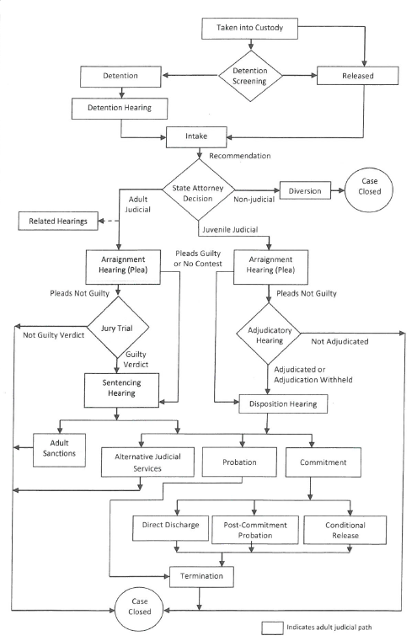
Case Flow Process
13 – Introduction to the Florida Department of Juvenile Justice

Slide 14
Initial Step: Complaint
The initial step into the DJJ system occurs when a complaint is made that a youth allegedly violated a law.
Complaints may be made by victims, parents, witnesses, neighbors, schools, state agencies, or any member of society.
14 – Introduction to the Florida Department of Juvenile Justice

Slide 15
Law Enforcement Officers
A Law Enforcement Officer (LEO) determines if there is probable cause that the youth has broken the law.
The LEO may issue a civil citation, may take the youth into custody, or a court date may be given if the youth is already involved with DJJ.
The LEO can take the youth to a Juvenile Assessment Center (JAC).
15 – Introduction to the Florida Department of Juvenile Justice

Slide 16
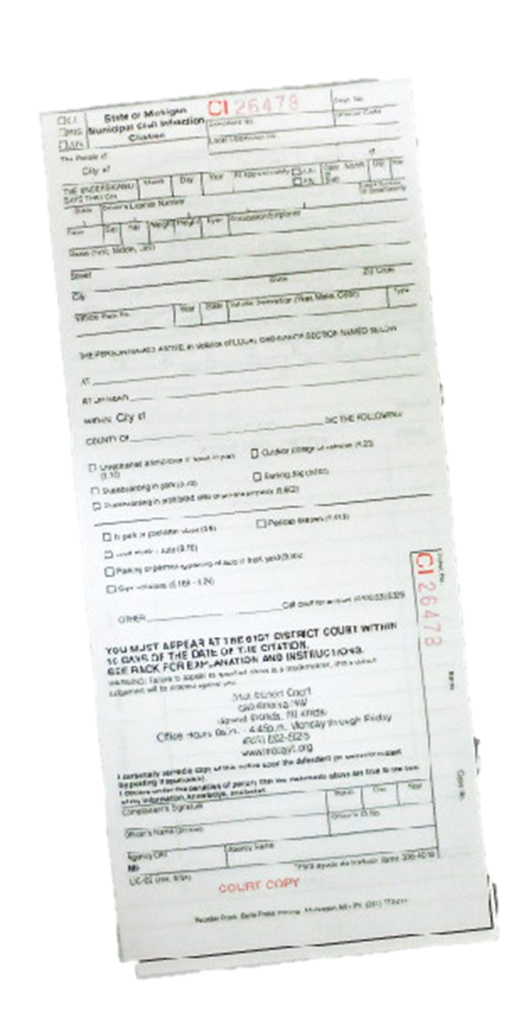
Civil Citations or Custody
Civil citations are an alternative to arrest. If youth complete their services and sanctions successfully, they are diverted from formal arrest.
DJJ accepts custody of the youth if the following conditions are met:
The youth is under 18,
There are no immediate health, mental health, or substance abuse needs, and
There is probable cause the youth has broken the law.
16 – Introduction to the Florida Department of Juvenile Justice

Slide 17
Detention
There are two detention options:
Secure detention
Non-secure detention
A detention hearing only occurs for youth on home or secure detention status.
The Detention Risk Assessment Instrument indicates whether or not the youth should be placed in secure or non-secure detention.
17 – Introduction to the Florida Department of Juvenile Justice

Slide 18
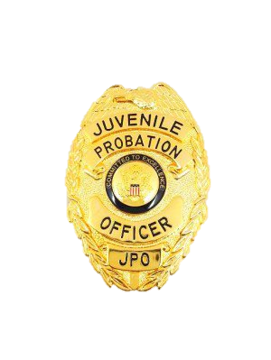
Juvenile Probation Officers
After the detention hearing, the youth is assigned a Juvenile Probation Officer (JPO) who continues the intake process.
The JPO prepares a report for the State Attorney known as the State Attorney Recommendation (SAR).
It provides information gathered during the screening and intake process.
18 – Introduction to the Florida Department of Juvenile Justice

Slide 19
State Attorney
The JPO recommends if the case should be handled judicially, non-judicially.
After reviewing the SAR, the State Attorney makes the ultimate decision on the handling of the case.
19 – Introduction to the Florida Department of Juvenile Justice

Slide 20
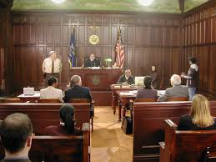
Hearings
If the case is handled judicially, the youth will have an arraignment hearing.
If the youth does not admit to the charges, the next step is an adjudicatory hearing.
An adjudicatory hearing is conducted before a judge without a jury.
20 – Introduction to the Florida Department of Juvenile Justice

Slide 21
Hearing Decisions
The adjudicatory hearing can have three outcomes:
Not Adjudicated | Adjudicated | Adjudication Withheld
The court does not find the youth guilty and the case is closed. | The court finds a youth guilty of committing a delinquent act. The court can commit the youth or place the youth on community supervision. | The court finds that a youth committed a delinquent act, but withholds an adjudication of delinquency. The court places the youth on community supervision.
21 – Introduction to the Florida Department of Juvenile Justice

Slide 22
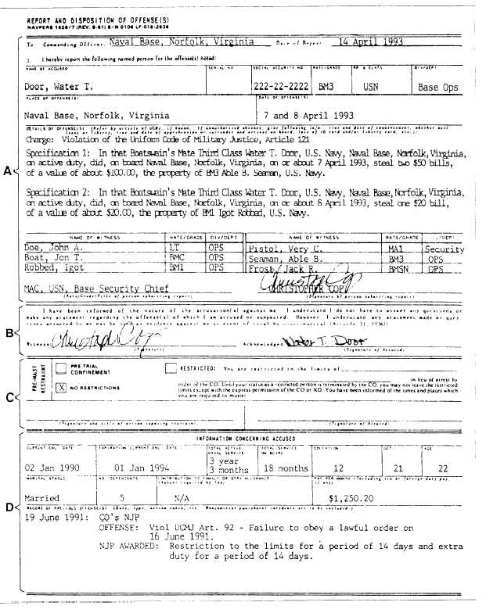
Disposition
Once the judge has ruled, DJJ prepares a pre-disposition report for the judge.
In the report, the JPO recommends the most appropriate handling (or disposition) of the youth’s case.
The report suggests sanctions and services that are least restrictive and in the best interest of the youth, family, and community.
22 – Introduction to the Florida Department of Juvenile Justice

Slide 23
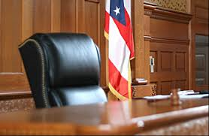
Judge’s Options
The judge can then chose between three dispositions (or sentencing options):
Alternative judicial sanctions
Probation (with treatment or redirection)
Commitment (minimum-risk nonresidential, non-secure residential, high-risk residential, or maximum-risk residential)
23 – Introduction to the Florida Department of Juvenile Justice

Slide 24
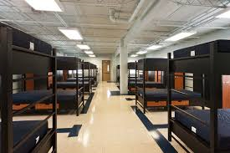
Release Options
If a youth is committed, there are three release options:
Direct discharge
Conditional release
Post-commitment probation
24 – Introduction to the Florida Department of Juvenile Justice

Slide 25
Release
Prior to the youth’s release, the program conducts a transition conference to finalize plans and the JPO makes post-residential service referrals.
Many others, such as circuit liaisons, community re-entry teams, youth workforce providers, education representatives, and local mental health and substance abuse providers support the youth and families.
25 – Introduction to the Florida Department of Juvenile Justice

Slide 26
Conclusion
DCF and DJJ work with children and families to provide assistance and guidance.
Sometimes youth and families are involved with both agencies, which can be difficult and overwhelming.
It is vital that both agencies work effectively and efficiently together to best serve these youth and families to help them succeed and protect public safety.
26 – Introduction to the Florida Department of Juvenile Justice

