Slide 1

Module 5
Family Conditions
Notes:
4.0.1

Slide 2
Agenda
Unit 5.1: The Basic Social Unit: The Family
Unit 5.2: The Impact of Family Dynamics and Culture on Family Functioning
Unit 5.3: Dynamics of Mental Illness
Unit 5.4: Dynamics of Poverty
Unit 5.5: Dynamics of Limited Cognitive Functioning
Pre-Service Curriculum Module 5.0.2
Notes:
4.0.2

Slide 3
Unit 5.1
The Basic Social Unit – The Family
Pre-Service Curriculum Module 5.1.1
Notes:
2.1.3

Slide 4

Learning Objectives
Pre-Service Curriculum Module 5.1.2
Notes:
2.1.4

Slide 5

Activity:
What is a Family?
Pre-Service Curriculum Module 5.1.3
Notes:
1.1.5

Slide 6
Six Protective Factors
Nurturing and attachment
Knowledge of parenting and child development
Parental resilience
Social connections
Concrete supports for families
Social and emotional competence of children
Pre-Service Curriculum Module 5.1.4
Notes:
1.1.10

Slide 7
Nurturing and attachment
Knowledge of Parenting and child development
Parental Resilience
Social and Emotional Competence of Children
Concrete Supports
Social Connections
CAREGIVER PROTECTIVE CAPACITIES
Takes action
Sets aside own needs
Demonstrates adequate skills
History of protecting
Is self-aware
Intellectually able/capable
Understands threats to child
Recognizes child needs
Understands protective role
Articulates plan to protect
Able to meet own needs
Resilient as a caregiver
Tolerant as a caregiver
Expresses love, empathy and sensitivity toward child
Able to intervene to protect child
Positively attached to child
Aligned with child
Pre-Service Curriculum Module 5.1.5

Slide 8
Unit 5.2
The Impact of Family Dynamics and Culture on Family Functioning
Pre-Service Curriculum Module 5.2.1
Notes:
4.2.16

Slide 9
Learning Objectives
Pre-Service Curriculum Module 5.2.2
Notes:
4.2.17

Slide 10

What are Family Dynamics?
Pre-Service Curriculum Module 5.2.3
Notes:
4.2.20

Slide 11

What is Family Culture?
Pre-Service Curriculum Module 5.2.4
Notes:
4.2.21

Slide 12
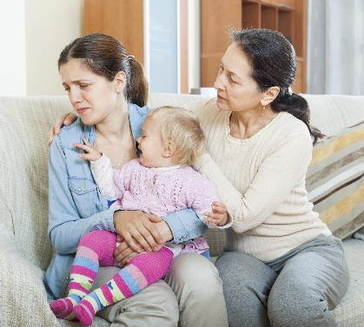


What Are Family Structures?
Pre-Service Curriculum Module 5.2.5
Notes:
4.2.22

Slide 13


Types of Family Dynamics
Notes:
4.2.23

Slide 14

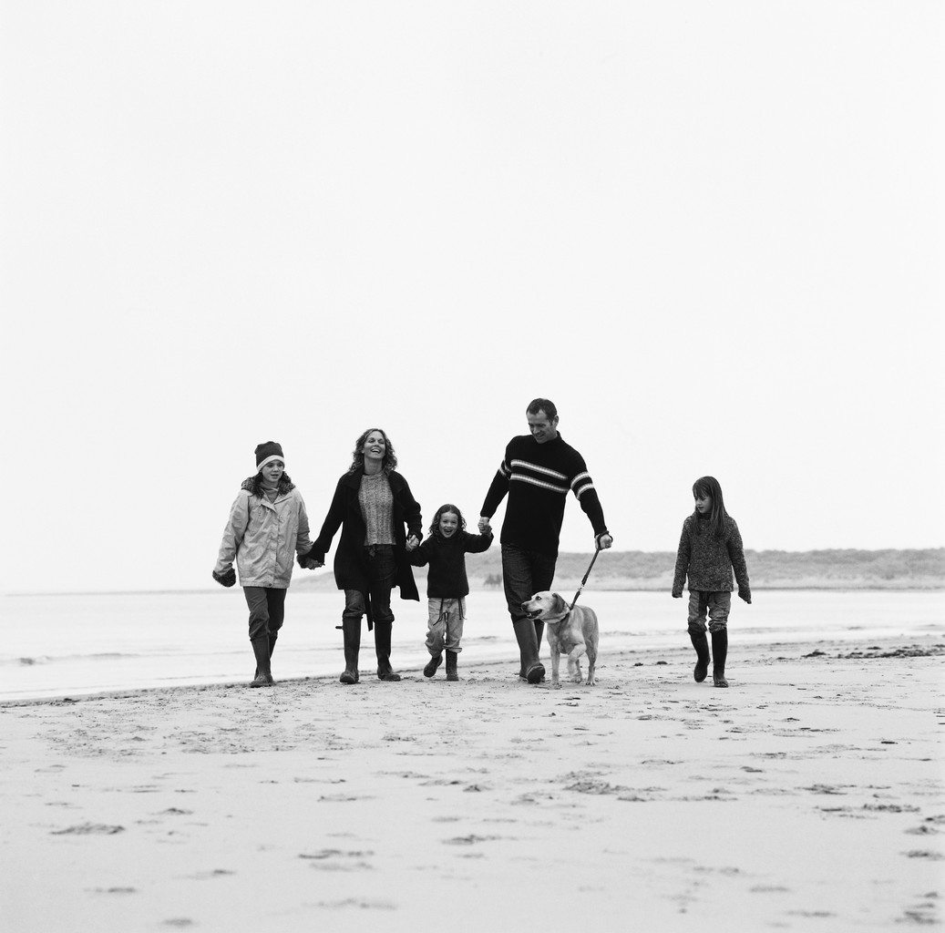
Interdependent vs. Individualistic
Pre-Service Curriculum Module 5.2.7
Notes:
4.2.24

Slide 15


Nuclear vs. Extended Family System
Pre-Service Curriculum Module 5.2.8
Notes:
4.2.25

Slide 16

Family Structures Can Be A Mixture of Structures
Pre-Service Curriculum Module 5.2.9
Notes:
4.2.26

Slide 17

A Deeper Look at Culture
Pre-Service Curriculum Module 5.2.10
Notes:
4.2.27

Slide 18
Family culture
is the set of beliefs about how things should occur in the family.
Family dynamics
are the actual patterns of relating, or interactions, between family members.
Pre-Service Curriculum Module 5.2.11

Slide 19

Cultural Sensitivity to Various Dynamics
Pre-Service Curriculum Module 5.2.12
Notes:
4.2.29

Slide 20

Sensitivity to Various Dynamics: Child Welfare Response
Pre-Service Curriculum Module 5.2.13
Notes:
4.2.32

Slide 21

The Importance of Cultural Sensitivity
Pre-Service Curriculum Module 5.2.14
Notes:
4.2.33

Slide 22

Family Dynamics and Role Flexibility
Pre-Service Curriculum Module 5.2.15
Notes:
4.2.34

Slide 23

Religion and Spirituality
Pre-Service Curriculum Module 5.2.16
Notes:
4.2.35

Slide 24

Activity
Profiling Your Own Family’s Dynamics
Pre-Service Curriculum Module 5.2.17
Notes:
4.2.36

Slide 25
Unit 5.3
The Dynamics of Mental Illness
Pre-Service Curriculum Module 5.3.1
Notes:
5.4.55

Slide 26
Learning Objectives
Pre-Service Curriculum Module 5.3.2
Notes:
5.4.56

Slide 27

What’s in a Name?
  Mental Health
  Behavioral Health
  Mental Illness/Mental Disorder
Pre-Service Curriculum Module 5.3.3
Notes:
5.4.57
Key Points
Mental Health: Is the state of emotional and psychological well-being.
Behavior Health: focuses on the reciprocal relationship between the holistic view of human behavior and the well-being of the body as a whole entity.
Mental Illness is the medical condition that disrupts a person's thinking, feeling, mood, ability to relate to others and daily functioning.
Characteristics of a person with mental illness can include:
Sustained and abnormal alterations in thinking, in mood, or in behavior.
Disruptions and impairment in a person’s daily functioning.

Slide 28

What You Need to Know
Pre-Service Curriculum Module 5.3.4
Notes:
5.4.58
Key Points:
Children whose parents have mental health needs are at far greater risk of developing emotional and behavioral difficulties than children of parents who do not have mental health diagnoses

Slide 29

What We Know About Mental Illness
Definition
Impact of mental illness on individuals
Pre-Service Curriculum Module 5.3.5
Notes:
5.4.59
Key Points
Mental illness is associated with increased occurrence of chronic diseases such as cardiovascular disease, diabetes, obesity, asthma, epilepsy, and cancer. It is also associated with the following:
Lower use of medical care.
Reduced adherence to treatment therapies for chronic diseases.
Higher risks of adverse health outcomes.
The use of tobacco products.
The abuse of alcohol.
Co-occurring Disorder (Dual Diagnosis): 8.9 million in the United States
7.4 percent of individuals receive treatment for both conditions, and 55.8 percent receiving no treatment at all

Slide 30

Anxiety Disorders
Pre-Service Curriculum Module 5.3.6
Notes:
5.4.61
Key Points
Anxiety disorders are among the most common mental disorders experienced by Americans.
There are a wide variety of anxiety disorders, including post-traumatic stress disorder, obsessive-compulsive disorder, and specific phobias to name a few.

Slide 31
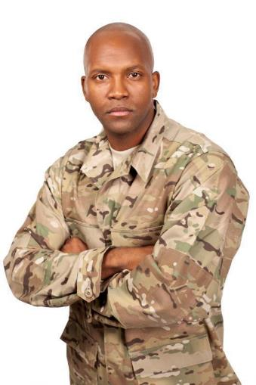
Post-Traumatic Stress Disorder (PTSD)
Definition
Pre-Service Curriculum Module 5.3.7
Notes:
5.4.62

Slide 32

Mood Disorders
Bipolar Disorder
Major Depressive Disorder
Post-Partum Depression (PPD)
Pre-Service Curriculum Module 5.3.8
Notes:
5.4.63

Slide 33
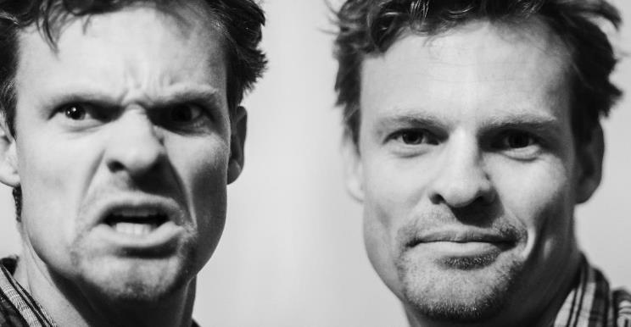
Bipolar Disorder
Pre-Service Curriculum Module 5.3.9
Notes:
5.4.64

Slide 34

Depression
Major Depressive Disorder
Post-Partum Depression
Pre-Service Curriculum Module 5.3.10
Notes:
5.4.65

Slide 35
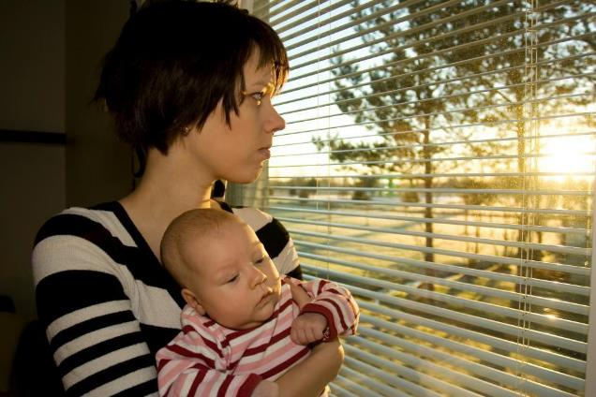
Post-Partum Depression
Pre-Service Curriculum Module 5.3.11
Notes:
5.4.66

Slide 36

Schizophrenia
Pre-Service Curriculum Module 5.3.12
Notes:
5.4.67

Slide 37

Dual Diagnosis
Definition
Prevalence
Implications
Pre-Service Curriculum Module 5.3.13
Notes:
5.4.68

Slide 38

Potential Impacts on Children
Pre-Service Curriculum Module 5.3.14
Notes:
5.4.69

Slide 39

Baker Act
Chapter 394 – Florida Mental Health Act
Provisions
Involuntary Exam Criteria
Pre-Service Curriculum Module 5.3.15
Notes:
5.4.70
Key Points
The Baker Act is found in Florida Statutes Chapter 394, Part 1. It is also known as the Florida Mental Health Act.
The Baker Act provides legal procedures for mental health examination and treatment, including:
Voluntary admission
Involuntary examination
Involuntary inpatient placement (IIP)
Involuntary outpatient placement( IOP)

Slide 40
Unit 5.4
The Dynamics of Poverty
Pre-Service Curriculum Module 5.4.1
Notes:
5.5.72

Slide 41
Learning Objectives
Pre-Service Curriculum Module 5.4.2
Notes:
5.5.73
Learning Objectives
Define the terms “poverty,” “the culture of poverty,” conditions of poverty and “intergenerational poverty.”
Describe the impact of poverty on families.
Identify how children are impacted physically, emotionally and educationally from living in poverty.
Describe how poverty impacts child development

Slide 42

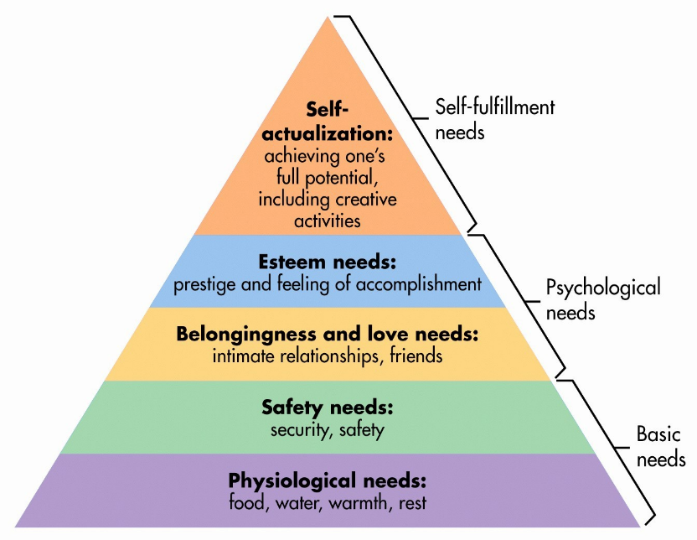
Pre-Service Curriculum Module 5.4.3
Notes:
5.5.74

Slide 43
Activity
Could You Survive Poverty?
Pre-Service Curriculum Module 5.4.4
Notes:
5.5.75

Slide 44
Definitions and Distinctions
2014: The poverty line in the U.S. is $23,850 for a family of four.
Poverty
Conditions of Poverty
Situational Poverty
Generational Poverty
Pre-Service Curriculum Module 5.4.5
Notes:
5.5.76

Slide 45
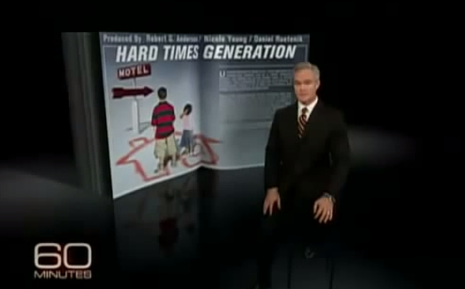
Hard Times Generation
https://www.youtube.com/watch?v=vK4PvcVAbes
Pre-Service Curriculum Module 5.4.6
Notes:
5.5.77
https://www.youtube.com/watch?v=vK4PvcVAbes

Slide 46
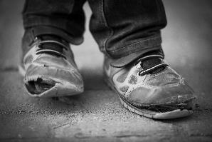
Impact of Poverty on Children
Florida’s Statistics
Environmental Deprivation/Stress
Relationship to Neglect
Brain Development
Pre-Service Curriculum Module 5.4.7
Notes:
5.5.78

Slide 47
Unit 5.5
The Effects of Limited Cognitive Functioning on Family Dynamics
Pre-Service Curriculum Module 5.5.1
Notes:
5.6.80

Slide 48
Learning Objectives
Pre-Service Curriculum Module 5.5.2
Notes:
5.6.81

Slide 49
Definitions and Distinctions
Cognitive Disorder
Limited Cognitive Functioning
Intellectual Disability
Cognitive Impairment
Developmental Disability
Pre-Service Curriculum Module 5.5.3
Notes:
5.6.82

Slide 50
Wechsler Adult Intelligence Scale-IV (WAIS-IV)
IQ Score Definition
>130 Very Superior
120–129 Superior
110–119 High Average
90–109 Average
80–89 Low Average
70–79 Borderline
69-< Extremely Low
Pre-Service Curriculum Module 5.5.4
Notes:
5.6.83

Slide 51
Stanford-Binet Fifth Edition Classification
Stanford-Binet Fifth Edition (SB5) classification^{[33][37]}
IQ Range ("deviation IQ") | IQ Classification
145–160 | Very gifted or highly advanced
130–144 | Gifted or very advanced
120–129 | Superior
110–119 | High average
90–109 | Average
80–89 | Low average
70–79 | Borderline impaired or delayed
55–69 | Mildly impaired or delayed
40–54 | Moderately impaired or delayed
Psychologists have proposed alternative language for Wechsler IQ classifications. Note especially that the term "borderline,” which implies being very close to being intellectually disabled, is replaced in the alternative system by a term that does not imply a medical diagnosis.
Pre-Service Curriculum Module 5.5.5

Slide 52
What Causes Limited Cognitive Functioning?
Genetic Conditions
Prenatal Problems
Problems at Birth
Health Problems
Post-birth problems
Environmental Factors
Pre-Service Curriculum Module 5.5.6
Notes:
5.6.84

Slide 53

Working with Individuals with Limited Cognitive Functioning
Pre-Service Curriculum Module 5.5.7
Notes:
5.6.85

Slide 54

Intellectual disability is not mental illness
Pre-Service Curriculum Module 5.5.8
Notes:
5.6.86

Slide 55
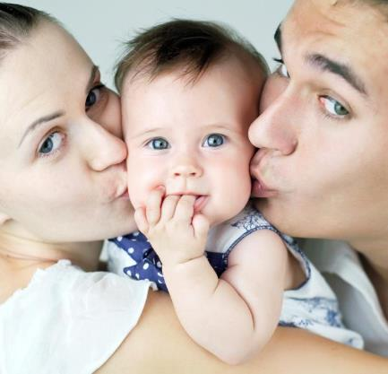
Do intellectual and developmental disabilities affect parenting ability?
Pre-Service Curriculum Module 5.5.9
Notes:
5.6.87

Slide 56
Implications for children with limited cognitive functioning
Cause
Parental capacity
Availability of services
Age delay occurred
Challenges
Pre-Service Curriculum Module 5.5.10
Notes:
5.6.88

