Slide 1
Data Integration and Missing Data Imputation
Zhe He, PhD, FAMIA
Hongyuan Cao, PhD
Florida State University

Slide 2
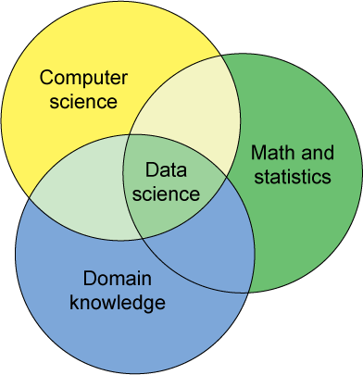
Data Science
Credit: Michael Franklin (UC Berkeley)

Slide 3
Why is Data Preprocessing Important?
No quality data, no quality mining results!
Quality decisions must be based on quality data
Data warehouse needs consistent integration of quality data

Slide 4
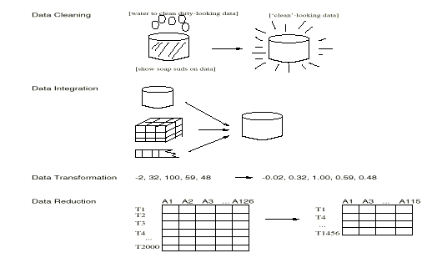
Major Tasks in Data Preprocessing
Data cleaning
Fill in missing values, smooth noisy data, identify or remove outliers, and resolve inconsistencies
Data integration
Integration of multiple databases, data cubes, or files
Data transformation
Normalization and aggregation
Data reduction
Obtains reduced representation in volume but produces the same or similar analytical results
Data discretization
Part of data reduction but with particular importance, especially for numerical data

Slide 5
Why is Data Dirty?
Incomplete data may come from
“Not applicable” data value when collected
Different considerations between the time when the data was collected and when it is analyzed.
Human/hardware/software problems
Noisy data (incorrect values) may come from
Faulty data collection instruments
Human or computer error at data entry
Errors in data transmission
Inconsistent data may come from
Different data sources
Functional dependency violation (e.g., modify some linked data)
Duplicate records also need data cleaning

Slide 6
Example of Dirty Data
Outliers? (really high or low numbers)
Example: Age = 110 (really 10 or 11?), Salary = -1
Value entered that doesn’t exist for variable?
Example: 3 entered for gender where 1=male, 2=female
Missing values?
Address = “ ”
Did the person not give an answer? Was answer accidentally not entered into the database
Inconsistent
e.g., Age=“42” Birthday=“03/07/1997”
Notes:
Data Cleaning
One of the first steps in analyzing data is to look at the data and “clean” it of any obvious errors due to incorrect data entry.
If there are outliers (really high or really low numbers), are those numbers correct? An age value of 110 years could be an error for someone who was really 10 or 11 (or 101!).
Was a value entered that doesn’t exist for the variable? For example, if 1 = male and 0 = female, and the number “2” was entered, there is clearly an error.
If there are missing values, did the person not give an answer, or was it accidentally not entered into the database?
Reduce the

Slide 7
Data Cleaning
Importance
“Data cleaning is one of the three biggest problems in data warehousing”—Ralph Kimball
Data cleaning tasks
Fill in missing values
Identify outliers and smooth out noisy data
Correct inconsistent data
Resolve redundancy caused by data integration

Slide 8
How to Handle Missing Data?
Ignore the tuple: usually done when class label is missing
Fill in the missing value manually: tedious + infeasible?
Fill in it automatically with
a global constant : e.g., “unknown”, a new class?!
the attribute mean
the most probable value: inference-based such as Bayesian formula or decision tree
Advanced techniques:
MICE
MissForest
Generative adversarial networks (GAN)

Slide 9
Impact of Missing Data Imputation on Prediction Model Performance
Payrovnaziri SN, Xing A, Salman S, Liu X, Bian J, He Z. Assessing the Impact of Imputation on the Interpretations of Prediction Models: A Case Study on Mortality Prediction for Patients with Acute Myocardial Infarction. AMIA Jt Summits Transl Sci Proc. 2021 May 17;2021:465-474. PMID: 34457162; PMCID: PMC8378616.

Slide 10
Objective
To study the impact of imputation on the interpretations of predictive models by examining:
The performance of imputation methods on missing values in EHR data
The impact of imputation methods on the performance of predictive models
Using all-cause mortality among AMI patients as a case study

Slide 11
Workflow for Evaluating Imputation Methods

Slide 12
Imputation Techniques Got Worst with More Missingness
Average Root Mean Square Error (RMSE)
Missingness level Imputation Method | 10% | 20% | 30% | 40% | 50%
MICE | 0.22±0.002 | 0.22±0.002 | 0.22±0.001 | 0.23±0.001 | 0.23±0.001
MissForest | 0.19±0.001 | 0.19±0.00 | 0.19±0.001 | 0.20±0.001 | 0.20±0.001
KNN-based | 0.21 | 0.22 | 0.22 | 0.22 | 0.22
Mean\Mode | 0.2038 | 0.2046 | 0.2052 | 0.2066 | 0.20
GAIN | 0.17±0.004 | 0.17±0.006 | 0.18±0.003 | 0.19±0.011 | 0.20±0.010

Slide 13
Imputation techniques play a role in model performance

Slide 14
15 MILLION PATIENTS • 4,100 PHYSICIAN PROVIDERS • 1,240 PRACTICES/CLINICS • 22 HOSPITALS • 67 COUNTIES

Slide 15
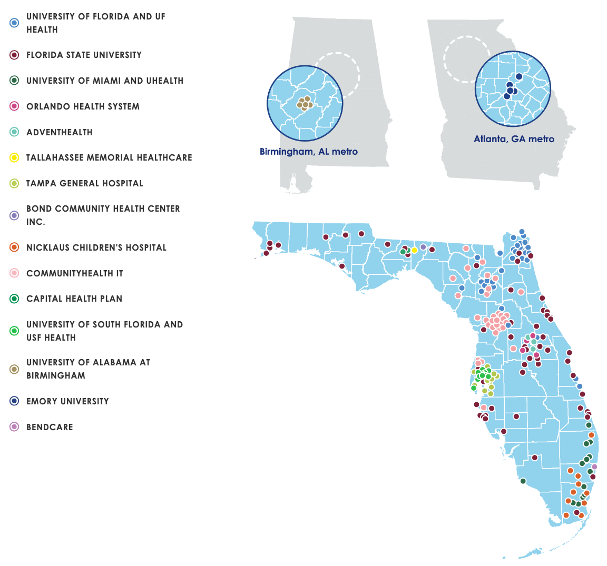

OneFlorida+ Partners
15 MILLION PATIENTS • 4,100 PHYSICIAN PROVIDERS • 1,240 PRACTICES/CLINICS • 22 HOSPITALS • 67 COUNTIES

Slide 16
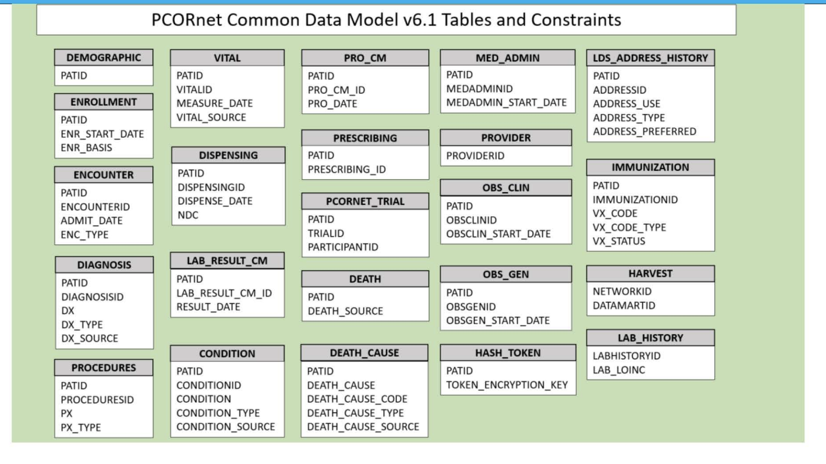

Slide 17
The OneFlorida Data Trust: A Central Data Repository to Facilitate Research
DATA
ACCESS
Limited Data Set
OneFlorida Research Mart
Florida Medicaid and Medicare, Florida Cancer Registry and
Florida Vital Statistics with
Identifying information
OneFlorida Data Trust Query
OneFlorida
Data Trust
✔
Success
Limited Data Sets from EHRs from Clinical Partners
Submit Protocol to OneFlorida IRB
and Steering Committee
Patient Consent for Registry and/or Study Participation
Data Capture Strategies
ETL Processed and Tablet-Based Electronic Systems
✔
Approval
Local Honest Brokers
for Limited Data Sets IDs
and/or Patient Contact Info
PROs and Other Study Data Collection
Data Provided
Notes:
OneFlorida Data Trust contains only a limited data set under the Health Insurance Portability and Accountability Act (HIPAA) and follows the PCORnet Common Data Model (CDM) v4.17 including patient demographics, enrollment status, vital signs, conditions, encounters, diagnoses, procedures, prescribing (ie, provider orders for medications), dispensing (ie, outpatient pharmacy dispensing), and lab results. All the identifiable information of patients such as SSN and name were removed but the dates in the data were not shifted.

Slide 18
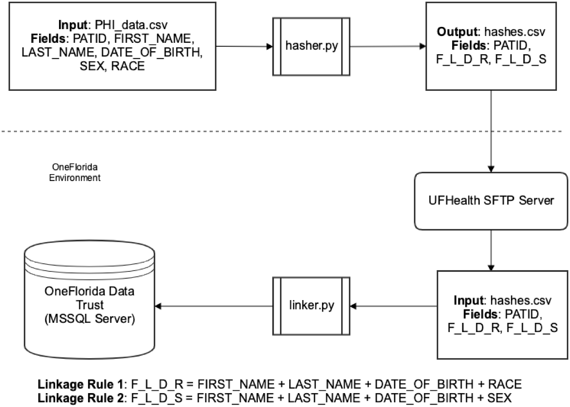
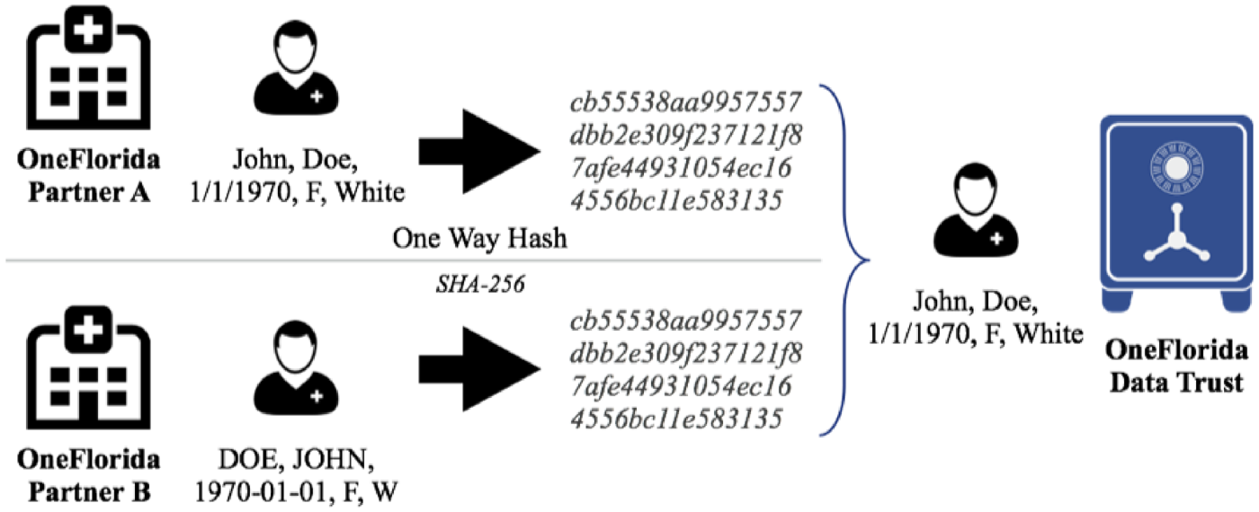

Florida has Good Models for Protecting Privacy in Data Integration
Using the gold-standard datasets, OneFL Deduper achieved a precision of 97.25∼99.7% and a recall of 75.5%.
With the tool, it deduplicated ∼3.5 million (out of ∼15 million) records down to 1.7 million unique patients across 6 health care partners and the Florida Medicaid program.
Bian J, Loiacono A, Sura A, Mendoza Viramontes T, Lipori G, Guo Y, Shenkman E, Hogan W. Implementing a hash-based privacy-preserving record linkage tool in the OneFlorida clinical research network. JAMIA Open. 2019 Sep 27.
19 MILLION PATIENTS • 4,100 PHYSICIAN PROVIDERS • 1,240 PRACTICES/CLINICS • 22 HOSPITALS • 67 COUNTIES
Notes:
PCORnet has data on more than ∼100 million patients nationwide. However, different data records of the same patient can come from different sources. Further, the same patient can seek care in different HCOs in the network. Linking and resolving duplicates in a CRN is a significant task in improving the quality of its data resources. Entity resolution/record linkage (ER/RL): the process of finding non-identical duplicates and merging the duplicates into a single tuple (record).
Setting and data sources: 6 EHR sources (ie, UFHealth, UHealth, TMH, ORH, AH, and NCH), the entire Florida Medicaid (FLM), and the tumor registry data (ie, linked using a different process) from UFHealth and ORH.
Different combinations of the quasi-identifiers available in the Florida Voter Registration System (FVRS) dataset was examined to discover linkage rules that will be accurate in identifying unique patients.
Based on the linkage rules discovered using FVRS, a pilot study was conducted to link and deduplicate patient records between UFHealth and FLM pediatric data.
OneFL Deduper: https://github.com/ufbmi/onefl-deduper
Using the gold-standard datasets, OneFL Deduper achieved a precision of 97.25∼99.7% and a recall of 75.5%.
With the tool, it deduplicated ∼3.5 million (out of ∼15 million) records down to 1.7 million unique patients across 6 health care partners and the Florida Medicaid program.

Slide 19
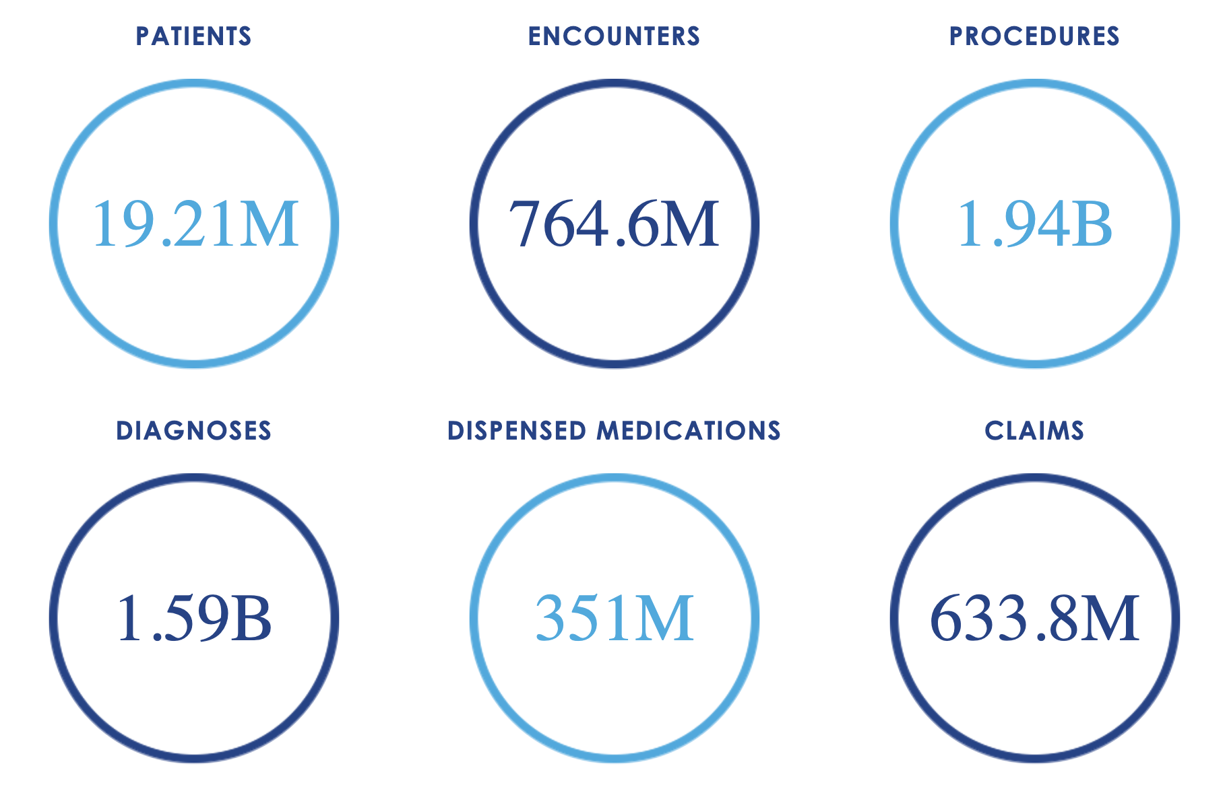
The Foundation: The OneFlorida Data Trust, Current Data Picture
19 MILLION PATIENTS • 4,100 PHYSICIAN PROVIDERS • 1,240 PRACTICES/CLINICS • 22 HOSPITALS • 67 COUNTIES

Slide 20
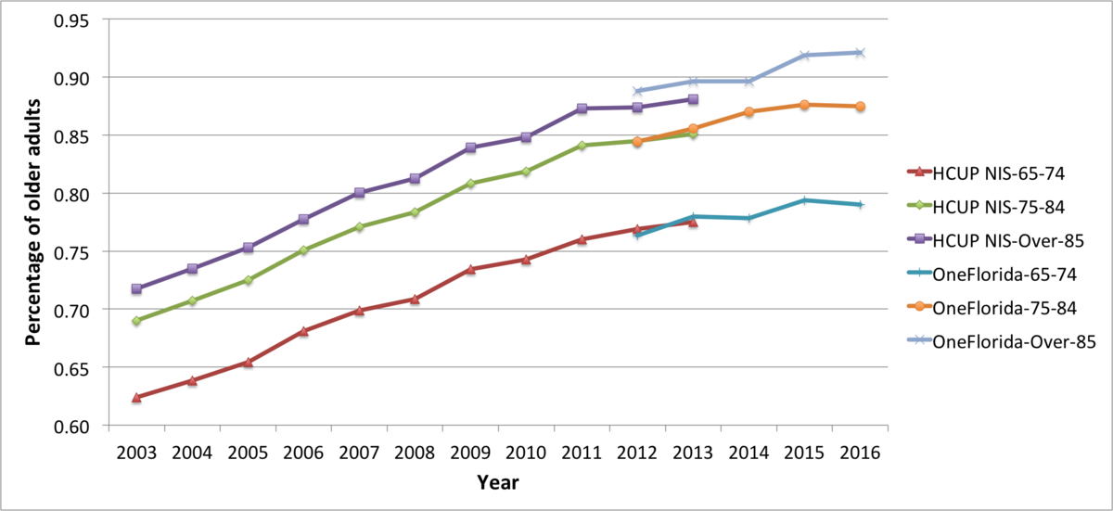
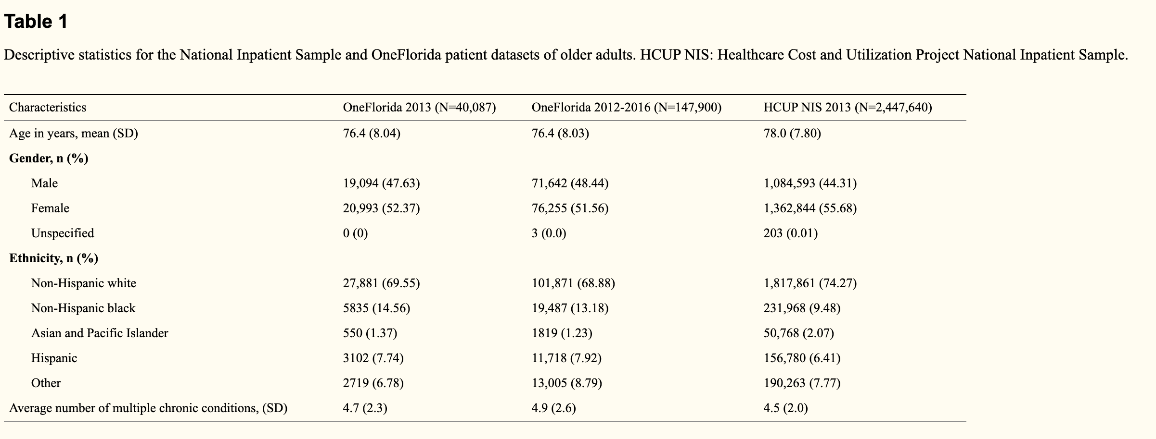
Prevalence of Multiple Chronic Conditions in OneFlorida
He Z, Bian J, Carretta HJ, Lee J, Hogan WR, Shenkman E, Charness N. Prevalence of Multiple Chronic Conditions Among Older Adults in Florida and the United States: Comparative Analysis of the OneFlorida Data Trust and National Inpatient Sample. J Med Internet Res. 2018 Apr 12;20(4):e137.
19 MILLION PATIENTS • 4,100 PHYSICIAN PROVIDERS • 1,240 PRACTICES/CLINICS • 22 HOSPITALS • 67 COUNTIES
Notes:
The aim of this study was to compare the prevalence of common chronic conditions and multiple chronic conditions in older adults between Florida and the United States using data from the OneFlorida Clinical Research Consortium and the Healthcare Cost and Utilization Project (HCUP) National Inpatient Sample (NIS).
The rankings of the top 10 prevalent conditions are the same across the OneFlorida and HCUP NIS datasets. Even though slight differences were observed, the similar estimates of prevalence of chronic conditions and multiple chronic conditions across OneFlorida and HCUP NIS suggested that clinical research data networks such as OneFlorida, built from heterogeneous data sources, can provide rich data resources for conducting large-scale secondary data analyses.

Slide 21



Doctors would recommend open surgical procedure to patients with large stone and small stone but not not to combined patients
Y is the disease outcome (1 diseased, 0 normal)
Z is the treatment (1 open surgical procedure, 0 small puncture)
X is the size of the kidney stone (1 large stone, 0 small stone)
Risk difference = $\frac{273}{273+77}−\frac{289}{289+61}=−0.05$
Risk difference = $\frac{192}{192+71}−\frac{55}{55+25}=0.04$
Risk difference = $\frac{81}{81+6}−\frac{234}{234+36}=0.06$

Slide 22
Simpson’s paradox
Why?
Sicker patients with large kidney stone tend to have have open surgical procedure
Healthier patients with small kidney stone tend to have small puncture
These two populations are not comparable
we are comparing apple with organge

Slide 23

Thank you!
Contact
Zhe He, PhD
zhe@fsu.edu
Hongyuan Cao, PhD
hcao@fsu.edu
Florida State University

Slide 24
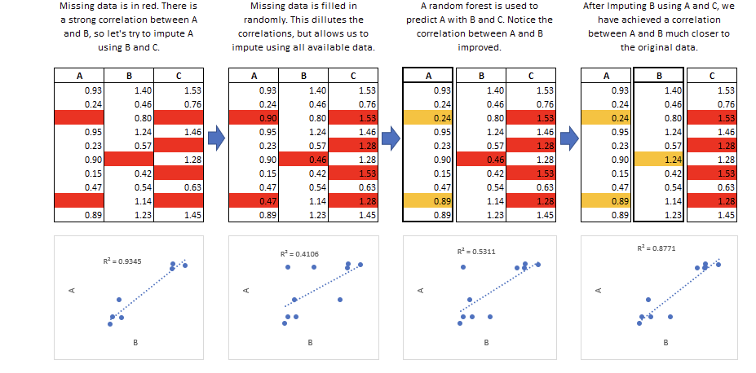
Advanced Technique: MICE

Slide 25
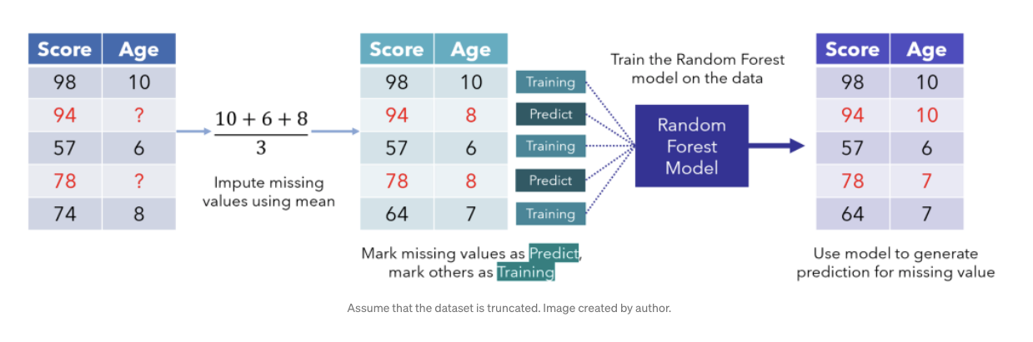
Advanced Technique: MissForest

