Slide 1
Supporting the “No Wrong Door” Model:
Mobile Response Teams and
Central Receiving Facilities
Amanda Regis
Statewide Baker Act and Marchman Act Coordinator
Florida Department of Children and Families
Office of Substance Abuse and Mental Health

Slide 2
Mobile response teams

Slide 3
Mobile Response Teams
Mobile Response Teams (MRTs) are available 24 hours a day, 7 days a week to provide emergency behavioral health care services
The goals of MRT are to:
  Reduce trauma,
  Prevent unnecessary psychiatric hospitalizations, and
  Divert individuals from emergency departments and criminal justice settings.

Slide 4
History of Florida Mobile Response Teams
2018
2020
2022
Marjory Stoneman Douglas High School Public Safety Act
Statewide Expansion of Behavioral Health Services
House Bill 945

Slide 5
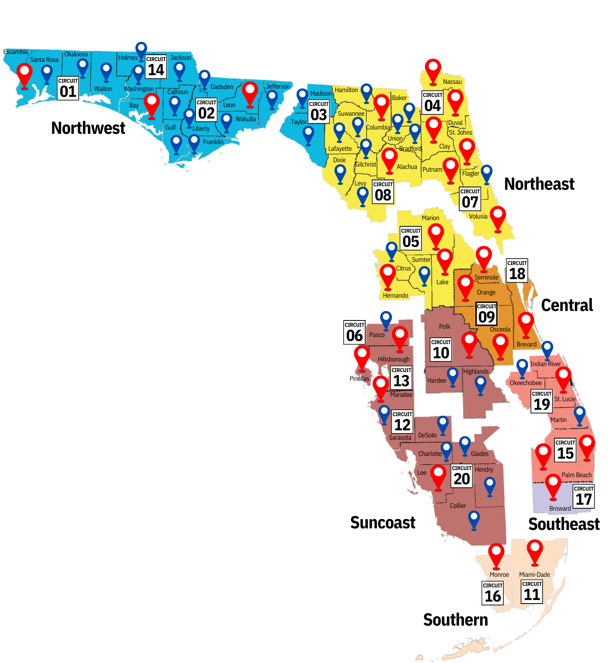

Expansion of
MRT services
2018 MRT MAP
After the Marjory Stoneman Douglas High School Public Safety Act of 2018, there were 29 MRTs established across the state.

Slide 6
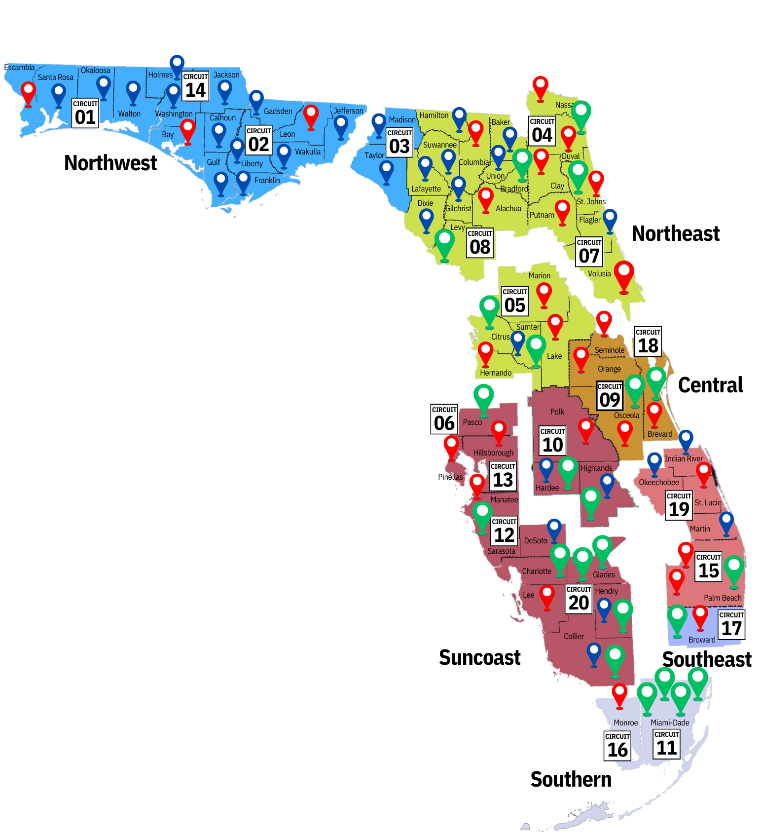
Expansion of
MRT services
2023 MRT MAP
  In 2022, an additional $15.5 million was invested to expand to 51 total MRTs.

Slide 7
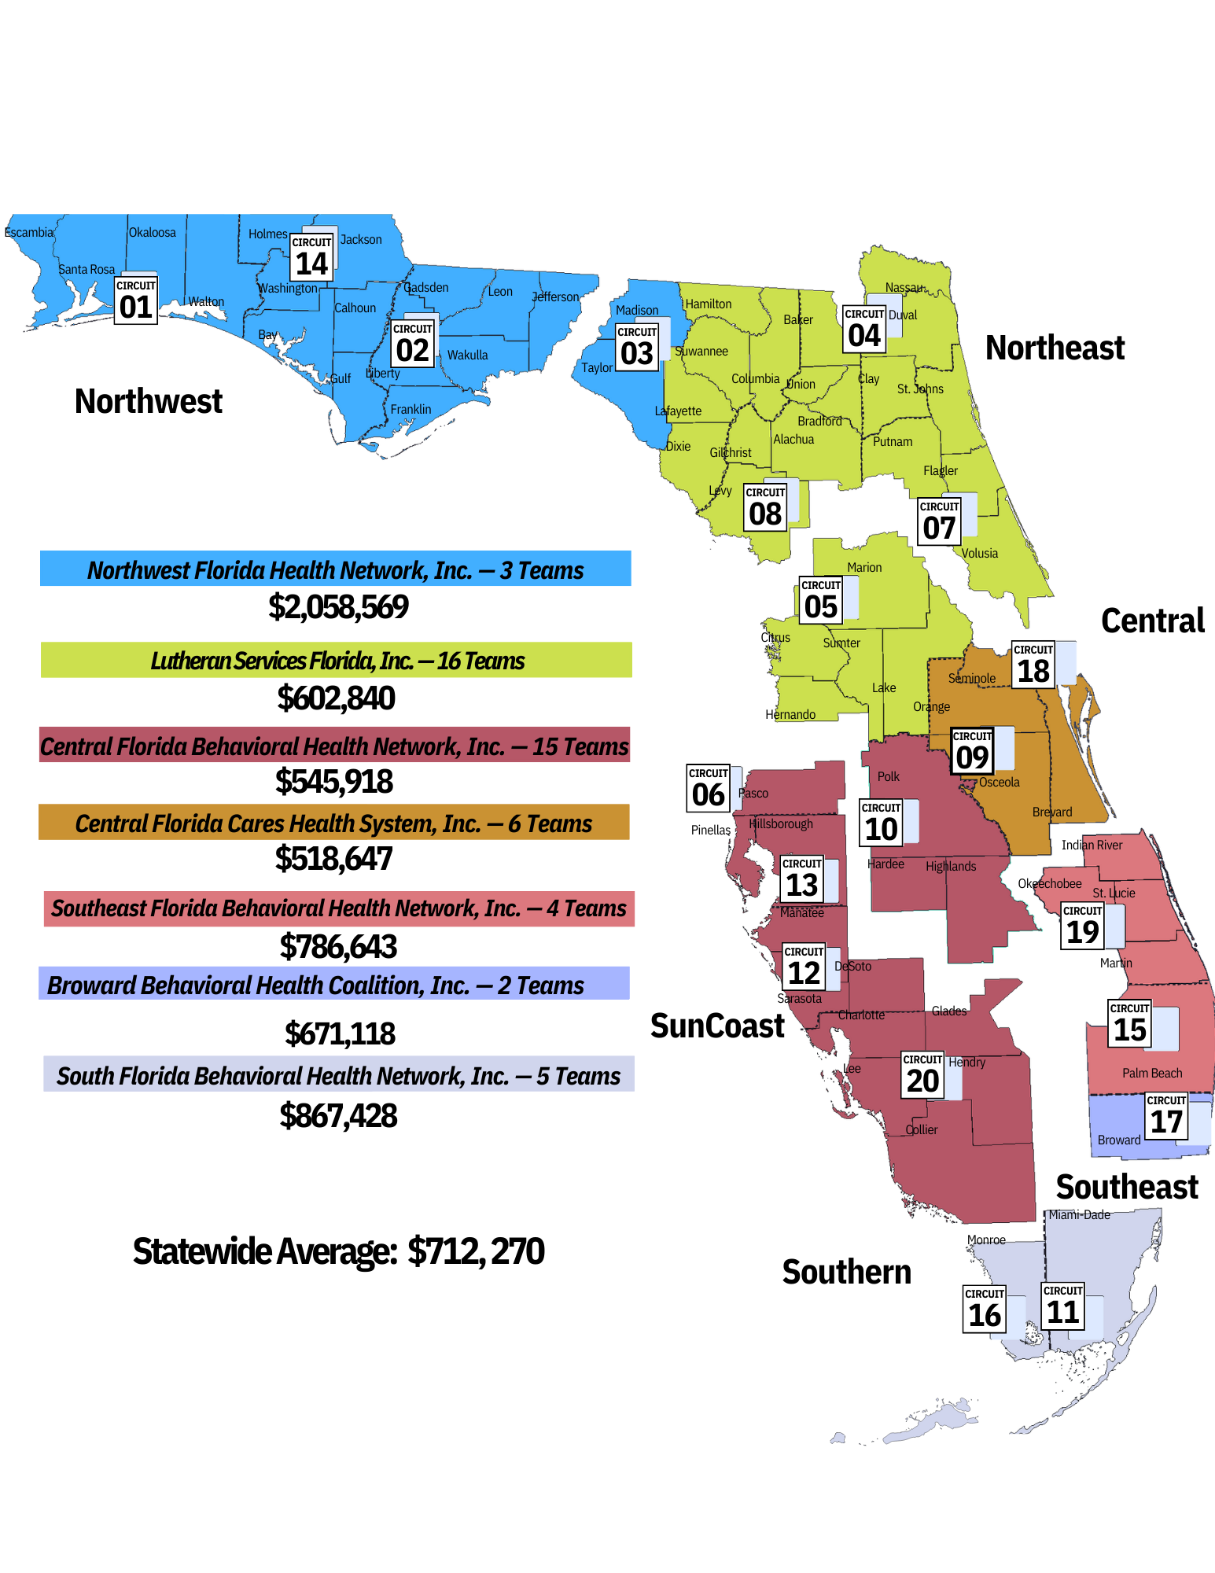
Average cost of each MOBILE RESPONSE TEAM by Managing Entity

Slide 8
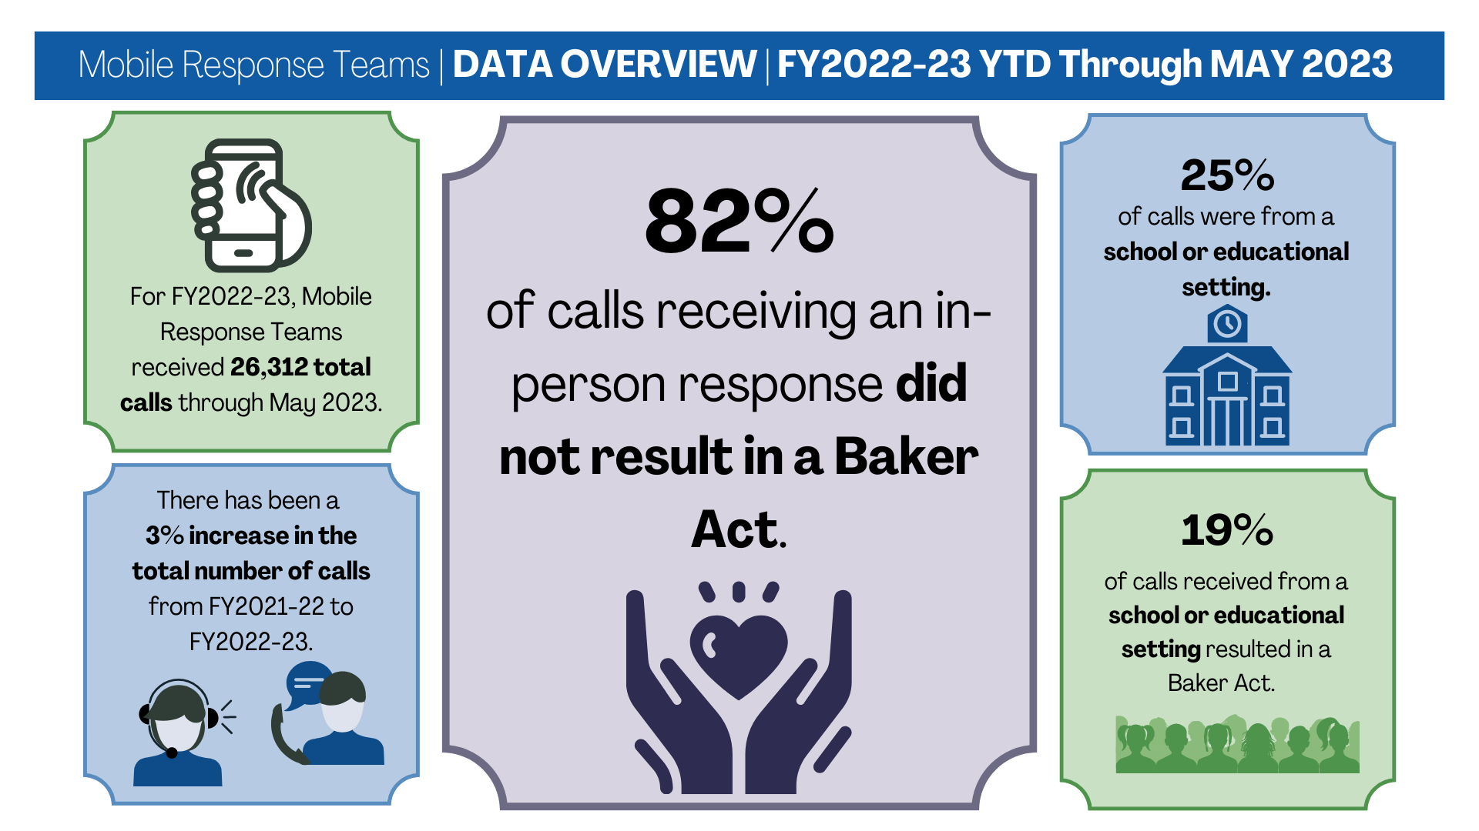

Slide 9
Central receiving facilities

Slide 10


Central receiving facility
One or more facilities serving a geographic area responsible for assessment, evaluation, and treatment or triage of individuals with behavioral health conditions.
No Wrong Door

Slide 11
Central receiving facility
Target Population
Purpose
Provide initial assessments, triage, case management
Provide opportunities for jail diversion
Reduce unnecessary use of emergency rooms
Increase the quality and quantity of services
Individuals in need of evaluation or stabilization under the Baker Act or Marchman Act
Individuals in need of crisis services.

Slide 12
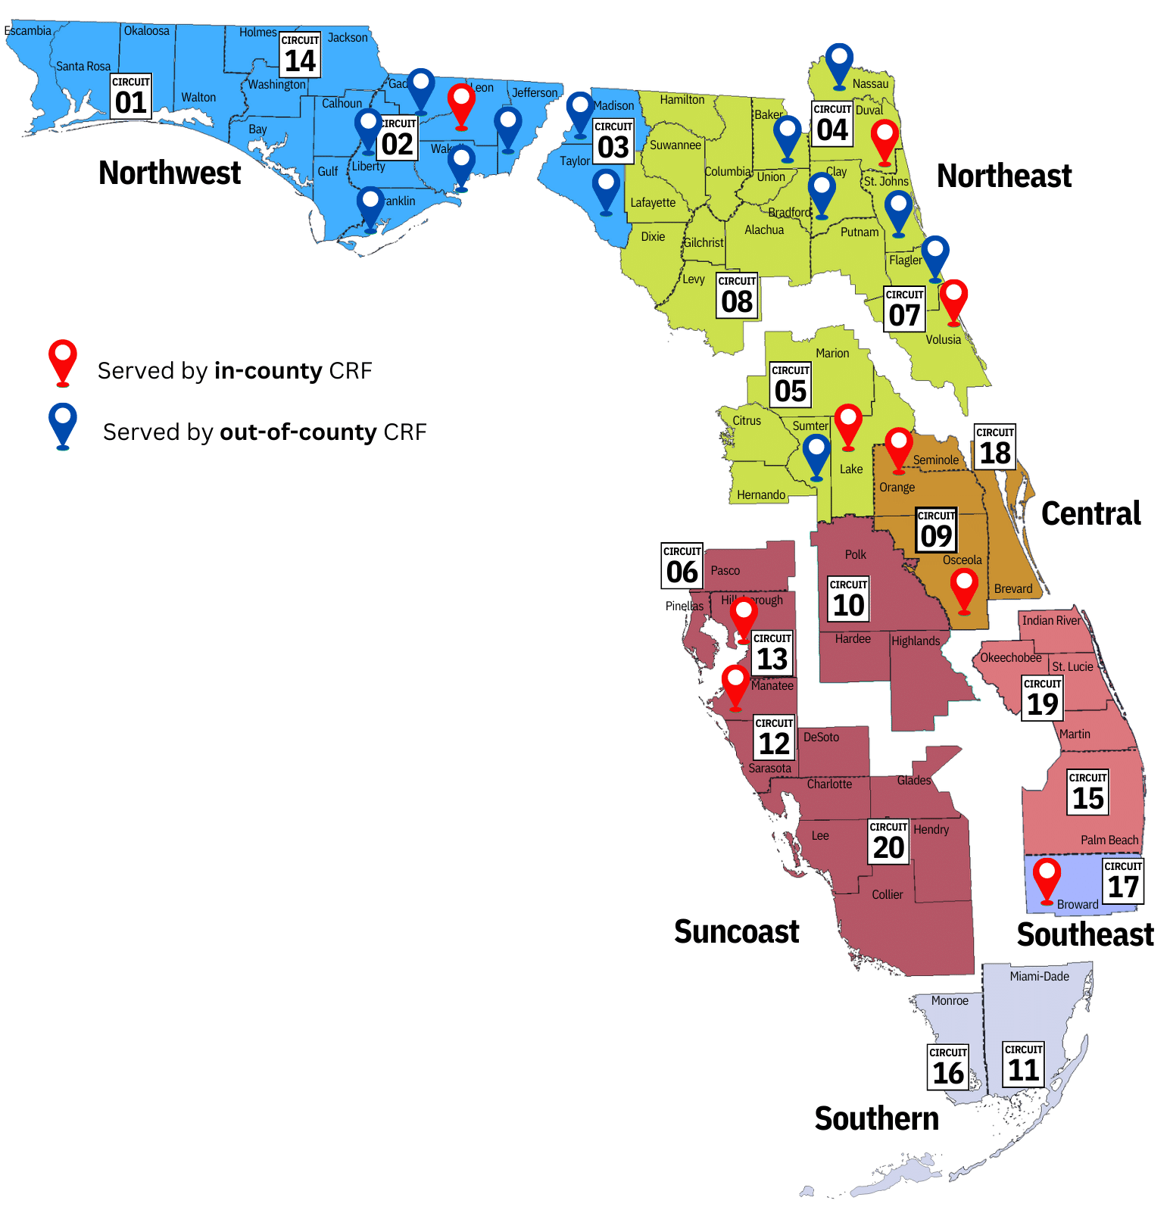
Central receiving facilities
FY 2021-22
Total Number of CRFs: 9
Number of Counties Served: 22

Slide 13
FISCAL YEAR 2021-22 Data overview
Individuals Served
Average Drop-off Time
Individuals diverted from admission
Diverted individuals that were linked to needed level of care
Percent of individuals readmitted within 30 days
Individuals diverted from ED drop off by law enforcement
4.77 minutes
43,641
29%
93%
9,519
8.58%

