Slide 1
Florida Department of Children and Families
Critical Thinking in Safety Decision-Making:
Evaluating Information Sufficiency
Reconciling and Validating Information
Applying the Safety Threshold Criteria
Notes:
Welcome and thank you for participating in this e-learning module on Critical Thinking in Safety Decision-Making. In this module we will look at evaluating information sufficiency, reconciling and validating information, and applying the safety threshold criteria.
These three important steps are the essence of critical thinking when applied to safety decision-making. [ADVANCE SLIDE]

Slide 2

Module Objective
D1:
Extent of Maltreatment
D6:
Discipline or Behavior Management
D2:
Surrounding Circumstances
KNOW THE FAMILY
D5:
General Parenting Practices
D3:
Child Functioning
Yes
Safe?
D4:
Adult Functioning
No
Notes:
Our objective is to build upon the two previous e-learning modules that introduced the Information Domains and key concepts in safety decision-making and to further enhance your safety decision-making skills.

Slide 3

Module Objective
When you have finished this module, you will be able to:
List the criteria for sufficient information
Explain what reconciliation and validation are in information gathering and analysis
Apply the safety threshold criteria
Notes:
When you have finished this module, you will be able to list the criteria for sufficient information, explain what reconciliation and validation are in information gathering and analysis, and be able to apply the safety threshold criteria. [ADVANCE SLIDE]

Slide 4

Review of Information Standards
Information standards
Notes:
Let’s begin with a very quick review which establishes the information standards that are the foundation of quality safety decision-making. [ADVANCE SLIDE]

Slide 5
Six Information Domains
D1:
Extent of Maltreatment
D6:
Discipline or Behavior Management
D2:
Surrounding Circumstances
KNOW
THE
FAMILY
D5:
General Parenting Practices
D3:
Child Functioning
D4:
Adult Functioning
Notes:
The six domains that we have previously explored form the foundation of our understanding and knowledge of the family. These six domains, when fully explored and documented, give us the information which allows us to identify present and/or impending danger. [ADVANCE SLIDE]

Slide 6
Safe or Unsafe?
D1:
Extent of Maltreatment
Safe?
D6:
Discipline or Behavior Management
D2:
Surrounding Circumstances
KNOW
THE
FAMILY
or
D5:
General Parenting Practices
D3:
Child Functioning
Unsafe?
D4:
Adult Functioning
Notes:
We gather this information about families because we must arrive at a decision about whether a child or children are safe or unsafe. [ADVANCE SLIDE]

Slide 7

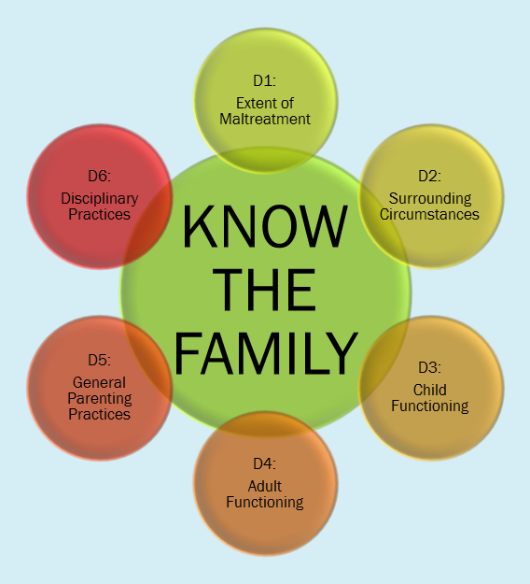
When is it Enough?
?
Notes:
So how do we know when we have sufficient information in each of these six areas? When is the information in each of the domains sufficient? [ADVANCE SLIDE]

Slide 8
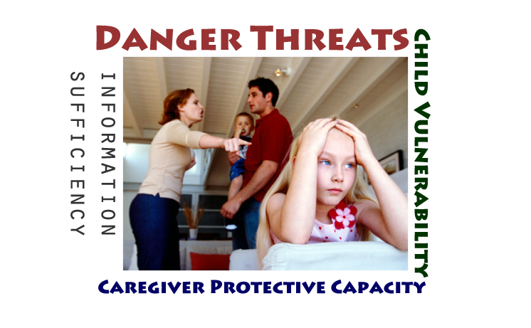
Why is Sufficiency Important?
Notes:
Perhaps the easiest way to think about information sufficiency is to remind ourselves that we are collecting this information in order to know whether we have danger threats, the degree to which we have child vulnerability and the extent of caregiver protective capacity.
In short, sufficient information paints a complete picture for us. Gathering sufficient information does not leave us wondering about certain areas of child or adult functioning which are critical to understanding vulnerability or protective capacity. Insufficient information does not leave us wondering what this family is like “most of the time”…. [ADVANCE SLIDE]

Slide 9
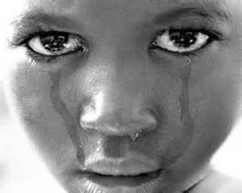
Judging Sufficiency of Information
Five essential criteria:
Describes the domain (by definition) in full and acceptable ways, so that a picture of what has or is happening can be understood
Notes:
We are going to review five essential criteria which every good decision maker should use when judging the sufficiency of information in the six information domains.
First we judge the information according to whether it describes the particular domain in full and acceptable ways, so that a picture of what has or is happening can be understood.
[ADVANCE SLIDE]

Slide 10
Judging Sufficiency of Information
Five essential criteria:
Is relevant to the domain only
D1:
Extent of Maltreatment
D4:
Adult Functioning
D2:
Surrounding Circumstances
D6:
Disciplinary Practices
D5:
General Parenting Practices
D3:
Child Functioning
Notes:
The second criteria to judge sufficiency is to evaluate whether the information is relevant ONLY to the particular domain. A key step in critical thinking is to separate information in order to be able to evaluate significance….so we must be able to isolate information about each of the six domains, so that we are not duplicating information or repeating ourselves. [ADVANCE SLIDE]

Slide 11


Judging Sufficiency of Information
Five essential criteria:
Is pertinent to gaining a full understanding of the domain
Notes:
Our third essential criteria is that the information is pertinent to gaining a full understanding of the domain. Let’s use child functioning to illustrate this. Child functioning should include a description of the child’s peer interactions. In describing pertinent information about the child’s peer interactions, we would expect to read about whether the child has friends and where and when they interact, and the quality of that interaction. Additional details, such as the name of every friend, may have been learned in interviewing a child, especially in rapport building, but they are not pertinent to our understanding of child functioning. [ADVANCE SLIDE]

Slide 12
Judging Sufficiency of Information
Five essential criteria:
Is adequate… enough information to have confidence about conclusions we reach
TH
C
D A N G E R
C H I
D
SAF
PAC
EAT
S
VULNERABL
E
P
O T E C T I V E
TY
U N S A F
Notes:
Achieving the fourth criteria for information sufficiency means that information collection on the six domains provides adequate information to fully inform our understanding of the safety constructs used in the determination of child safety. [CLICK] Without adequate information our understanding of danger threats, child vulnerability and caregiver protective capacity is extremely compromised. When our information collection is sufficient we have full confidence [CLICK] in the conclusion of safe or unsafe. [ADVANCE SLIDE]

Slide 13


Judging Sufficiency of Information
Five essential criteria:
Covers the principal or core issues associated with the domain
Notes:
The fifth and final criteria for judging information sufficiency provides a critical thinking focus for you as the decision maker. You must be sure that the information in the domain covers the principal or core issues associated with that domain. Every family is unique and different and will present its own challenges in terms of how easily you will be able to collect information. And remember, as we’ve previously discussed, your sources of information will be numerous. For example, information about adult functioning will come not only from your interview and observations of the adults, but from information provided by the children, other family members, collaterals, and professional providers. [ADVANCE SLIDE]

Slide 14
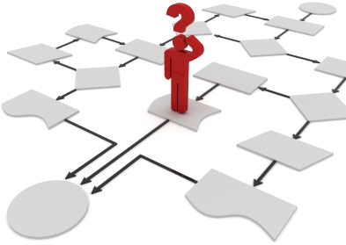
Reconciling and Validating
Notes:
Let’s move now to part two of this module, reconciling and validating information. As we have said, information collection involves the use of numerous sources and methods. We interview, observe, and read reports or other documents. It is not uncommon for the information to be different, depending on the source. For example, a parent might tell us that his or her child fell down the stairs and that is how the child was injured, but the doctor’s evaluation may indicate that the injury was caused by someone twisting the child’s arm. This is information from two sources about the child’s condition, and as the decision-maker, you have to reconcile that information. [ADVANCE SLIDE]

Slide 15
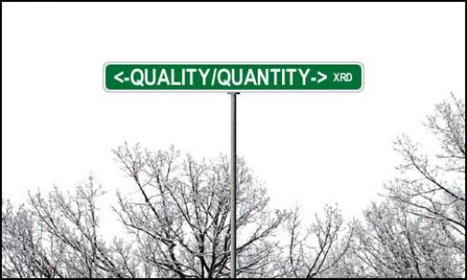
Qualitative Judgment About the Information
Notes:
Quality safety decision-making requires more than getting a LOT of information. Quality safety decision-making requires qualitative judgment about the information. That is what we mean by reconciling and validating. [ADVANCE SLIDE]

Slide 16
Process of Reconciling and Validating
Information collection with the child victim
Alleged perpetrator
Non-abusing parent
Other siblings
Notes:
In the discussion guide resource materials, you will be introduced to the information collection protocol. The protocol lays out a recommended order of interviews which allows for the most complete information gathering process. We begin our information collection with the child victim whenever possible, and we end our information collection with the alleged perpetrator. If we are presented with a perpetrator who denies involvement or does not acknowledge his or her role in the maltreatment, the information we have gathered prior to this gives us the ability to challenge the denial, and to engage the person in helping us to understand what really happened. This is part of the process for reconciling and validating. [ADVANCE SLIDE]

Slide 17
Reconciling and Validating
Reconciling & Validating
D1:
Extent of Maltreatment
Reconciling & Validating
D6:
Discipline or Behavior Management
D2:
Surrounding Circumstances
Reconciling & Validating
KNOW
THE
FAMILY
D5:
General Parenting Practices
D3:
Child Functioning
Reconciling & Validating
Reconciling & Validating
D4:
Adult Functioning
Reconciling & Validating
Notes:
We have given examples of reconciling and validating that relate to maltreatment, but it is important to keep in mind that reconciling and validating must be done for all information domains. We are attempting to form a complete picture for each domain, and that complete picture must be the decision-maker’s view of each domain.
[ADVANCE SLIDE]

Slide 18



Example: Adult Functioning
Notes:
Let’s take an example of one aspect of adult functioning: substance use. Suppose in our interview with the child that she describes a single father who comes home from work every night and sits in front of the television and drinks 6-10 beers. When we interview the father and ask about alcohol consumption, he says that “he has an occasional beer, usually only on a Friday or Saturday night”.
These are very different accounts, and in order to understand a key aspect of his adult functioning, and the father’s general parenting capacity, we need to reconcile this information. We may seek the input of our professional partners such as substance abuse specialists. This is reconciling and validating. [ADVANCE SLIDE]

Slide 19


Goal of Reconciling and Validating
Present or impending danger threats
Child vulnerability
Caregiver protective capacity
Safe
or Unsafe
+/-
+/-
=
Notes:
The goal is that through the process of collecting information, reconciling and validating the information, we have a “true” picture of each of the information domains. This true picture is what we will use to reach our safety decision. [ADVANCE SLIDE]

Slide 20
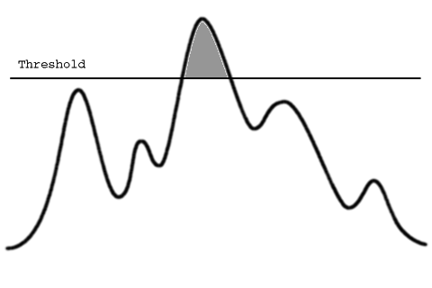
Safety Threshold Criteria
Notes:
In this module, we have explored sufficiency criteria and the concepts of reconciling and validating. The final area we will explore is applying the safety threshold criteria.
The concept of a threshold is critical to determining the point of entry for something, the point that we “cross” over or differentiate between what meets certain criteria and what does not. [ADVANCE SLIDE]

Slide 21
Threshold Criteria: Out of Control Behaviors,
Circumstances and Conditions
DANGER THREAT?
1. Immediacy
2. Severity
3. Out of Control
4. Vulnerable Child
5. Observable
Notes:
We use the word “threshold” in safety decision-making because it helps us to distinguish the point at which a person’s behavior, or a circumstance or condition, crosses over into a danger threat. There are five criteria which help us determine if the danger threshold has been crossed: [CLICK] immediacy, severity, the degree that the behavior, circumstance or condition is out-of-control, vulnerability, and is the danger threat observable? Let’s take a few minutes to explain what we mean by each one. [ADVANCE SLIDE]

Slide 22





Threshold Criteria #1: Immediacy?
Immediacy
WITHOUT DELAY
OCCURRING IN NEAR FUTURE
Notes:
The first safety threshold criteria looks at the expected or known timeframe for the maltreatment occurrence. Immediate means that the danger threat is likely to become active without delay [click] and will occur in the near future. [ADVANCE SLIDE]

Slide 23
Threshold Criteria #2: Severity?
Immediacy
Severity
SERIOUS INJURY
DEBILITATING PHYSICAL HEALTH
SIGNIFICANT IMPAIRMENT/ACUTE SUFFERING
TERRORIZING/LIFE THREATENING
Notes:
The second threshold criteria is the severity of the anticipated harm to the child or children. Severity means that maltreatment has caused or is very likely to cause [CLICK] serious injury to the child victim. Examples of severe circumstances are [CLICK] serious injury, grave or debilitating physical health conditions, significant impairment, acute suffering, terrorizing, or potentially life threatening. [ADVANCE SLIDE]

Slide 24
Threshold Criteria #3: Out of control?
Immediacy
Severity
Out of Control
NOT SUBJECT TO INTERNAL INFLUENCE
UNRESTRAINED/UNMANAGED
WITHOUT LIMITS
Notes:
The third threshold criteria assesses whether there are behaviors, actions or circumstances of an individual in the household that are out of the control of the family. These conditions are [CLICK] not easily subject to internal influence, are unrestrained, unmanaged, and without limits. Not subject to internal influence means that there is a history or pattern of embedded dynamics that are contributing to the individual’s or family’s inability to control the danger threat. [ADVANCE SLIDE]

Slide 25
Threshold Criteria #4: Vulnerable Child?
DEPENDENT ON OTHERS FOR PROTECTION
INDIVIDUAL CHILD FACTORS
(AGE, PHYSICAL ABILITY, COGNITIVE ABILITY, DEVELOPMENTAL STATUS AND MORE . . .)
ALL CHILDREN IN HOME
Immediacy
Severity
Out of Control
Vulnerability
Notes:
The fourth threshold criteria establishes vulnerability. Vulnerability refers to a child who is dependent on others for protection. [CLICK] As explored in our previous e-learning module, vulnerability looks at numerous individual child factors including age, physical ability, cognitive ability, developmental status and more to determine if the child is vulnerable to an identified danger threat.
It is important to note that many, if not most children in our child protective investigations are physically healthy and within developmentally normal limits with no additional child vulnerabilities but are still considered a vulnerable child in the presence of an active danger threat. Vulnerability is a threshold criteria because if a child is not vulnerable to a danger threat, then we have a safe child. [ADVANCE SLIDE]

Slide 26
Threshold Criteria #5: Observable?
CAN BE SEEN AND DESCRIBED
HAS BEEN OBSERVED BY FAMILY AND OTHERS
PERSONAL OBSERVATIONS
FEELINGS OR PERCEPTIONS EVIDENCED
BY SPECIFIC BEHAVIORS, SITUATIONS
OR VERBAL STATEMENTS
Immediacy
Severity
Out of Control
Vulnerability
Observable
Notes:
The fifth and last threshold criteria establishes that the behavior, condition, or family circumstances creating the threat can be [CLICK] seen and described. Observable takes it out of the realm of a “gut” feeling we have about the family and allows you to describe the specific conditions that have been observed by family members and others, or your own personal observations. Even the family’s feelings or perceptions are evidenced by specific behaviors, situations or verbal statements that fall into the observable category or range. [ADVANCE SLIDE]

Slide 27
Summary
Critical thinking
Five criteria for evaluating information sufficiency
Importance and process of reconciling and validating information
Safety threshold criteria
Notes:
In this module, we have explored three stages of critical thinking which are integral to quality, consistent safety decision-making. We established five criteria for evaluating the sufficiency of information. We explored the importance and process for reconciling and validating information in all domains. And, finally, we explored the five criteria which we use to determine when behaviors, circumstances, or conditions cross the danger threshold. [ADVANCE SLIDE]

Slide 28

Discussion Guide and Quiz
Notes:
The discussion guide which you will be using following this module will provide additional resource information to further enhance your understanding of critical thinking in safety decision making. Activities in the guide will include determining information sufficiency and the need for additional reconciliation and validation of information, and using the five safety threshold criteria to determine if out of control conditions are present in the families you are asked to assess.
For now, please proceed to answer the questions which follow and thank you for your participation. [ADVANCE SLIDE]

Slide 29
Q1: Sufficient information is:
Information that gives us a full picture
Is relevant to the particular information domain
Is pertinent to the information domain
Is adequate and gives us confidence about conclusions
All of the above
Notes:
Q1: Sufficient information is:
information that is gives us a full picture
is relevant to the particular information domain
is pertinent to the information domain
is adequate and gives us confidence about conclusions
all of the above

Slide 30
Q1: Sufficient information is:
Information that gives us a full picture
Is relevant to the particular information domain
Is pertinent to the information domain
Is adequate and gives us confidence about conclusions
ALL OF THE ABOVE
The correct answer is (e) all of the above. Information sufficiency is dependent upon these four standards and a fifth one – being able to describe principal or core issues associated with each domain - being met which ensures you that you have all the necessary information you need to make the appropriate safety decision.
Notes:
The correct answer is (e) all of the above. Information sufficiency is dependent upon these four standards and a fifth one – being able to describe principal or core issues associated with each domain - being met which ensures you that you have all the necessary information you need to make the appropriate safety decision.

Slide 31
Q2: Which is the typical sequence followed in the information collection protocol:
Other children in the home, victim, non-abusing parent, alleged perpetrator
Alleged perpetrator, victim, other children in the home, non-abusing parent
Victim, other children in the home, non-abusing parent, alleged perpetrator
Victim, non-abusing parent, other children in the home, alleged perpetrator
Notes:
Q2: Which is the typical sequence followed in the information collection protocol? :
other children in home, victim, non-abusing parent, alleged perpetrator
alleged perpetrator, victim, other children in the home, non-abusing parent
victim, other children in home, non-abusing parent, alleged perpetrator
victim, non-abusing parent, other children in the home, alleged perpetrator

Slide 32
Q2: Which is the typical sequence followed in the information collection protocol:
Other children in the home, victim, non-abusing parent, alleged perpetrator
Alleged perpetrator, victim, other children in the home, non-abusing parent
VICTIM, OTHER CHILDREN IN THE HOME, NON-ABUSING PARENT, ALLEGED PERPETRATOR
Victim, non-abusing parent, other children in the home, alleged perpetrator
The correct answer is (c). Because of a combination of factors - safety concerns, children generally being more open and honest, or at least easier to recognize when they are being deceptive, we almost always interview all children in the home prior to the adults. And, the last adult we want to interview is the alleged perpetrator so we can be as prepared as we can with the most information available to us at the time of that interview.
Notes:
The correct answer is (c). Because of a combination of factors - safety concerns, children generally being more open and honest, or at least easier to recognize when they are being deceptive, we almost always interview all children in the home prior to the adults. And, the last adult we want to interview is the alleged perpetrator so we can be as prepared as we can with the most information available to us at the time of that interview.

Slide 33
Q3: Reconciling information means:
Quoting exactly what the parents said
Knowing only what maltreatment occurred
Determining the evidence that is necessary for prosecution
Settling or resolving differences in information in order to have a true understanding of each information domain
None of the above
Notes:
Q3: Reconciling information means:
quoting exactly what the parents said
knowing only what maltreatment occurred
determining the evidence that is necessary for prosecution
settling or resolving differences in information in order to have a true understanding of each information domain
none of the above

Slide 34
Q3: Reconciling information means:
Quoting exactly what the parents said
Knowing only what maltreatment occurred
Determining the evidence that is necessary for prosecution
SETTLING OR RESOLVING DIFFERENCES IN INFORMATION IN ORDER TO HAVE A TRUE UNDERSTANDING OF EACH INFORMATION DOMAIN
None of the above
The correct answer is (d): settling or resolving differences in information in order to have a true understanding of each information domain. Remember, the foundation for all quality decision making is the accuracy of the information upon which the decision is based so it is essential for you to resolve all critical discrepancies in what has occurred regarding the maltreatment and in what you know about the family in terms of their day to day functioning which reveals impending danger.
Notes:
The correct answer is (d): settling or resolving differences in information in order to have a true understanding of each information domain. Remember, the foundation for all quality decision making is the accuracy of the information upon which the decision is based so it is essential for you to resolve all critical discrepancies in what has occurred regarding the maltreatment and in what you know about the family in terms of their day to day functioning which reveals impending danger.

Slide 35
Q4: Which of the following is not one of the safety threshold criteria:
Immediate
Potentially Severe
Out Of Control
Protective Capacity
Observable
Notes:
Q4: Which of the following is not one of the safety threshold criteria:
immediate
potentially severe
out of control
protective capacity
observable

Slide 36
Q4: Which of the following is not one of the safety threshold criteria:
Immediate
Potentially Severe
Out Of Control
PROTECTIVE CAPACITY
Observable
The correct answer is (d) protective capacity. The other four choices, along with vulnerable child, are the five safety threshold criteria. Protective capacity, on the other hand, has to do with an adult caregiver’s ability to protect a child from an identified danger threat in the household in which the caregiver and child reside. It is a key component in the determination of safe or unsafe but is not one of the safety threshold criteria in identifying whether a present or impending danger threat exists or not.
Notes:
The correct answer is (d) protective capacity. The other four choices, along with vulnerable child, are the five safety threshold criteria. Protective capacity, on the other hand, has to do with an adult caregiver’s ability to protect a child from an identified danger threat in the household in which the caregiver and child reside. It is a key component in the determination of safe or unsafe but is not one of the safety threshold criteria in identifying whether a present or impending danger threat exists or not.

Slide 37
Q5: The threshold criteria “observable” means you have personally witnessed the action or behavior:
True
False
Notes:
Q5: The threshold criteria “observable” means you have personally witnessed the action or behavior:
True
False

Slide 38
Q5: The threshold criteria “observable” means you have personally witnessed the action or behavior:
True
FALSE
The correct answer is (b) false. In terms of the safety threshold criteria “observable” simply means someone in the family or any second party observer, neighbor, teacher, or any collateral contact has personally seen the action, behavior or circumstance being described. Skilled investigators and case managers try to validate this information from another source whenever possible.
Notes:
The correct answer is (b) false. In terms of the safety threshold criteria “observable” simply means someone in the family or any second party observer, neighbor, teacher, or any collateral contact has personally seen the action, behavior or circumstance being described. Skilled investigators and case managers try to validate this information from another source whenever possible.

Slide 39


Congratulations!
Module Three: Critical Thinking in Safety Decision Making
Notes:
Congratulations on completing Module Three: Critical Thinking in Safety Decision Making
Within the week you should also complete the discussion guide that accompanies this module. If you are not watching the module as part of a group exercise facilitated by your supervisor or assigned safety practice expert please contact them for a copy of the discussion guide. The discussion guide is intended to provide additional resources and instruction so you can begin to apply the concepts introduced in this module.
One last thing, don’t forget to get credit for participating in this e-learning module by going to your individual training screen in FSFN and selecting the training course titled Module Three: “Critical Thinking in Safety Decision Making.”
Thank you for your participation!

Slide 40
Critical Thinking Course Registration
To receive credit for this course, you will need to:
Log into FSFN.
Click Create > Worker Training > Individual Training Plan.
Click Search within the Assigned Training in Progress group box.
Enter E-Learning 3: Critical Thinking (or simply enter “E“ followed
by *) and then click search.
Click Select next to the course when it appears.
Click Continue at the bottom of the page.
When the selected course title is displayed on your Individual Worker screen, indicate that the status is “Completed” and record the completion date.
Click Save.
  This should then be displayed in your “Individual Training History”.

