Slide 1
Florida Safety Decision Making Methodology
Present and Impending Danger, Child Vulnerability and Protective Capacity
Notes:
Welcome and thank you for participating in this E-learning module which will feature the key concepts in safety decision-making: Present and Impending Danger, Child Vulnerability and Protective Capacity.

Slide 2
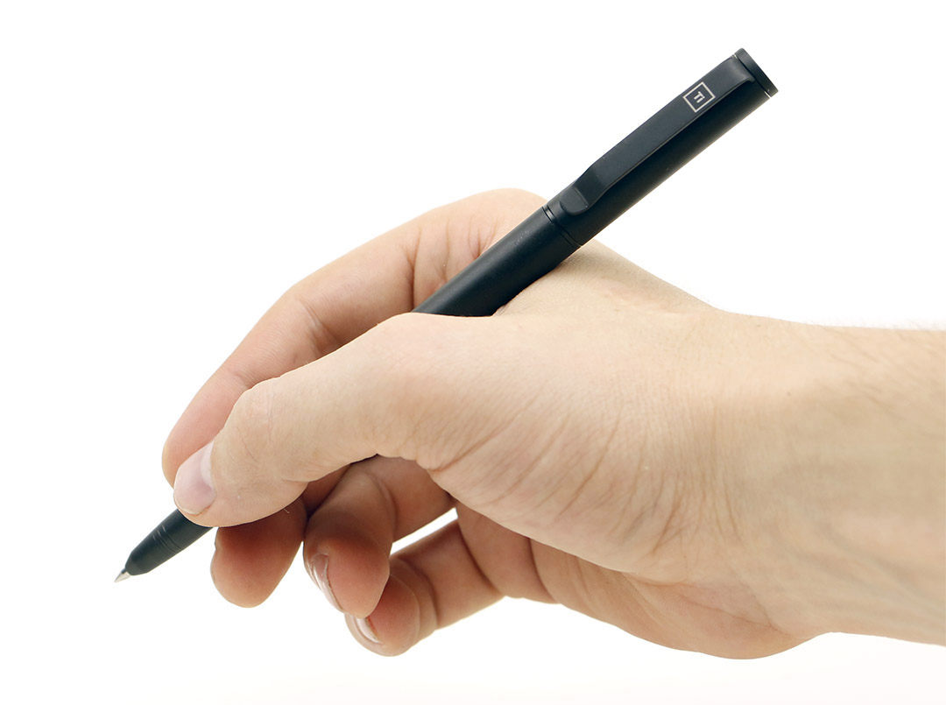
Module Objective
D1:
Extent of Maltreatment
D6:
Discipline or Behavior Management
D2:
Surrounding Circumstances
KNOW THE FAMILY
D5:
General Parenting Practices
D3:
Child Functioning
Yes
Safe?
D4:
Adult Functioning
No
Notes:
Our objective is to build upon the previous e-learning module which introduced the six Information Domains of the information collection protocol, and demonstrate the link between these domains and safety decision-making.

Slide 3


Safety Decision-Making Formula
Present or impending danger threats
Child vulnerability
Caregiver protective capacity
Safe
or Unsafe
+/-
+/-
=
Notes:
When you have finished this module you will recognize the major components of the safety decision-making formula and understand how they relate to each other in the determination of child safety. The major components of the safety decision making formula are [CLICK] present or impending danger threats, plus or minus child vulnerability plus or minus caregiver protective capacity equals safe or unsafe.

Slide 4

Foundation of Quality Decision Making?
Information Standards
Notes:
Let’s begin with a very quick review which establishes the information standards that are the foundation of quality safety decision making.

Slide 5
Information Domains
D1:
Extent of Maltreatment
D6:
Discipline or Behavior Management
D2:
Surrounding Circumstances
KNOW
THE
FAMILY
D5:
General Parenting Practices
D3:
Child Functioning
D4:
Adult Functioning
Notes:
Module 1 featured the information domains which are critical to informing our knowledge and understanding of the family. These six domains, when fully explored and documented, provide the information we need to know about the family to accurately identify and assess for present and impending danger.

Slide 6
Safety Decision-Making Formula
Present or impending danger threats
Child vulnerability
Caregiver
protective capacity
Safe
or Unsafe
+/-
+/-
=
Notes:
Ultimately, we gather this information about families because we must arrive at a decision about whether a child or children are [CLICK] safe or unsafe. Before we go any further let’s make sure we have the same understanding on how the Safety Decision-Making Methodology defines these two critical constructs.

Slide 7

Definition of Safe
Children are considered safe when there are no present or impending danger threats, or the caregivers’ protective capacities control existing threats.
Notes:
Let’s start with the definition of safe. Children are considered safe when there are no present or impending danger threats, or the caregivers’ protective capacities control existing threats. Let’s compare this with our definition for unsafe and then use our formula to illustrate how the presence or absence of the inter-related constructs determine the safety decision.

Slide 8
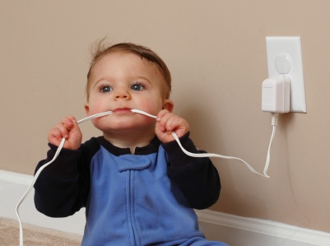
Definition of Unsafe
Children are Unsafe when vulnerable to present or impending danger threats, and caregivers have insufficient protective capacity to control existing threats.
Notes:
In contrast, children are considered unsafe when they are vulnerable to the present or impending danger threats, and caregivers have insufficient protective capacity to control these existing threats.

Slide 9
Three key concepts
Notes:
Let’s take a closer look at the three key concepts in these definitions of Safe and Unsafe so you have a better understanding of what kind of conditions, behaviors, emotions and actions are clearly observable in the home which should provide sufficient information to accurately inform the safety decision making process.

Slide 10
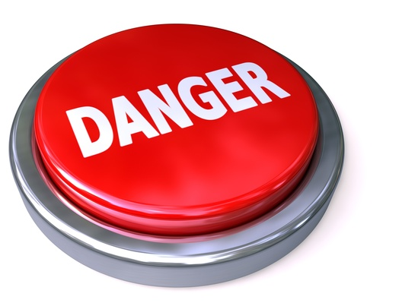
Present Danger
Immediate
Significant
Clearly Observable
Severe harm
Present tense—right now
Requires immediate response
Notes:
We will explore Present Danger first because it is the most obvious and always the first condition to address in any contact with a family.
Present danger is the immediate, significant and clearly observable severe harm or threat of severe harm that is occurring to a child at the present time, in other words, right now… and which requires an immediate safety action on the part of the worker.

Slide 11
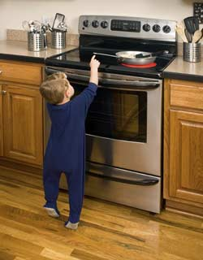
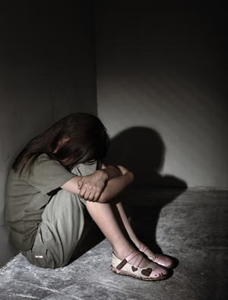
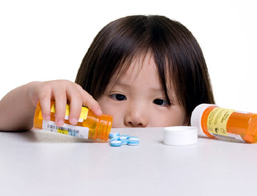
Examples of present danger
Notes:
Some common examples of present danger include situations in which young children are left alone without adequate supervision or situations in which caregiver functioning is impaired to a severe degree and children are present and exposed to the danger which is likely to result in severe harm to the child.

Slide 12
Examples of present danger
Premeditated maltreatment
Injuries to the face and head
Life threatening living arrangements
Bizarre cruelty toward a child
Child needing immediate medical care
Caregiver unable to provide basic care
Caregiver out of control or under the influence of substances posing an immediate danger threat to the child
Notes:
Examples of present danger include, but are not limited to: premeditated maltreatment, injuries to the face and head, life threatening living arrangements, bizarre cruelty toward a child, a child needing immediate medical care, a caregiver unable to provide basic care, and a caregiver out of control or under the influence of substances posing an immediate danger threat to the child.

Slide 13


Present danger assessment
IMMEDIATE RESPONSE!
First Contact for all Investigations…
focus is on Present Danger
24 hour
or
Immediate response?
Notes:
Our assessment of present danger begins when the Hotline receives a call and they evaluate the degree to which the situation being reported is currently a threat of severe harm to a child. [CLICK] These are situations in which the response time would be immediate. [CLICK] Regardless of the initial response priority assigned by the Hotline [CLICK] the investigator always begins by identifying and assessing for present danger. They are beginning the process of gathering information in the six domains, with their focus on identifying and acting upon any present danger.

Slide 14
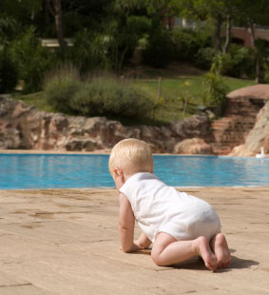
Present danger can happen at any time
CPI has responsibility…
Case Manager has responsibility…
Responsibility is to take action—protective action
Notes:
It’s important to keep in mind that present danger can arise at any point in the life of a case. Because family and individual circumstances are dynamic and not static in nature, assessment of present danger should be an on-going process, not limited to our first contact with the family and certainly not limited to just the front-end of our child protection system. At any point in time if the circumstances in the family present immediate, out of control and potentially severe threats to a child, happening in the present time, that is present danger and immediate action is required.

Slide 15

Present Danger
Notes:
So present danger captures those threats that are happening now. It is that “in your face” danger that is easy to recognize. And fortunately, we do not see present danger in most of the cases we receive.

Slide 16
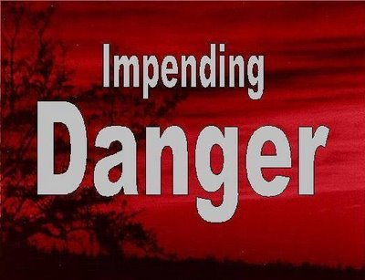
Impending Danger
Impending Danger... not happening at this moment… …but a “state of danger”
Child is in a position of continual or pervasive danger
Notes:
Our second important concept after Present Danger, is Impending Danger.
Just as the word implies, this is danger that is not happening at this moment, but what we would more accurately describe as a “state of danger”. So this is descriptive of those circumstances in which the child is in a position of continual or pervasive danger.

Slide 17
Impending Danger
Impending danger… not as obvious
Impending danger… more prevalent
Impending Danger Impending Danger Impending Danger PRESENT
Impending Danger Impending Danger Impending Danger DANGER
Notes:
In contrast to present danger, impending danger is often not as obvious….but ironically, impending danger is more prevalent.

Slide 18
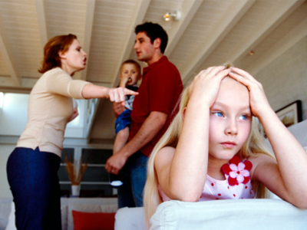
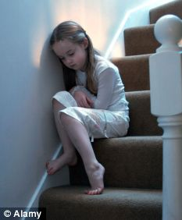
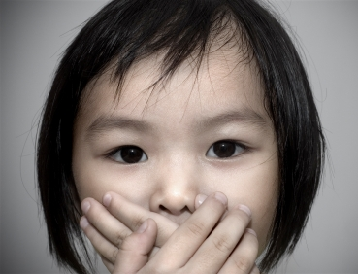
Examples of Impending Danger
Notes:
Examples of impending danger include violent caregivers or other violent members in the household with vulnerable children or caregivers who do not demonstrate impulse control in the presence of vulnerable children.

Slide 19
Impending Danger
Specific
  can be described
Observable
  can be seen by you and others
Notes:
These impending danger threats are family conditions that are specific and observable. In other words, they can be seen by you and others, and they can be described.

Slide 20

Impending Danger
Imminent—could or likely will occur in the near term
Require a controlling intervention
Notes:
Impending danger threats are also imminent, which means they could or likely will occur in the near term. We are not making a specific estimate of when they will occur, but we are making a professional judgment that they will occur in the near future, and therefore, they require a controlling intervention.

Slide 21
Information reveals impending danger
D1:
Extent of Maltreatment
D6:
Discipline or Behavior Management
D2:
Surrounding Circumstances
KNOW THE FAMILY
reveals
D5:
General Parenting Practices
D3:
Child Functioning
D4:
Adult Functioning
Notes:
Bhecause Impending Danger threats are not as obvious, it makes the information gathering process even more critical, because it is the information in the six domains that will reveal for us what and how impending danger is operating in a particular family.
In the Discussion Guide which accompanies this E-learning module, you will be introduced to the specific list of present and impending danger threats which are contained in the Safety Decision Making Methodology. You will have an opportunity to review these threats, definitions and examples in more detail which will help you to understand and apply them.

Slide 22
Summary
Child Vulnerability
Present or impending danger threats
Child vulnerability
Caregiver
protective capacity
Safe
or Unsafe
+/-
+/-
=
Notes:
So far we have explored the first part of our equation….present and impending danger. [CLICK] Now we will move to the second part, child vulnerability.

Slide 23
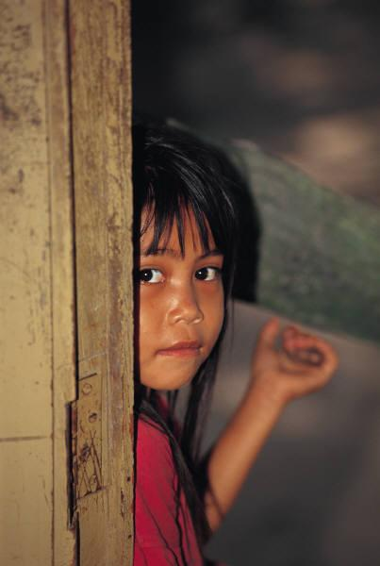
Child Vulnerability
Children are vulnerable because they depend on others for protection and care
Notes:
Remember in our definitions of safe and unsafe, in order for a child to be unsafe, there must be threats of danger and they must be vulnerable to those threats. Children are vulnerable because they depend on others for protection and care.

Slide 24
Child Vulnerability
How does the child protect himself?
How does the child care for himself?
Notes:
Determining if a child is vulnerable to a specific danger threat involves both knowing about the child’s ability to protect himself from threats and knowing how the child is able to care for himself.

Slide 25
Child Vulnerability
Information Domains give us the information we need to determine child vulnerability…
  Age
  Physical ability
  Cognitive ability
  Developmental status
  Emotional security
  Family loyalty
D1:
Extent of Maltreatment
D6:
Discipline or Behavior Management
D2:
Surrounding Circumstances
KNOW THE FAMILY
D5:
General Parenting Practices
D3:
Child Functioning
D4:
Adult Functioning
Notes:
Once again, the information from the six information domains gives us the information we need to determine child vulnerability. Criteria to consider include, but are not limited to: age, physical ability, cognitive ability, developmental status, emotional security and family loyalty.

Slide 26
Child Vulnerability
Additional considerations of child vulnerability:
  prior impact of maltreatment
  child’s isolation from the community
  child’s ability to anticipate or judge danger
  child’s ability to articulate problems or danger
  situations in which a child’s own behavior provokes a dangerous reaction from a caregiver
Notes:
The factors we just considered are the more obvious factors which help us to understand vulnerability. Some additional factors which may not be as obvious, but are equally important include: prior impact of maltreatment, a child’s isolation from the community, a child’s ability to anticipate or judge danger, a child’s ability to articulate problems or danger and even situations in which a child’s own behavior provokes a dangerous reaction from a caregiver.

Slide 27
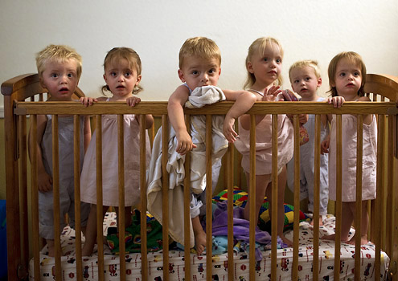
Vulnerability of every child
Our concerns about safety should involve all children in the household
Notes:
In our assessment of safety, we must consider vulnerability for every child in the household, regardless of whether they were the reported victim in the original report. And our conclusion about child vulnerability to danger threats may be different for individual children, which will result in different actions in terms of safety planning.

Slide 28
Summary
Caregiver Protective Capacities
Present or impending danger threats
Child vulnerability
Caregiver protective capacity
Safe
or Unsafe
+/-
+/-
=
Notes:
So the second part of the equation is now complete…..we have an understanding of how each child is vulnerable, or not, to any identified danger threat. That includes both present and impending danger threats.
Now we move on to the final safety concept and the final part of our safety equation. Caregiver protective capacity. [CLICK]

Slide 29
Definition of Protective Capacity
Protective Capacity… how a parent thinks, feels, acts…
Protective Capacity… how a parent thinks, feels, acts… that makes him or her protective!
Notes:
Protective capacity is a specific quality that can be observed and understood to be part of the way a parent thinks, feels and acts [pause CLICK] that makes him or her protective.

Slide 30
Protective Capacities
Emotional
Behavioral
Cognitive
Vigilant Protectiveness
Notes:
Protective capacities are cognitive, behavioral and emotional qualities supporting vigilant protectiveness.

Slide 31

Protective Capacities
Notes:
Let’s take each one of these individually and examine them more closely.

Slide 32
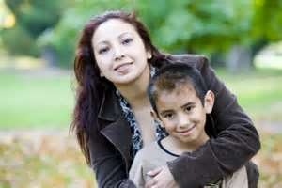
Cognitive Protective Capacity
Examples:
understanding of protective role
understanding and recognizing threats
recognition of a child’s needs
reality oriented
accurate perception of a child
ability to accurately process and interpret various stimuli
intellectually able
Specific knowledge, understanding and perceptions that contribute to protective vigilance
Notes:
Cognitive protective capacity refers to specific knowledge, understanding and perceptions that contribute to protective vigilance. [CLICK] Some examples of cognitive protective capacity include: understanding of protective role; understanding and recognizing threats; recognition of a child’s needs; reality oriented; accurate perception of a child; ability to accurately process and interpret various stimuli; and intellectually able.

Slide 33
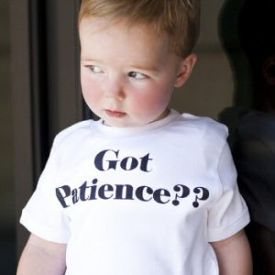
Behavioral Protective Capacity
Examples:
physical capacity and energy
impulse control
ability to set aside own needs
adaptive, assertive and responsive
takes action
history of being protective
Specific action, activity, performance that results in protective vigilance
Notes:
Behavioral protective capacity refers to specific action, activity and performance that is consistent with and results in parenting and protective vigilance. [CLICK] Some examples of behavioral protective capacity include: physical capacity and energy; impulse control; ability to set aside own needs; adaptive, assertive and responsive; takes action; and history of being protective

Slide 34
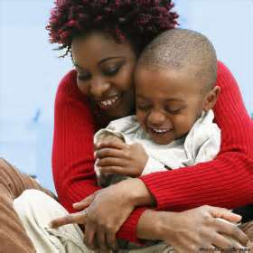
Emotional Protective Capacity
Examples:
emotional bond with the child
positive attachment with the child
love, sensitivity and empathy for the child
resiliency
stability
effectively meets own emotional needs
emotional control
Specific feelings, attitudes and identification with the child and motivation that results in protective vigilance
Notes:
Emotional protective capacity refers to specific feelings, attitudes and identification with the child and motivation that results in protective vigilance. [CLICK] Some examples of emotional protective capacity include emotional bond with the child, positive attachment with the child, love sensitivity and empathy for the child; resiliency; stability; effectively meets own emotional needs and emotional control.

Slide 35
Assessment of Protective Capacity
Are caregivers protective?
Who do we assess?
Adult Caregivers in the Household
Parents in the Household
Notes:
The assessment of these three types of protective capacity are critical to our safety decision-making process, because they tell us about the capacity of the caregivers and/or other adults living in the household, in terms of their ability to protect. It is important to keep in mind that your assessment of protective capacity should include all the adults in the home who have a caregiving role.
If we are making a determination that the maltreating caregiver is creating a Danger Threat, then that person can not be the person the agency looks to, to manage or control the threat in a safety plan. To be a threat, you have determined that their protective capacities are significantly diminished.
In summarizing this module, let’s bring up our safety decision making chalkboard one more time to review the process from start to finish.

Slide 36
Safety Decision-Making
?
?
?
Present or impending danger threats
Child vulnerability
Caregiver protective capacity
Safe
or Unsafe
+/-
+/-
=
Notes:
Once we have gathered sufficient information to form a picture of danger threats,[CLICK] child vulnerability [CLICK] and protective capacity,[CLICK] it is time to review all the information in totality [CLICK] to make the appropriate safety decision. [CLICK] This specific decision demands a logical, sequential process built on credible and relevant information.

Slide 37
Session Review
Gather sufficient information
Step 1
Weigh the information against our criteria for present & impending danger to determine if one or more exists
Step 2
Determine child vulnerability to these identified threats, again using the sufficient information gathered
Step 3
Determine if protective capacity exists to manage the specific identified threats
Step 4
Reach a decision about whether the child is safe or unsafe
Step 5
Notes:
Let’s review the steps as we conclude this session.
Step 1: Gather sufficient, relevant information
Step 2: Weigh the information against our criteria for present and impending danger to determine if one or more exist
Step 3: Determine child vulnerability to these identified threats, again using the sufficient information gathered.
Step 4. Determine if protective capacity exists to manage the specific identified threats.
Step 5: Reach a decision about whether the child is safe or unsafe.

Slide 38
Upcoming e-Learning Module
Unsafe!
Now what do we do?
Safety planning
Notes:
In Module four we will go into detail about what to do if a child is determined to be unsafe….how you develop a safety plan, and how you determine whether an in-home or an out-of-home plan will be sufficient.

Slide 39
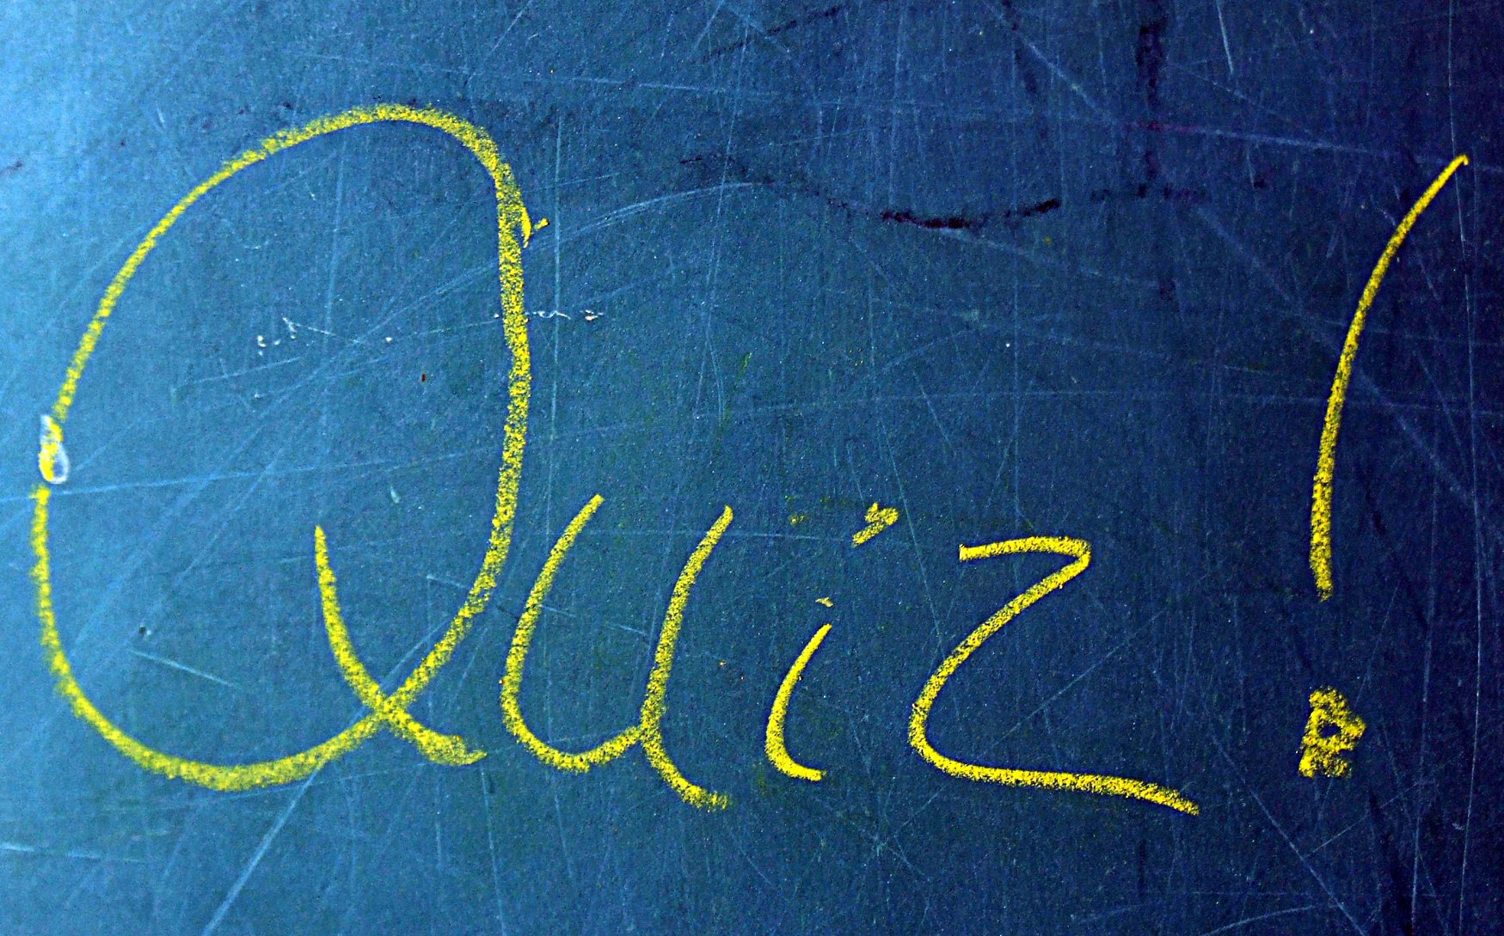
Quiz Directions
Notes:
Please proceed to answer the questions which follow and thank you for your participation.

Slide 40
Q1: Which of the following best defines impending danger?
  A child being in a state of danger due to parent/caregiver behaviors, attitudes, motives, emotions and/or situations posing a specific threat of severe harm to a child.
  An immediate, significant, and clearly observable family condition that is actively occurring or in process of occurring at the point of contact with a family and will likely result in serious harm to a child, therefore requiring a prompt CPS “system” response.
  The point at which a negative family condition gets worse.
  It is the same as present danger.

Slide 41
Q1: Which of the following best defines impending danger?
  A CHILD BEING IN A STATE OF PERVASIVE DANGER DUE TO A PARENT’S BEHAVIORS, ATTITUDES, MOTIVES, EMOTIONS OR OUT OF CONTROL FAMILY CONDITIONS.
  An immediate, significant, and clearly observable family condition that is actively occurring or in process of occurring at the point of contact with a family and will likely result in serious harm to a child, therefore requiring a prompt CPS “system” response.
  The point at which a negative family condition is identified.
  It is the same as present danger.
Answer (a) best describes impending danger. Answer (b) is incorrect because it is the definition for present danger. Impending danger is not clearly observable and actively occurring upon first contact with the family, that is why sufficient information collection helps us recognize the more subtle, disguised out of control family conditions that produce impending danger threats. Answer (c) is incorrect because negative family conditions and circumstances related to impending danger are representative of clearly identifiable danger threats, not simply the risk of maltreatment. Answer (d) is incorrect because present and impending danger are separate and distinct types of danger threats.

Slide 42
Q2: Caregiver protective capacities are:
  Family resources
  General parenting practices including discipline and knowledge of child development
  Parenting strengths
  How a parent determines if their children are developing appropriately
  Personal and parenting behaviors, cognitive, and emotional characteristics that specifically and directly associate with protecting one’s child(ren)

Slide 43
Q2: Caregiver protective capacities are:
  Family resources
  General parenting practices including discipline and knowledge of child development
  Parenting strengths
  How a parent determines if their children are developing appropriately
  PERSONAL AND PARENTING BEHAVIORS, COGNITIVE, AND EMOTIONAL CHARACTERISTICS THAT SPECIFICALLY AND DIRECTLY ASSOCIATE WITH PROTECTING ONE’S CHILD(REN)
The correct answer is (e). Answers (a), (c) and (d) while potentially useful information to have, are not specific enough, that is, are not directly associated with the caregiver’s ability to protect their child in the form of cognitive, behavioral or emotional assets to qualify as protective capacities. Answer (b) is incorrect because it is a combination of the general parenting practice and disciplinary practice and behavior management information domains.

Slide 44
Q3: The concept of “impending danger” recognizes that a child may be in a state of danger even though the threat is not immediate.
  True
  False

Slide 45
Q3: The concept of “impending danger” recognizes that a child may be in a state of danger even though the threat is not immediate.
  TRUE
  False
Answer (a) is correct. While the threat is not immediate and actively occurring in your very presence the impending danger threat is generated from a pervasive state of out of control family conditions and is highly likely to occur in the imminent or very near future.

Slide 46
Q4: When a danger threat has been identified in the home, only the alleged child victim’s vulnerability to the threat is assessed.
  True
  False

Slide 47
Q4: When a danger threat has been identified in the home, only the alleged child victim’s vulnerability to the threat is assessed.
  True
  FALSE
Once a danger threat has been identified in the home, the vulnerability of all children is assessed, not just the alleged child victim making answer (b) the correct response.

Slide 48
Q5: In terms of the identification and prevalence of danger threats . . . Present Danger is more prevalent but Impending Danger is typically more obvious.
  True
  False

Slide 49
Q5: In terms of the identification and prevalence of danger threats . . . Present Danger is more prevalent but Impending Danger is typically more obvious.
  True
  FALSE
The correct answer is (b) false. It is just the opposite, by definition present danger is the more obvious “in your face” danger threat while the more subtle, but pervasive impending danger is much more prevalent in the family’s that typically you will come into contact in your line of work.

Slide 50


Congratulations!
Module Two: Present and Impending Danger, Child Vulnerability and Protective Capacity
Notes:
Congratulations on completing Module Two: Present and Impending Danger, Child Vulnerability and Protective Capacity
Within the week you should also complete the discussion guide that accompanies this module. If you are not watching the module as part of a group exercise facilitated by your supervisor or assigned safety practice expert please contact them for a copy of the discussion guide. The discussion guide is intended to provide additional resources and instruction so you can begin to apply the constructs introduced in this module.
One last thing, don’t forget to get credit for participating in this e-learning module by going to your individual training screen in FSFN and selecting the training course titled Module Two: Present and Impending Danger, Child Vulnerability and Protective Capacity.
Again, thank you for your participation!

Slide 51
Present Danger Course Registration
To receive credit for this course, you will need to:
Log into FSFN.
Click Create > Worker Training > Individual Training Plan.
Click Search within the Assigned Training in Progress group box.
Enter E-Learning 2: Present Danger (or simply enter “E“ followed
by *) and then click search.
Click Select next to the course when it appears.
Click Continue at the bottom of the page.
When the selected course title is displayed on your Individual Worker screen, indicate that the status is “Completed” and record the completion date.
Click Save.
  This should then be displayed in your “Individual Training History”.

