Slide 1

Thank you for joining. The presentation will begin shortly.

Slide 2
Housekeeping
If you are using Internet Explorer, there are known issues with functionality; please copy the URL and paste it into Firefox or Chrome. You can be logged in twice while you change browsers.
If you are having difficulty with audio, check your Audio Settings in the GoToTraining control panel. Expand the Audio card and select Computer Audio. If you still have difficulties, you can select phone call and the system will provide you with a telephone number and PIN.
If you have questions during this training, please utilize the “Raise Hand” button and you will be called on by the trainer to ask the question. The instructor will also pause throughout segments of the training for questions, but know, you can ask questions at anytime throughout.
Let's do a quick check to test the functionality of GoToTraining - find the hand button and raise your hand.
Did you know GoToTraining has an Attention feature that lets the presenter know if you’ve clicked away? Please limit your distractions during the presentation time to avoid missing important information that is being communicated.
At the end of the session, you will receive an email notification to complete a brief evaluation. Please take a few moments to complete as this allows our team to monitor and improve the quality of trainings conducted by the department.

Slide 3

Family First Prevention Services Act
Train-the-Trainer Workshop
April 2021

Slide 4
FFPSA Overview
Placement Decisions
Qualified Settings and Program Requirements
Age Differential Waiver Process
Child Caring Agency
Case Planning and Petition
Notifications
Other FSFN Enhancements
Q&A
Training Overview

Slide 5
Family First Prevention Services Act (FFPSA) Overview

Slide 6
Agenda
History of Family First Prevention Services Act
Why This, Why Now
End Goals of FFPSA
FFPSA Provisions
Notes:
Under the prevention services provisions, States have the option to use Title IV-E funding to help prevent children’s entry into foster care
Services include in-home parenting, mental health and substance abuse treatment services
For planning and implementation purposes, Florida elected to take a two year delay, with an effective date of September 28, 2021.
Florida has worked in collaboration with Casey Family Programs, the CBCs, and the Florida Institute for Child Welfare to inventory Florida’s service array, identify gaps, and make recommendations on improving the array of community-based services.

Slide 7
FFPSA - History
The Family First Prevention Services Act was passed into law on February 9, 2018 as part of the Bipartisan Budget Act of 2018.
The Act enable States to use Federal funds available under parts B and E of title IV of the Social Security Act to provide enhanced support to children and families and prevent foster care placements through the provision of mental health and substance abuse prevention and treatment services, in-home parent skill-based programs, and kinship navigator services.
Notes:
The original version introduced in 2015 immediately drew objections from several states
FFPSA is an extensive piece of legislation that is more than 100 pages long
The act is a bipartisan bill that reformed the child welfare funding streams
SEC. 50701. SHORT TITLE. This subtitle may be cited as the ‘‘Bipartisan Budget Act of 2018’’.
SEC. 50702. PURPOSE. The purpose of this subtitle is to enable States to use Federal funds available under parts B and E of title IV of the Social Security Act to provide enhanced support to children and families and prevent foster care placements through the provision of mental health and substance abuse prevention and treatment services, in-home parent skill-based programs, and kinship navigator services.

Slide 8
Why This, Why Now?
Child Welfare Financing 101
Title IV-E biggest pot of federal child welfare money
Majority of federal funds only available for foster care
Need funds for upfront prevention services
Source: Child Trends, Child Welfare Financing Survey SFY 2014
Notes:
Traditional IV-E reimbursement is based on funding for an eligible child, in an eligible foster care setting
To be eligible under IV-E, expenditures must be:
On behalf of an eligible child:
Who meets certain removal and placement standards, and
Who’s family at the time of removal would have been eligible for AFDC on July 16, 1996.
Who resides in an eligible setting:
A licensed family foster home, or
A licensed child care institution.
Maintenance Payments
“Administration”
SACWIS
Training
Demonstrations
Requirements for an “eligible child” and an “eligible placement” were waived so that Title IV-E funds could be spent on any child / family and any child welfare purpose
In exchange, Florida agreed to a capped allocation with annual automatic increases plus “triggers” to adjust the allocation if actual levels significantly exceeded estimates
All waivers must end 9/30/2019
When Florida transitioned back to traditional Title IV-E claiming, we were unable to earn $90m of our current Title IV-E Foster Care budget
42% of waiver funds are spent on non-IV-E eligible services – 42% of $188m = $80m we can’t earn
Reduced eligibility rate since waiver began, outdated cost allocation practices results in $10m we can’t earn
Initiatives – “Expanding the IV-E Footprint”
Extended Foster Care – eliminates $7m deficit in Independent Living
Guardianship Assistance – about $20m*
Candidacy – about $40m*
Eligibility rate improvement – about $10m
Remaining $20m gap is included in Department’s LBR

Slide 9
FFPSA—
End Goals
•Safely Reduce Out-of-Home Placement
•Improve Resiliency of Families
•Reduce Foster Care Reentry
•Involve Families in Prevention Services
•Reduce Reliance on Congregate Care
•Provide Care in the Least Restrictive Environment
Notes:
Under the prevention services provisions, States have the option to use Title IV-E funding to help prevent children’s entry into foster care
Services include in-home parenting, mental health and substance abuse treatment services
For planning and implementation purposes, Florida elected to take a two year delay, with an effective date of September 28, 2021.
Florida has worked in collaboration with Casey Family Programs, the CBCs, and the Florida Institute for Child Welfare to inventory Florida’s service array, identify gaps, and make recommendations on improving the array of community-based services.

Slide 10
FFPSA –
Provisions
PART I
Prevention Activities Under Title IV–E
PART II
Enhanced Support Under Title IV–B
PART III
Miscellaneous
PART IV
Ensuring the Necessity Of A Placement That Is Not In A Foster Family Home
PART V
Continuing Support For Child And Family Services
Part VI
Continuing Incentives To States To Promote Adoption And Legal Guardianship
Part VII
Technical Corrections
Part VIII
Ensuring States Reinvest Savings Resulting From Increases In Adoption Assistance
Notes:
FFPSA impacts a wide range of child welfare programs, including preventive services, foster care and adoption
The Act includes significant amendments to:
Title IV-E (foster care, adoption assistance and Chafee independent living services)
Title IV-B (child welfare services)
There are multiple effective dates in the Act, including the option to delay certain provisions
The main provisions that receive a lot of discussion include Part I prevention services and Part IV limitation on the use of residential group homes

Slide 11
PART I—Prevention Activities Under Title IV–E
Allows the use of Title IV-E funds for the following services to prevent the placement of children and youth into the foster care system.
    In-home parent skill-based programs,
    Mental health services, and
    Substance abuse prevention and treatment services.
Title IV-E funds can only be used in this capacity for 12 months for children who are “candidates for foster care” and for pregnant or parenting foster youth.
The act further clarifies that children and youth under the guardianship of a kin caregiver are also eligible for these funds.
Notes:
Under the prevention services provisions, States have the option to use Title IV-E funding to help prevent children’s entry into foster care
Services include in-home parenting, mental health and substance abuse treatment services
For planning and implementation purposes, Florida elected to take a two year delay, with an effective date of September 28, 2021.
Florida has worked in collaboration with Casey Family Programs, the CBCs, and the Florida Institute for Child Welfare to inventory Florida’s service array, identify gaps, and make recommendations on improving the array of community-based services.
PART I—PREVENTION ACTIVITIES UNDER TITLE IV–E
Sec. 50711. Foster care prevention services and programs.
Sec. 50712. Foster care maintenance payments for children with parents in a licensed residential family-based treatment facility for substance abuse.
Sec. 50713. Title IV–E payments for evidence-based kinship navigator programs.

Slide 12
PART I—Prevention Activities Under Title IV–E
Services or programs must be
Trauma-informed:
Be provided under a structure that involves understanding, recognizing and responding to all types of trauma
In accordance with recognized principles of trauma-informed approach and trauma-specific interventions to address trauma consequences and facilitate healing
Meet the requirements for a “promising, supported or well-supported practice” as defined and approved by HHS
At least 50% of state expenditures reimbursed by Title IV-E funds must be for services and activities that meet federal requirements for well-supported practices
Notes:
Comply with general practice requirements (e.g., practice has writings that specify components and administration of the practice, no empirical basis that practice constitutes risk of harm, and multiple studies support benefits of practice)

Slide 13
PART I—Prevention Activities Under Title IV–E
Creates optional funding under title IV-E for kinship navigator programs that meet specific requirements for a “promising, supported or well-supported practice” as defined and approved by HHS
A kinship navigator program assists kinship caregivers in learning about, finding, and using programs and services to meet the needs of the children they are raising and their own needs, and to promote effective partnerships among public and private agencies to ensure kinship caregiver families are served
50% of state expenditures reimbursed by Title IV-E funds must be for services and activities that meet federal requirements for kinship navigator programs approved by HHS
Notes:
Child and Family Eligibility for Title IV-E Kinship Navigator Programs
Children in kinship care arrangements and their families are eligible for services under the Title IV-E Kinship Navigator Program, without regard to whether the child is currently, or is potentially, eligible for title IV-E foster care maintenance payments (section 474(a)(7) of the Act). There also is no requirement that the child be determined to meet the definition of a foster care candidate to be eligible for services.
A title IV-E agency has discretion to determine the scope of the population to be served through its Kinship Navigator program, including children being cared for by kin in foster care or legal guardianship arrangements, children at risk of entering foster care being cared for by kin, and children being cared for by kin outside of the child welfare system.
The statute does not define “kinship caregiver” for purposes of this program. Therefore, the title IV-E agency may serve families headed by a grandparent or other relative as well as tribal kin, extended family and friends, or other ‘fictive kin’ who are caring for children.
(1) a kinship navigator program to assist kinship caregivers in learning about, finding, and using programs and services to meet the needs of the children they are raising and their own needs, and to promote effective partnerships among public and private agencies to ensure kinship caregiver families are served, which program—
(A) shall be coordinated with other State or local agencies that promote service coordination or provide information and referral services, including the entities that provide 2–1–1 or 3–1–1 information systems where available, to avoid duplication or fragmentation of services to kinship care families;
(B) shall be planned and operated in consultation with kinship caregivers and organizations representing them, youth raised by kinship caregivers, relevant government agencies, and relevant community-based or faith-based organizations;
(C) shall establish information and referral systems that link (via toll-free access) kinship caregivers, kinship support group facilitators, and kinship service providers to—
(i) each other;
(ii) eligibility and enrollment information for Federal, State, and local benefits;
(iii) relevant training to assist kinship caregivers in caregiving and in obtaining benefits and services; and
(iv) relevant legal assistance and help in obtaining legal services;
(D) shall provide outreach to kinship care families, including by establishing, distributing, and updating a kinship care website, or other relevant guides or outreach materials;
(E) shall promote partnerships between public and private agencies, including schools, community based or faith-based organizations, and relevant government agencies, to increase their knowledge of the needs of kinship care families and other individuals who are willing and able to be foster parents for children in foster care under the responsibility of the State who are themselves parents to promote better services for those families;
(F) may establish and support a kinship care ombudsman with authority to intervene and help kinship caregivers access services; and
(G) may support any other activities designed to assist kinship caregivers in obtaining benefits and services to improve their caregiving;

Slide 14
PART II—Enhanced Support Under Title IV–B
Funding authority is provided to support states in establishing an electronic interstate processing system for the placement of children into foster care, guardianship or adoption.
FFPSA extends regional partnership grants for five years and allows the grants to be used on a statewide basis and for organizations that are not state agencies.
Notes:
Florida participated in the NEICE project to help pilot the development of the interstate processing system. As such, Florida has fully implemented this provisions and is working to update existing policies to provide statewide guidance.
The provisions for the regional partnership grants are specific to providers within the community, how they apply for the grants, and how the collaborate with others.
PART II—ENHANCED SUPPORT UNDER TITLE IV–B
Sec. 50721. Elimination of time limit for family reunification services while in foster care and permitting time-limited family reunification services when a child returns home from foster care.
Sec. 50722. Reducing bureaucracy and unnecessary delays when placing children in homes across State lines.
Sec. 50723. Enhancements to grants to improve well-being of families affected by substance abuse.

Slide 15

PART III—Miscellaneous
Model Licensing Standards
States must demonstrate that they are in line with newly established national model licensing standards for relative foster family homes.
Tracking and Preventing Child Maltreatment Deaths
States must create a plan and fully document the steps taken to track and prevent child maltreatment deaths in their state.
Notes:
All states are required to have a set of licensing standards. FFPSA added the requirement that states review their licensing standards with the new model licensing standards. While states are not required to 100% adopt the national standards, states are must provide notice to the feds on how and why their licensing standards differ from the model licensing standards. Florida’s standards closely align with the model licensing standards with the main differences being the age of the foster home applicant (18 years old vs 21 years old in Florida) and health certificates (required health exams and shots vs Florida requests additional health certificates on a case by case basis).
PART III—MISCELLANEOUS
Sec. 50731. Reviewing and improving licensing standards for placement in a relative foster family home.
Sec. 50732. Development of a statewide plan to prevent child abuse and neglect fatalities.
Sec. 50733. Modernizing the title and purpose of title IV–E.
Sec. 50734. Effective dates.

Slide 16
PART IV—Ensuring the Necessity Of A Placement That Is Not In A Foster Family Home
Places a limit of two weeks on federal payments for placements that are not foster homes or specified residential group care:
A licensed residential family-based treatment facility for substance abuse
A supervised setting where the child may live independently if the child is 18 years or older
A specialized setting providing prenatal, post-partum or parenting supports
A setting providing high-quality residential and supportive services to children who are victims of, or at risk of human trafficking, or
A qualified residential treatment program (QRTP)
Notes:
PART IV—ENSURING THE NECESSITY OF A PLACEMENT THAT IS NOT IN A FOSTER FAMILY HOME
Sec. 50741. Limitation on Federal financial participation for placements that are not in foster family homes.
Sec. 50742. Assessment and documentation of the need for placement in a qualified residential treatment program (QRTP).
Sec. 50743. Protocols to prevent inappropriate diagnoses.
Sec. 50744. Additional data and reports regarding children placed in a setting that is not a foster family home.
Sec. 50745. Criminal records checks and checks of child abuse and neglect registries for adults working in child-care institutions and other group care settings.
Sec. 50746. Effective dates; application to waivers.
FFPSA has a huge focus on children’s placement in foster family homes. If a child is not placed in a family foster home and instead the child is placed in a residential group home, federal funding is only available for the first 14 days. To claim federal funding for a child placed in a residential group home after 14 days, the residential group home must be a specified setting that meets the needs of the child.
Florida has elected to delay the implementation of this part of the legislation for two years. The effective date is September 28, 2021.
Currently, DCF SAMH in partnership with the MEs provide services to pregnant and parenting women through the Substance Abuse Prevention and Treatment Block Grant. In these situations, the women have custody of the children. The provision in the Act allows the State to place a child with their parent while the parent resides in a residential substance abuse treatment facility and the Department does retain placement and care of the child.
Legislative language is needed to support the implementation of this provision. OCW will work with SAMH and CLS to further define this population and policies to support it.
In January 2019, the department made changes to the Extended Foster Care policies and practices to align with the Title IV-E requirements and move Florida’s EFC program from a state funded program to a IV-E program. These changes were beneficial in that it helped Florida better align and meet the FFPSA requirements regarding supervised independent living settings. These settings are not licensed by the Department. They are settings that contract directly with the CBCs.
The department currently license group homes for pregnant and parenting youth. These settings do meet the FFPSA requirements.
Another group home currently licensed by the department are Safe Houses. The Safe Houses are licensed as residential group homes and then must complete additional requirements to be certified as a Safe House to serve youth who have been identified as having been a victim of sex trafficking. The currently requirements for Florida’s Safe Houses meet the FFPSA requirements.
A group home serving youth who are at-risk of sex trafficking is a new category of group homes. The feds did not provide a definition for at-risk and will not be providing additional guidance on the development of a definition. States will have flexibility to develop a definition and programming.
The Office of Child Welfare worked in collaboration with our DCF licensing staff, CBCs, and FCC partners to develop programming that best meet the needs of Florida and the children we serve.
A QRTP placement is a specific category of a non-foster family home setting
Must meet detailed assessment, case planning, documentation, judicial determinations and ongoing review and permanency hearing requirements for a child to be placed in and continue to receive title IV-E FCMPs for the placement
Must be licensed, criminal record and child abuse and neglect registry checks must be completed
Must be accredited by one of the independent, not-for-profit organizations specified in the statute or one approved by the Secretary (CARF, JCAHO, COA, or any other approved by the Secretary)
Additional congregate care related provisions:
◾Starting Oct. 1, 2018, states are required to conduct criminal history and child abuse and neglect registry checks on any adults working in a childcare institution.
◾States must develop a plan to prevent the enactment or advancement of policies or practices that would result in an increase in the population of youth in a state’s juvenile justice system.
States are also required to train judges and court staff on child welfare policies, including limitations on use of funding for children placed outside of a foster care family.

Slide 17
PART V—Continuing Support For Child And Family Services
Recruiting and Keeping Foster Families: Increased Financial Support through 2022
A one-time, $8 million competitive grant will be made available through 2022 to support the recruitment and retention of high-quality foster families.
Extending John H. Chaffee Foster Care Independence Programs to Age 23
States may use John H. Chafee Foster Care Independence Program funds for youth up to 23 years of age who have aged out of foster care if that state has extended federal Title IV-E funds to children up to age 23 They may also extend education and training vouchers up to age 26, but for no more than five years total.
Notes:
Embrace CBC in Orlando was a recipient of this grant and is working with DCF Central Region and other community partners on the recruitment and retention of foster families
Florida was already one of the states that served youth to the age of 23, using state funds. The changes allow the State to use Chafee funds.
PART V—CONTINUING SUPPORT FOR CHILD AND FAMILY SERVICES
Sec. 50751. Supporting and retaining foster families for children.
Sec. 50752. Extension of child and family services programs.
Sec. 50753. Improvements to the John H. Chafee foster care independence program and related provisions.

Slide 18
PART VI & VII
PART VI—Continuing Support For Child And Family Services
Reauthorizes Adoption and Legal Guardianship Incentive Payment Program
PART VII—Technical Corrections
Amends state plan requirement under Title IV-B to describe ways to reduce length of time to permanency for children under the age of 5 and to address developmental needs of all vulnerable children under the age of 5 who receive IV-E or IV-B services
Notes:
PART VI—CONTINUING INCENTIVES TO STATES TO PROMOTE ADOPTION AND LEGAL GUARDIANSHIP
Sec. 50761. Reauthorizing adoption and legal guardianship incentive programs.
PART VII—TECHNICAL CORRECTIONS
Sec. 50771. Technical corrections to data exchange standards to improve program coordination.
Sec. 50772. Technical corrections to State requirement to address the developmental needs of young children.

Slide 19
PART VIII—
Ensuring States Reinvest Savings Resulting From Increases In Adoption Assistance
Delays Fostering Connections implementation of federal assistance for adoption of special needs children
Authorizes children with special needs under 2 years old to be eligible for assistance if they meet existing requirements
Requires GAO study on state reinvestment of these savings because of this delay
Notes:
◾The Fostering Connections to Success and Increasing Adoptions Act, signed in 2008, set the income test for federal adoption assistance payments to gradually expire by 2019. Teens were to be the first group to be exempt from the income test and this exemption would gradually extend to newborns.
◾With the FFPSA this process is halted at 2-year-olds until 2024. The federal Government Accountability Office is tasked with conducting a study to determine how states are using the money they saved from the exemptions. The income test for federal adoption assistance payments will end in October 2024.
PART VIII—ENSURING STATES REINVEST SAVINGS RESULTING FROM INCREASE IN ADOPTION ASSISTANCE
Sec. 50781. Delay of adoption assistance phase-in.
Sec. 50782. GAO study and report on State reinvestment of savings resulting from increase in adoption assistance.

Slide 20

Questions/
Comments

Slide 21


FFPSA Qualified Settings and Program Requirements

Slide 22



Independent Living
Population Served:
Young adults, ages 18-21 years of age (22 years if documented disability), who are enrolled in Extended Foster Care. PESS or Aftercare (23 years .
  Collaboration with child welfare team to approve a shared living arrangement plan
LICENSURE
IS
OPTIONAL
Notes:
For Participant Guide
Licensure is optional. Providers may continue to select to enter into a contract/agreement with the CBC to be a host home or transitional home to serve children under IL programs.
Room and board rate is determined by the CBC
Collaboration with child welfare team to complete shared living arrangement plan

Slide 23
Maternity
Population Served:
Pregnant, post-partum, or parenting youth or young adults, age 17 and under
Sibling groups of a youth who is pregnant or parenting
Services provided must include:
Pre-natal and childbirth education
Parenting education
Water safety education and training
Individual/group/family counseling
Clinical services to address trauma, sexual exploitation, etc
Notes:
For Participant Guide
Population Served:
Pregnant, post-partum, or parenting youth or young adults, age 17 and under
Sibling groups of a youth who is pregnant or parenting
Staff ratio 1:6 awake, 1:12
Ratio is based on young parent and staff
Young parent is responsible for the care their own child and not counted in the ratio

Slide 24
Maternity
  Acknowledgement:
The child-caring caring agency shall ensure youth acknowledge the receipt of:
Training for infant safety and care
Infant water safety
Safe sleep practices

Slide 25
Maternity
  Service Plan:
Outlines details of the supports and resources for the pregnant or parenting youth
Including support for school, employment, and providing for the care of their child
If under the care and supervision of the Department, the CBC must:
Provide a daycare referral and transportation
Collaborate with the CCA to ensure the young parent has diapers, food, and clothing for their child

Slide 26
Safe House
Population Served:
Youth, age 17 and under, who are victims of sex trafficking If serving dependency youth, ages 12-17
Program service requirements include but are not limited to:
Victim-witness counseling
Behavioral health care
Treatment and intervention for sexual assault
Survivor mentoring support

Slide 27


Safe House
A Verified or Not Substantiated finding on a CSEC intake report
  Admission
  Criteria
Human Trafficking Screening Tool “likely is” or “definitely is” determination
Safe House Assessment
Notes:
For Participant Guide
Admission Criteria:
A verified or not substantiated finding on a CSEC intake report,
Human Trafficking Screening Tool (HTST) “likely is” or “definitely is” determination, and/or;
Safe House Assessment

Slide 28
Safe House Tiers
  What’s New?
Tier 1
Step down option from Tier 2
New Safe House assessment
Initial placement based on the HTST/MDT recommendation
Less restrictive policies related to normalcy
School options
Cell phones
Outside activities
Usually, the initial housing option for youth recommended for a safe house placement
Tier 2

Slide 29

Safe House
Discharge or denial of placement:
    Trauma-related behaviors and coping mechanisms shall not be used as a reason to deny a placement request or discharge a youth, unless it can be determined that such behavior will create an imminent risk to the safety or stability of other residents in the home. Such as:
Running Away
Nonviolent Delinquent Offense
Recruitment
Violent offenses that do not pose an immanent risk to others
Mental Health diagnosis that requires a higher level of care
Occasional Substance Abuse
Notes:
For Participant Guide
Trauma-related behaviors and coping mechanisms shall not be used as a reason to deny a placement request or discharge a youth, unless it can be determined that such behavior will create an imminent risk to the safety or stability of other residents in the home.
Running away;
Non-violent delinquent offenses (case-by-case basis);
Recruitment or similar behaviors;
Violent behaviors that do not pose an imminent risk to others; or
Mental health diagnoses that do not require a higher level of care
Prior to discharge
Re-evaluation of the child’s service/treatment plan
Multidisciplinary team staffing with the case management agency and community-based care’s human trafficking liaison.

Slide 30
Safe House
  thin four (4) hours of receipt of the request from the CBC
Prior to discharge
Re-evaluation of the child’s service/treatment plan
Multidisciplinary team staffing with the case management agency and community-based care’s human trafficking liaison.

Slide 31
At Risk of Sex Trafficking
“Child or youth at risk of sex trafficking” means an individual who has experienced trauma, such as abuse, neglect, and/or maltreatment, and presents with one or more of the accompanying risk factors:
History of running away and/or homelessness.
History of sexual abuse and/or sexually acting out behavior.
Inappropriate* interpersonal and/or social media boundaries.
Family history of or exposure to human trafficking.
Out-of-home placement instability demonstrated by repeated moves from less restrictive levels of care.
* Inappropriate means behaviors assessed by the Child Welfare Professional that are not suitable based on the child’s age and may cause harm to the child.

Slide 32
At Risk of Sex Trafficking
Population Served :
Youth, age 17 and under, who are at risk of sex trafficking
If serving dependency youth, ages 12-17
Program Requirements:
Staff must be trained in a human trafficking prevention education curriculum to facilitate to youth residing in the home. CCA may select a DCF approved curriculum of their choice.

Slide 33
At Risk of Sex Trafficking
Admission
  The child or youth meets criteria for at-risk of sex trafficking
  If a dependency youth, they are at least 12 years of age at time of admission
Treatment and Intervention for Sexual Assault
Substance Abuse and Mental Health Screening
Life Skills
Educational Supports
Discharge Planning
Programming Related to the Prevention of Sex-Trafficking.
Family, Group or Individual Counseling
Behavioral Health Care
Mentoring
Program
Service Requirements:
Notes:
For Participant Guide
Programming related to the prevention of sex-trafficking including healthy relationships, interpersonal boundaries, community engagement, etc

Slide 34
Qualified Residential
Treatment Program
A licensed therapeutic group home with a QRTP credential that provides care for youth who have serious emotional or behavioral disorders or disturbances.
Population Served : Youth, age 17 and under, who have serious emotional or behavioral disorders or disturbances
Exclusionary Criteria
Emergency placements
Secure shelter for the child
Acute psychiatric crisis: referred to a crisis stabilization unit
Notes:
For Participant Guide
Population Served : Youth, age 17 and under, who have serious emotional or behavioral disorders or disturbances
Exclusionary Criteria
Emergency placements
Secure shelter for the child
Acute psychiatric crisis: referred to a crisis stabilization unit
Ensure the emotional safety and recovery are assessed and precautions are taken for children in the same setting

Slide 35
Qualified Residential
Treatment Program
Program Requirements
Trauma Informed Treatment Model
Availability of Clinical Services
Family Engagement
Discharge and Aftercare Support
Background Screening Requirements
Accreditation

Slide 36
Qualified Residential
Treatment Program
Accreditation
Commission on Accreditation of Rehabilitation Facilities (CARF)
The Joint Commission, formerly known as Joint Commission on Accreditation of Healthcare Organizations (JCAHO)
Council on Accreditation (COA)
Any other not-for-profit accrediting agency approved by the Children’s Bureau
Send request to regional licensing team

Slide 37

Qualified Residential
Treatment Program
Nursing Staff
Registered or licensed nursing staff and licensed clinical staff on-site according to treatment model.
Available 24 hours a day, 7 days a week
May be contracted
providers.

Slide 38
Qualified Residential
Treatment Program
Utilize Trauma-Informed Treatment Model
Responsible for the development of service and treatment plans
Policy/Documentation
Optional Resource: The National Child Traumatic Stress Network (NCTSN)

Slide 39








Qualified Residential
Treatment Program
Basic Service Requirements
Treatment options
Substance abuse and mental health screening and treatment, if applicable
Family, group, or
individual therapy
Behavioral management
Psychiatric services
Specialized intervention services
Social & rehabilitative services
Psycho-educational services
Support groups

Slide 40
Qualified Residential
Treatment Program
Family Engagement Requirements
Treatment program
Inclusion in family therapy
Outreach to family members, including siblings
Family Engagement Documentation Requirements
Family integration into the treatment process and post-discharge
Maintaining sibling connections
Family Engagement
Notes:
For Participant Guide:
Family Engagement
Policy and documentation requirements
Treatment program
Inclusion in family therapy;
Outreach to family members, including siblings;
Documentation
Family integration into the treatment process and post-discharge
Maintaining sibling connections
Capacity
Capacity & Institution for Mental Diseases (IMD)
16 beds
Campus settings with a QRTP cannot have a combined capacity for all setting types that exceeds 16, regardless of the various setting types (maternity, at-risk, etc.).
Providers with various locations: Case by Case
Separate ownership, CEO, nursing/clinical staff, program requirements (services)
Specialized therapeutic group home (STGH) and statewide inpatient psychiatric program (SIPP)
SIPP are excluded from IMD (psych under 21)
STGH are not excluded from IMD but align with IMD requirements as they are not licensed for more than 12 bed (DCF Rule 65E-9).
Providers seeking to add QRTP should discuss options with their licensing AHCA team, as well as their Medicaid liaison.
Best practice: providers should inquiry with AHCA about any additional setting types that are not QRTP if they have a STGH on their campus since the STGH is not excluded.
Medicaid impact not IV-E impact

Slide 41
Qualified Residential
Treatment Program
All Direct Care Staff and adult household members:
NCIC/FCIC
Juvenile Justice
Florida Abuse and Neglect History
Out of State Abuse History
Children of staff ages 12 to 17:
Juvenile Justice
Background Screening Requirements

Slide 42
Qualified Residential
Treatment Program
The child’s diagnosis shall be considered during discharge planning and development
Copy shall be provided to the child’s welfare professional.
Developed with input from the child, the child’s parent or guardian, foster parents, caregiver, Department, and guardian ad litem
Discharge
Planning

Slide 43

Qualified Residential
Treatment Program
Aftercare
6 months aftercare supports
Developed at least one month prior to discharge.
Align to meet the needs of a child with intent placement in the most appropriate, least restrictive setting.
Aftercare Support Eligibility
Suitability assessment and court order recommending placement in a QRTP setting
Not required for youth who discharge to another QRTP setting or Statewide In-Patient Psychiatric Program (SIPP)

Slide 44




Qualified Residential
Treatment Program
Aftercare
Community service coordination for the youth and their family/caregiver.
Service referrals linked and barriers to access services are eliminated.
Minimum of two (2) contacts per month
Provide written progress reports every 30 calendar days to the CWP. Progress reported to the courts at judicial review.
One face-to-face or telehealth contact with youth and family/caregiver.
Required Aftercare Supports:

Slide 45
Qualified Residential
Treatment Program
Aftercare Support Responsibility
Contract/Sub-Contract with a Community Provider
Outlined in policy (contracting)
Vendor listing (providers)
QRTP provides all supports
Aftercare

Slide 46
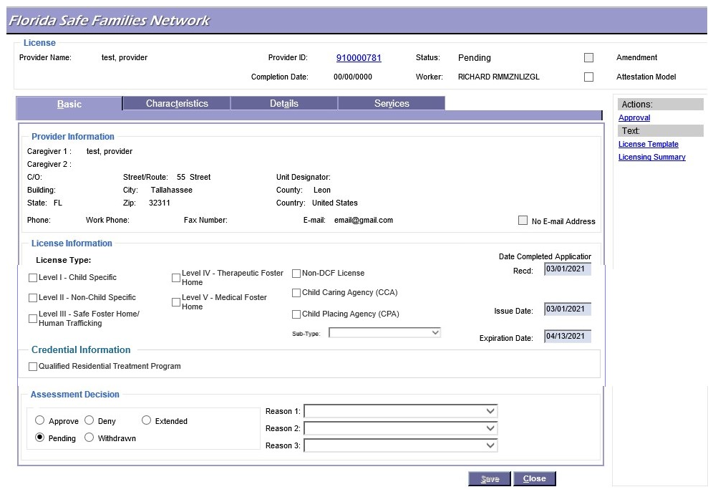
Upcoming FSFN Change - QRTP Credential
Screen mockup of the QRTP Credential on the FSFN License Page

Slide 47
QRTP
Placement

Slide 48

Qualified Residential
Treatment Program
Suitability Assessment
Completed prior to placement by a Qualified Evaluator (QE)
1. Psychiatrist or Psychologist licensed in Florida
2. Two years' experience working with children or adolescents involved in the child welfare system of care
3. No actual or perceived conflict of interest with placement in a QRTP
4. Completed training pertaining to the population of children in the child welfare system.
Qualified Evaluator:
When therapeutic placement is recommended:
Always begin with a QRTP credentialed placement
Notes:
For Participant Guide :
Completed training pertaining to the population of children in the child welfare system. Training topics shall include, but are not limited to, trauma-informed care and human trafficking.

Slide 49






Qualified Residential
Treatment Program
Assessment Components
Child and Adolescent Needs and Strengths (CANS) Trauma Comprehension Assessment Tool
Suitability
Assessment
Review of Prior Treatment Records
Speak with Relevant Parties
Recommendation from the Child’s Treating Clinical Professional
Interview with the Child
QRTP Recommendation
Notes:
For Participant Guide:
Required Relevant Parties: Guardian ad litem, case manager, current caregiver, the child’s family, Department of Juvenile Justice worker, treating clinical professional, and the permanency team
The treating clinical profession shall be a member of the permanency team

Slide 50



Qualified Residential
Treatment Program
Placement in a QRTP
Placement in a less restrictive setting with wraparound services
Placement in a statewide inpatient psychiatric program
The QE shall recommend one of the following placement options:

Slide 51
Qualified Residential
Treatment Program
Reconsiderations
  Missing components to the clinical record
  Child has experienced a decompensation in mental or behavioral health functioning since the assessment
Copy of assessment must be provided to the following parties to allow the opportunity to discuss the findings with the evaluator:
Department/CBC/CMO
GAL
QRTP
Court

Slide 52


Qualified Residential
Treatment Program
Multidisciplinary team shall offer to assist in developing a plan for necessary treatment and support services for the child in the community.
Child must be moved from the program within 30 calendar days of the recommendation.
QE does not recommend placement in a QRTP:

Slide 53

Qualified Residential
Treatment Program
Court Approval
Courts must consider the QRTP assessment, determination, and documentation made by the QE.
If placement is approved by the initial 60-day court review, the QE must conduct an independent suitability assessment review at least every 90 days.
If the court orders the child to be placed in a QRTP after the QE does not recommend placement, the assigned child welfare professional shall request a reconsideration.
Child must be moved from the QRTP within 30 days if the court denies the motion to place the child into a QRTP or orders the placement of the child into a less restrictive setting during a review hearing.
Must occur within 60 calendar days after initial placement in a QRTP.

Slide 54

Qualified Residential
Treatment Program
Continuing Placement
A child may not be placed in a QRTP for more than:
  12 consecutive months, or
  18 nonconsecutive months, or
  6 consecutive or non-consecutive months (under the age of 13)
Approval of the RMD or designee to exceed timeframes & SAMH clinical team
The Department shall provide a determination within seven (7) business days of the extension request

Slide 55

Qualified Residential
Treatment Program
Continuing Placement
Elopement or Baker Act
  May be readmitted into the same or newly identified QRTP without an additional assessment
    So long as the child was not discharged from the QRTP

Slide 56

Qualified Residential
Treatment Program
Continuing Placement
Transfer from one QRTP to another
  New assessment is not required
  Must not be a lapse in placement
  CBC must coordinate an MDT
    Both QRTP providers must participate
    Discuss the child’s identified needs
    Sharing of records to allow for adequate continuation of services and treatment.

Slide 57
Case Plan and Judicial Review
When a child is placed in a QRTP, the case plan must include the following:
Documentation outlining the most recent assessment for a QRTP
The treatment or service needs of the child
Date of the most recent placement in a QRTP
Aftercare progress reports shall be uploaded into FSFN and notification provided to the courts on the child’s progress during a judicial review.
A copy of the signed QRTP Extended Placement Request approval by the Department
A transition plan for the child specifying the following:
  Placement setting upon discharge;
  Efforts to achieve permanency if child remains in out-of-home care
  Discharge criteria
  Aftercare support recommendations for the child and caregiver(s).

Slide 58
FSFN
DEMO

Slide 59
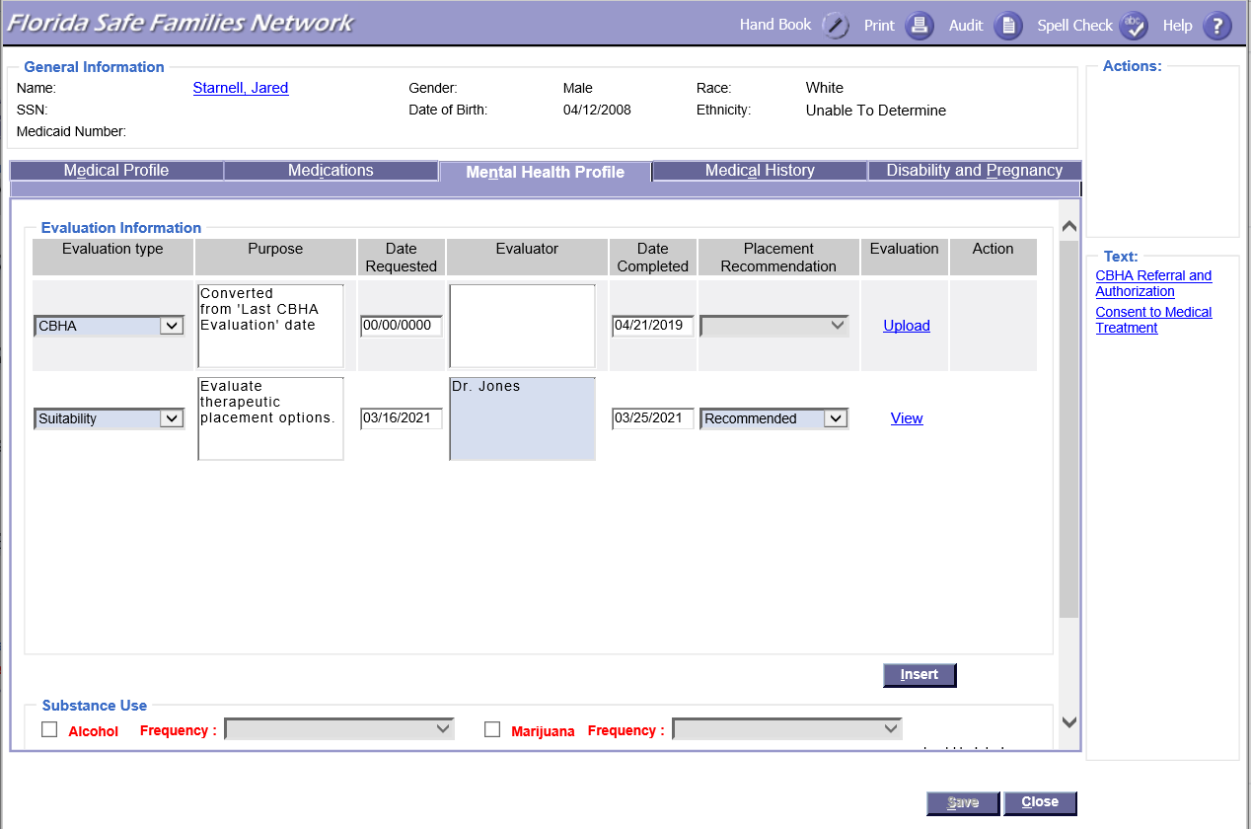
QRTP Suitability Assessment
FSFN users are required to document a child’s Suitability assessment to evaluate placement in a QRTP setting
Notes:
FSFN users are required to document a child’s QRTP suitability assessment if placed in a QRTP setting. Documentation is completed under the child’s Medical and Mental Health page. After selecting QRTP as the evaluation type, users can use the text box to document the purpose and evaluator’s information. The date requested shall be entered as well as the date completed. Users can also upload a copy of the evaluation using the “upload” hyperlink.

Slide 60
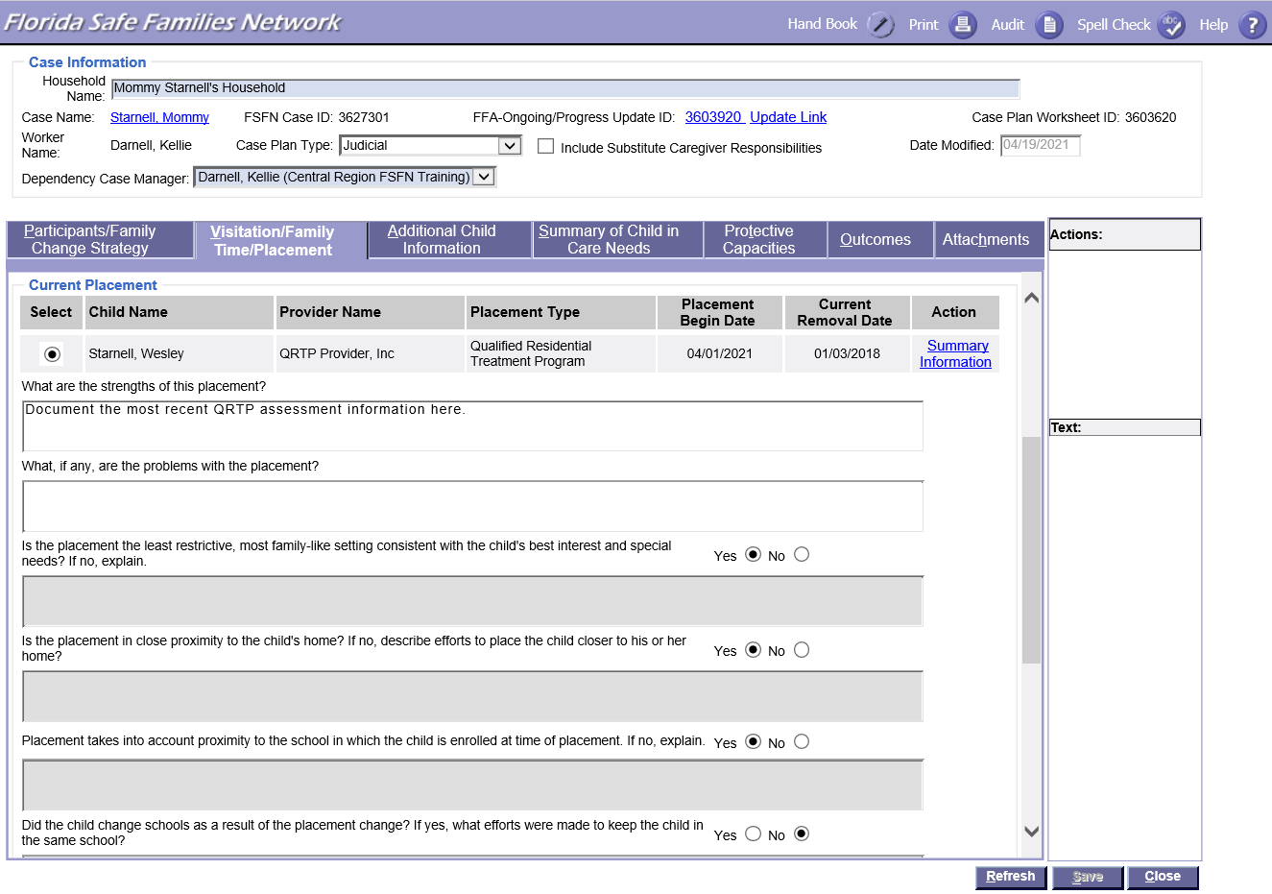
Case Plan
Date of the most recent placement in a QRTP
Documentation outlining the most recent assessment for QRTP

Slide 61
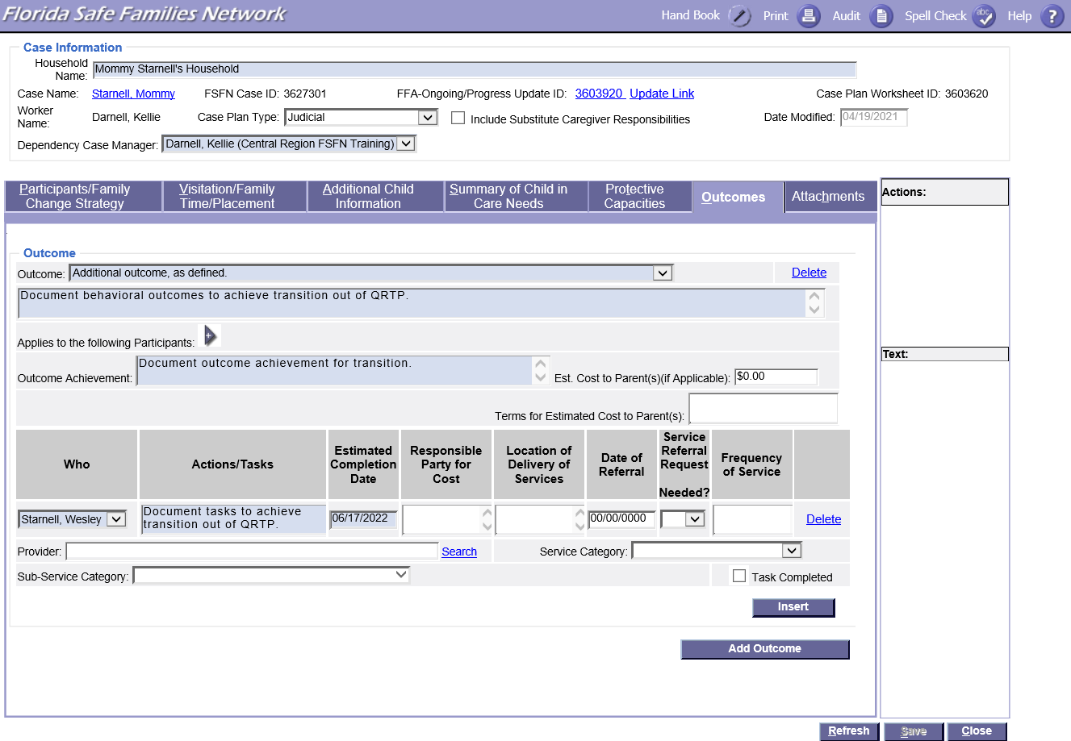
Case Plan
Services should be outlined as response to an outcome which identifies the desired change to which the service is being provided.
Transition plan should be outlined in an Outcome with tasks that meet these requirements.

Slide 62
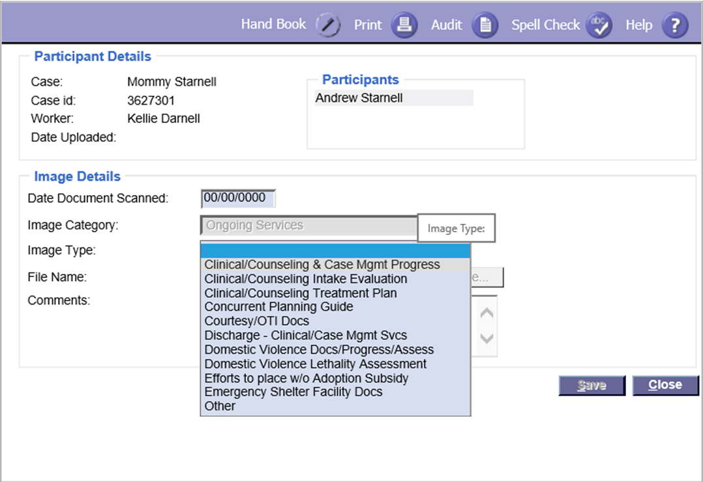
FSFN File Cabinet
Aftercare progress reports shall be uploaded to FSFN and notification provided to the courts on the child’s progress during a judicial review

Slide 63
FSFN File Cabinet
A copy of the signed QRTP Extended Placement requesting approval from the Department

Slide 64
Placement
Decisions

Slide 65
Comprehensive Placement Assessment
Child Welfare Professionals use the Comprehensive Placement Assessment to:
  Identify the appropriate level of care for each child in out-of-home care, and
  Prevent placement in an unnecessary clinical setting.
Child Welfare Professionals must complete the assessment:
  At the time of removal, and
  When seeking placement in a new level of out-of-home care
The assessment may not be used to formulate a diagnosis.
Utilization of the Assessment

Slide 66
Comprehensive Placement Assessment
Assessment Process
Initial assessment is completed by the CPI at the time of removal to determine the most appropriate setting for child.
Recommend placement in Relative or Non-Relative Care
Assessment is completed to document the recommendation
If the child cannot be placed in Relative or Non-Relative Care
Assessment is updated to reflect that the child cannot be placed in Relative/Non-Relative Care
MDT convenes to make a better decision with more robust assessment details
MDT makes a recommendation
Assessment is updated
Notes:
PG
Contact the community-based care lead agency (CBC) or subcontracted agency for coordination of a multidisciplinary team staffing (MDT) and placement into licensed care.
The MDT shall have a minimum of three individuals currently involved with the child.

Slide 67
Comprehensive Placement Assessment
  MDT meets to revisit or update the placement setting:
  When a change in the level of care is recommended.
      Except when care goes from relative or non-relative to Level-I Foster Home.
  Every 90 calendar days.
Additional Assessment Updates

Slide 68
Comprehensive Placement Assessment
  MDT discussion items:
  Medical needs
  Developmental needs
  Mental health needs
  Medication history, including psychotropic medications
  Behavioral health needs
  Alleged type of abuse or neglect and trafficking history
  Community ties and school placement, including educational needs
  Current placement decisions related to any siblings
  Child’s age, maturity, hobbies or activities, and preference for placement
  The child’s Adverse Experiences Questionnaire (ACE) score (Part 2B of the Comprehensive Placement Assessment).
Additional Assessment Updates

Slide 69
FSFN
Demo
Notes:
Demo

Slide 70
Qualified Residential
Treatment Program
Placement in a QRTP
Placement in a less restrictive setting with wraparound services
Placement in a statewide inpatient psychiatric program
The QE shall recommend one of the following placement options:

Slide 71
Age Differential Waiver

Slide 72
Age Differential Waiver
General Rules
No child under the age of 10 years may be admitted into a child-caring agency.
No dependency youth under the age of 12 may be placed in an at-risk home setting or safe house.

Slide 73
Age Differential Waiver
Exceptions
The placement of a child under the age of 10 without a waiver is valid under the following exceptions:
To prevent separation of a parenting young adult and child if placed outside of a maternity home.
The child of the parenting young adult must meet the eligibility requirements for admission into the child caring agency.
Approved Age Differential Waiver
The child-caring agency must provide the services outlined in rule 65C-14.1181 F.A.C.
A non-dependent child meets the criteria for placement in one of the following settings:
Unaccompanied Alien Minor Home
Emergency Shelter
Runaway Shelter

Slide 74
Age Differential Waiver
Valid Waiver Reasons
  thin four (4) hours of receipt of the request from the CBC
To prevent the separation of siblings.
A sibling must be placed in the same home whenever possible.
If it is not possible to place the siblings in the same home, siblings may be placed on the same campus.
Efforts to place the siblings in the same home must be documented in the child’s record
When the Comprehensive Placement Assessment recommends placement in a Child-Caring Agency.
The child must meet the eligibility requirements for admission into the child caring agency.
Supporting documentation for dependency youth under the age of 12 who are recommended for placement in an at-risk home setting or safe house must show all efforts to place the youth with:
    A relative or fictive kin or
    In an available Level III safe foster home within Florida, and
    In an available Level II foster home within the youth’s lead CBC geographical area.

Slide 75
Age Differential Waiver
Approval Process
  thin four (4) hours of receipt of the request from the CBC
Submitted by the CBC for signed approval by DCF or CBC designee
1. Considers information outlined in the Comprehensive Placement Assessment, the Age Differential Waiver request form, and the eligibility criteria for admission of the requested group home setting.
2. DCF or CBC designee shall provide a determination within two (2) hours of receipt of the request.

Slide 76
Age Differential Waiver
Approval Process
  thin four (4) hours of receipt of the request from the CBC
Must be completed prior to placement with a Child Caring Agency
Must be uploaded to the child’s case file
Must be reviewed with the Comprehensive Placement Assessment every 90 days

Slide 77

Group Home
Child-Caring Agency

Slide 78
Non-FFSPA Reimbursable Placements
Emergency Shelter
Runaway
Shelter
Wilderness Camp
Unaccompanied Alien Child
Traditional
Residential

Slide 79
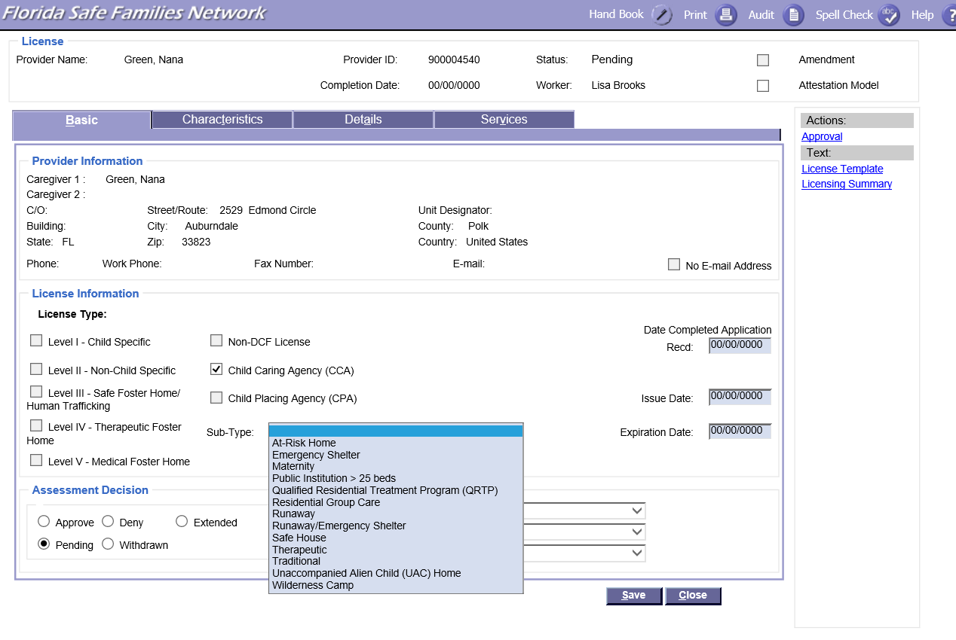
FSFN License Selection Screenshot

Slide 80



Traditional and Residential Child Caring Agencies
If serving dependency youth with an active dependency case, may be licensed to serve:
Youth entering out-of-home care whose Comprehensive Placement Assessment recommends placement in a child caring agency and the placement is unavailable.
  Transition planning initiated 48 hours after placement
  Assist with the following services:
Family finding efforts
Coordinate assessments
Coordinate referrals
Notes:
For Participant Guide:
Requires approval from the RMD or DCF designee.
If providing care or supervision to children for more than 30 calendar days, or in the case of multiple child welfare professionals alternating shifts for more than 30 calendar days,
Approved background screening through fingerprint submission under Chapter 435 and Chapter 39.0138 of Florida Statute,
Florida abuse history check,
Out of state abuse history check
All background screenings must be approved before the 30 calendar days.
A copy of the background screening results must be provided to the regional licensing teams and uploaded into the provider file cabinet.

Slide 81



Non DCF License
Create provider in FSFN using first/last name for foster parent, name on license for group home/residential facility.
CBC Responsibilities
Upload copy of license.
Submit requests to your regional licensing team.
In order to meet the qualifications for a non-DCF license, the following criteria must be met:
  Federal Background screenings
  State license

Slide 82
CCA Need Coordination
Letters of Need are no longer required.
Regions will analyze FSFN data to determine whether a CCA is needed in the local area.
  If a need is determined, the Region will contact the local CBC to confirm.
  If the local CBC is not interested but the statewide data supports the need for a specific setting type, the Region will contact a CBC that would benefit from having a group home.
A CCA will have only one contract, regardless of the number of CBCs with a need for the CCA.
CCAs under contract are required to include the CBC on their liability insurance.

Slide 83


Child Records Group Care
Child’s File
Any available assessments
Child’s placement agreement
Comprehensive Placement Assessment
(most recent upon placement)
CCA participation ongoing
Overcapacity
No overcapacity process for group homes.
Capacity must be amended!

Slide 84
Service and Treatment Plans
Treatment Plans
Must be developed and completed within 14 days of admission (for applicable program types)
Developed with a collaboration team approach
Reviewed every 30 days and updated as needed or at least every 6 months
84
Service Plans
Initiated within 14 days of admission and completed by day 30
Developed with a collaboration team approach
Reviewed every 30 days and updated as needed or at least every 6 months.
Treatment plans outline the problems that need to be addressed, goals to reach to address each problem, action steps taken to accomplish goals, target dates for completion, a description/frequency of services provided, youth’s diagnosis and discharge criteria.
Service plans outline details of the supports, activities, and resources required for the child to achieve individual goals.
Page

Slide 85

Discharge Planning for all CCA that are not QRTP
Discharge planning shall include input from the child, the child’s parent or guardian, foster parents, caregiver, Department, and guardian ad litem, and a copy shall be provided to the child’s welfare professional.
Aftercare plans shall, at minimum, reflect recommendations for services, where appropriate, and document any referrals generated, and include at least one (1) documented contact with the discharged child or his or her family within the first 30 days following discharge.

Slide 86

Group Care Quality Standards Assessment (GCQSA)
  thin four (4) hours of receipt of the request from the CBC
Surveys should be sent to providers and CBC contract or placement teams no later than 90 days prior to license expiration
Results of the assessment should be shared with the CBC and CCA when there is an indication to enhance the quality of the CCA

Slide 87



Background Screening Requirements
A Child Welfare Professional providing care or supervision to children at a Child Caring Agency
Requires approval from the RMD or DCF designee.
All background screenings must be approved before the 30 calendar days
If providing care or supervision to children for more than 30 calendar days, or in the case of multiple child welfare professionals alternating shifts for more than 30 calendar days:
A copy of the background screening results must be provided to the regional licensing teams and uploaded into the provider file cabinet
Approved background screening through fingerprint submission under Chapter 435 and Chapter 39.0138 of Florida Statute
Florida abuse history check
Out of state abuse history check
Notes:
For Participants Guide
Requires approval from the RMD or DCF designee.
If providing care or supervision to children for more than 30 calendar days, or in the case of multiple child welfare professionals alternating shifts for more than 30 calendar days,
Approved background screening through fingerprint submission under Chapter 435 and Chapter 39.0138 of Florida Statute,
Florida abuse history check,
Out of state abuse history check
All background screenings must be approved before the 30 calendar days.
A copy of the background screening results must be provided to the regional licensing teams and uploaded into the provider file cabinet.

Slide 88
Background Screening Requirements
All young adults age 18 and older residing in a licensed child-caring agency setting serving children under the age of 18:
  Fingerprint screenings
  Abuse and neglect records check
  Out of state abuse and neglect check
When a child is initially placed or remains with a relative or non-relative, all household members age 12 or older:
  • Abuse and neglect records check –
    When the applicant or any other household member was named as caregiver responsible in a report verified for sexual abuse, this shall be an automatic disqualifier for placement

Slide 89

Case Planning & Petition

Slide 90

Co-Constructing a Case Plan with Parents/Legal Guardians and Children
Beginning at age 14, any case plan development must be in consultation with the child or young adult.
The case plan must include the responsibility of the parents and caregivers to work together when it is safe to do so, which includes:
Ongoing collaboration to successfully implement the case plan.
The right to notify the court or the case manager if ineffective communication takes place that negatively impacts the child.
The case manager assisting the parents and caregivers in developing a productive relationship that includes meaningful communication and mutual support.
CFOP 170-9 Chapter 5-3

Slide 91

Case Planning and Child Welfare Professional Responsibilities to Parents
65C-30.006.
The Child Welfare professional will develop the case plan in consultation with the family and the child.
65C-30.008. Case Manager shall ensure that parents have the information necessary to contact their case manager.
The parent will notify all parties and the court of barriers to completing each case plan task, provide all parties with identification and location for individuals who may be available as a placement for the child in out of home care, and maintain contact and provide updated contact information to the child welfare professional.
For judicial cases, refer the parent for services no later than seven calendar days after case plan approval by the court.
If a new case manager is assigned to a case, the new case manager shall notify the parent within two business days of case assignment and provide updated contact information.
65C-30.006 and 65C-30.008

Slide 92
Case Plan Template Updates
Case Manager's Responsibilities:
(17) The Case Manager will assist the parents and caregivers in developing a productive home environment, including meaningful communication and mutual support.
NOTICE TO PARENTS section:
The parents will work together with the caregivers to successfully implement the case plan.
The parents will notify the case manager if ineffective communication takes place that negatively impacts the child.
In addition to the above, the following was added to the Court Involved Case Plan Template:
Substitute Caregiver Responsibilities:
(13) The caregiver will work together with the parents to successfully implement the case plan.
(14) The caregivers will notify the court or the case manager if ineffective communication takes place that negatively impacts the child.

Slide 93

The Department may file a petition for shelter or dependency without a new child protective investigation or in concurrence with the CPI if the child is unsafe or for the use of a safety plan and the parent or caregiver has not sufficiently increased caregiver capacities within 90 days after the transfer of the safety plan to the lead agency.
While the CPI is not required for concurrence, Case management must ensure that the CPI is the one to conduct the removal from the home.
(Reference CFOP 170-1 Chapter 11)
Section 11-2 Safety plan

Slide 94

Completing a Diligent Search For Parent or Diligent Efforts to Locate Relatives
The child welfare professional must complete the Diligent Search section in the Judicial Review worksheet.
If the child is a member or is eligible for membership in a tribe, obtain the child’s tribal membership information including the name and location of the tribe from both parents.
This includes diligent efforts to locate relatives and fictive kin.
The Department must conduct a diligent search to provide notice to the parents of dependency and termination of parental rights proceedings before the court can enter final orders impacting the parents’ rights to their child.
CFOP 170-1 Chapter 14
Notes:
Should this be included in workshop?

Slide 95

Completing a Diligent Search For Parent or Diligent Efforts to Locate Relatives
Locating parents, relatives, and fictive kin is important for maintaining and strengthening the child’s long-term or permanent family connections and developing a visitation plan.
These persons are possible placement resources for concurrent planning.
They also have specific rights for notice and participation in the child’s dependency case.
CFOP 170-1 Chapter 14

Slide 96

Completing a Diligent Search For Parent or Diligent Efforts to Locate Relatives
Family connections should not only be used for placement purposes but to also establish long-term emotional support networks with other adults who may not be able to have the child placed into their home but want to remain connected to the child.
CFOP 170-1 Chapter 14

Slide 97
Completing a Diligent Search For Parent or Diligent Efforts to Locate Relatives
Diligent searches and diligent efforts begin during the investigation phase and intensify after case transfer to ongoing services.
Both the child protective investigator (CPI) and case manager share the responsibility for obtaining and documenting diligent search efforts.
CFOP 170-1 Chapter 14

Slide 98
FSFN
Demo
Notes:
Demo

Slide 99

State Institutional Claims for Damages Caused by Shelter or Foster Child
Confirm the damage described on the application and confirm the claimant has provided pictures of the damages, two written estimates for repair, or receipt(s) if the repair has been paid for.
The application will be processed and sent to the Office of the Attorney General no later than 10 business days from receipt of the completed form with receipts and estimates attached.
CFOP 170-16, Chapter 4
Replaces CFOP 175-60

Slide 100
Child Welfare Professional reviewing the circumstances agrees that the shelter or foster child was responsible for the injury or property damage.
State Institutional Claims for Damages Caused by Shelter or Foster Child
The Child Welfare Professional must:
Complete the State Institutional Claims for Damages Recommendation form
Indicate that the application appears to meet or does not meet the criteria for reimbursement consideration
Forward the recommendation form to the Office of the Attorney General for processing along with the claimant’s application
CFOP 170-16, Chapter 4
Replaces CFOP 175-60

Slide 101

State Institutional Claims for Damages Caused by Shelter or Foster Child
In the event the claim is denied by the Office of the Attorney General and the claimant requests a 120 hearing, the Child Welfare Professional must attend the hearing.
CFOP 170-16, Chapter 4
Replaces CFOP 175-60

Slide 102
Notifications
39.301, F.S.

Slide 103



The department shall promptly notify the court of any report to the central abuse hotline that is accepted for a protective investigation and involves a child over whom the court has jurisdiction
Notification of calls to the Hotline that does not warrant an investigation (screened out)
Case Management should review the intake and assess if follow-up is needed or determine if there are any potential safety concerns.
Best practice to review within 1 business day.
Notification to CLS to prompt court notification
For cases in which supervision is terminated, and the courts retained jurisdiction, the CPI shall immediately notify managing attorney for the circuit

Slide 104


Notification on new reports for cases in on-going services.
CPI’s must immediately contact the case manager and the assigned CLS attorney on a child or victim for whom the courts have jurisdiction.
Collaboration for both CPI and Case Management are required.
Judicial Review Filing Notifications
Upon data entry into FSFN by CLS of when the JR is due, an email notification will be sent to the assigned case manager associated with the case.
This will prompt to begin the completion of the document.
Additional notifications can be found through the ticklers

Slide 105
Other FSFN
Changes
Notes:
Demo

Slide 106
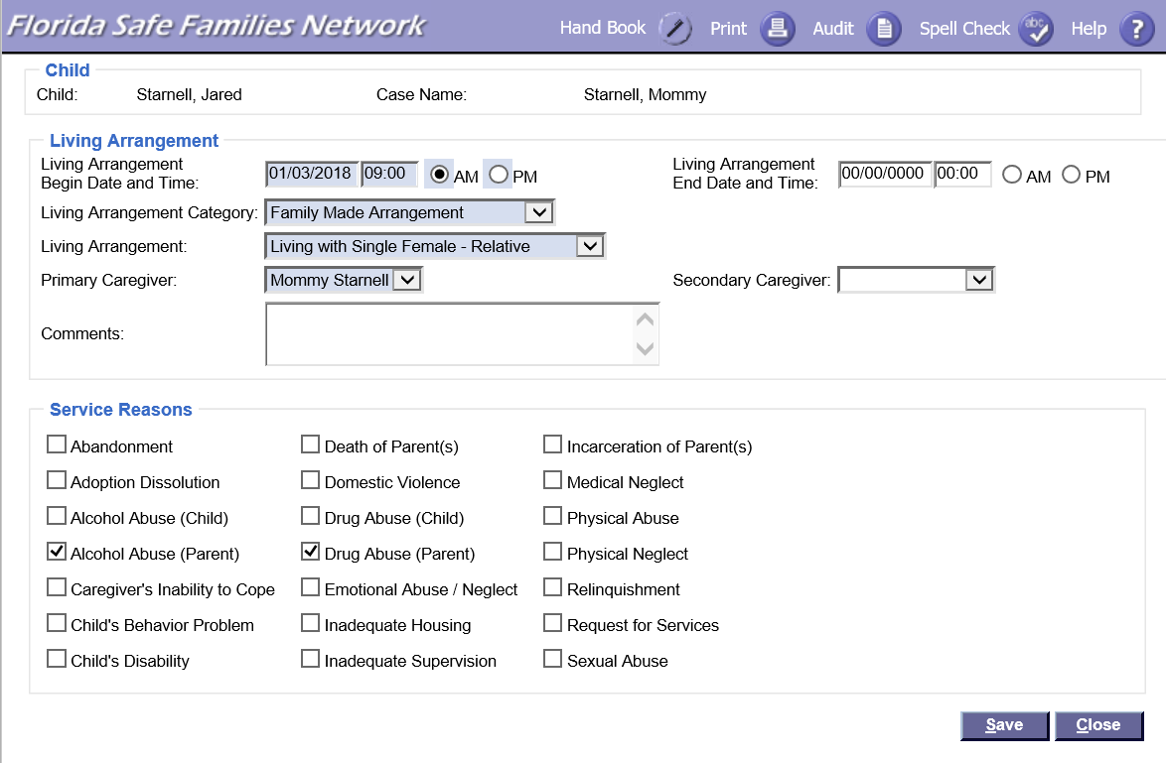
Family Made Arrangement
Living Arrangement Category now includes Family Made Arrangement

Slide 107
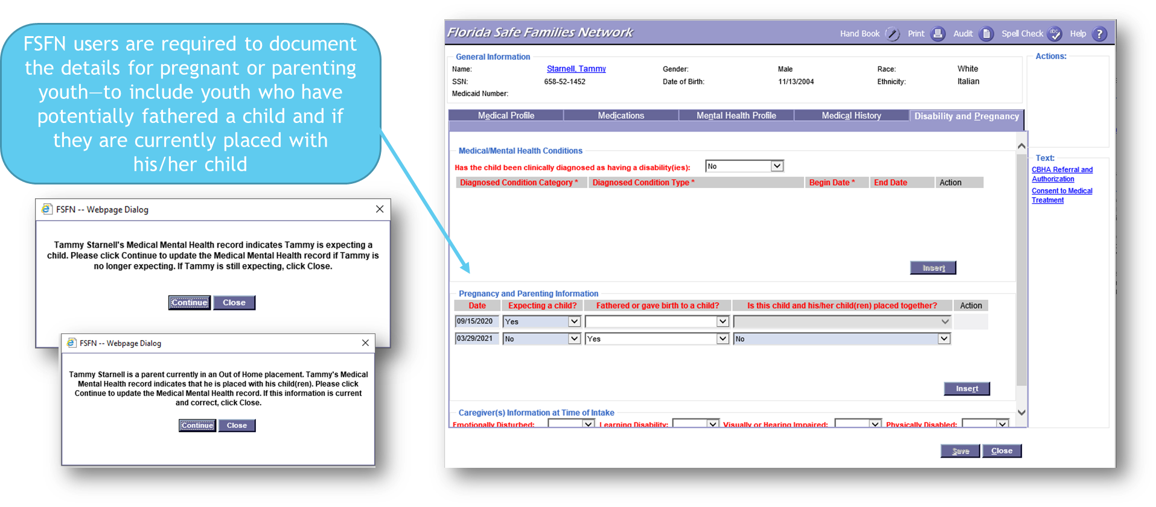
Pregnant & Parenting Youth
Notes:
Under the Disability and Pregnancy tab includes a new data box, “Pregnancy and Parenting Information,” which allows the user to identify when a client is expecting a child and when they are no longer expecting. This also allows the user to identify a client that has fathered or gave birth to a child and if the client is placed with his/her child. The data captured is required for AFCARS reporting and the Family First Prevention Services Act.
Notifications:
The system will generate a notification pop-up indicating if records indicate that a youth is pregnant and/or placed with their child.

Slide 108
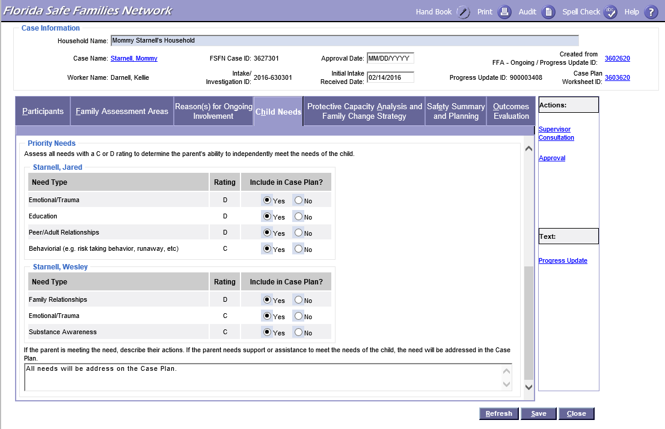

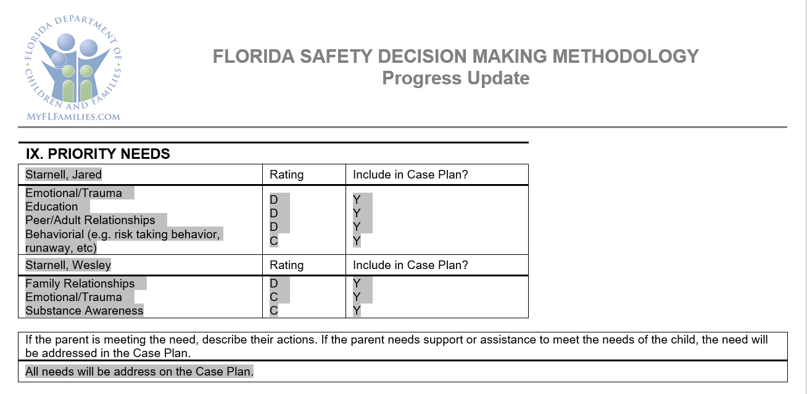
Progress Update Template
Child Needs section on Progress Update Template updated to correctly reflect the same language that appears on the Progress Update screen
Notes:
The Child Needs section on Progress Update Template updated to correctly reflect the same language that appears on the Progress Update screen.

Slide 109
Other FSFN Enhancements
  Modifications throughout the system to change ‘Rapid Safety Feedback’ references to reflect a ‘Quality Review’
    This is a name change that synchronizes the new Quality Office. This change includes displays on FSFN screens and within automated messages.
  FSFN-Query capability for law enforcement
    This new query will allow FCIC users to query FSFN to determine if someone is the subject of a child abuse investigation or a parent/caregiver of a child under in-home supervision.

Slide 110

Question
&
Answer Session

