Slide 1
2018 FLORIDA YOUTH SUBSTANCE ABUSE SURVEY
Washington County

Slide 2
Methodology
Survey was administered in February of 2018.
Sampling strategy: schools and classrooms were selected to generate statistically representative county-level estimates.
Final sample size was 587 across grades 6 through 12.
The margin of error is less than 4.7 percentage points for prevalence rates for the combined middle school and high school sample.

Slide 3
Substance Use
Prevalence Rates
2018 Results

Slide 4
Graph 1
Lifetime use of alcohol, tobacco and other drugs among Washington County students, 2018

Slide 5
Graph 2
Past-30-day use of alcohol, tobacco and other drugs among Washington County students, 2018

Slide 6
Key Findings
With overall prevalence rates of 34.9% for lifetime use and 15.1% for past-30-day use, alcohol is the most commonly used drug among Washington County students.
After alcohol, students reported vaping/e-cigarettes (33.2% lifetime and 14.8% past-30-day) and marijuana (22.6% lifetime and 10.2% past-30-day) as the most commonly used drugs.
16.6% of high school students reported blacking out after drinking on one or more occasions.
For other drug use categories, past-30-day prevalence ranges from 4.2% for cigarettes to 0.0% for heroin.

Slide 7
Alcohol, Cigarettes
and Marijuana
2008-2018 Trends
Early Initiation and Risk of Harm
Substance Use and Driving

Slide 8
Graph 3
Past-30-day alcohol use, Washington County 2008-2018 and Florida Statewide 2018
Washington County 2008-2018
Florida Statewide 2018

Slide 9
Graph 4
Binge Drinking, Washington County 2008-2018 and Florida Statewide 2018
Washington County 2008-2018
Florida Statewide 2018

Slide 10
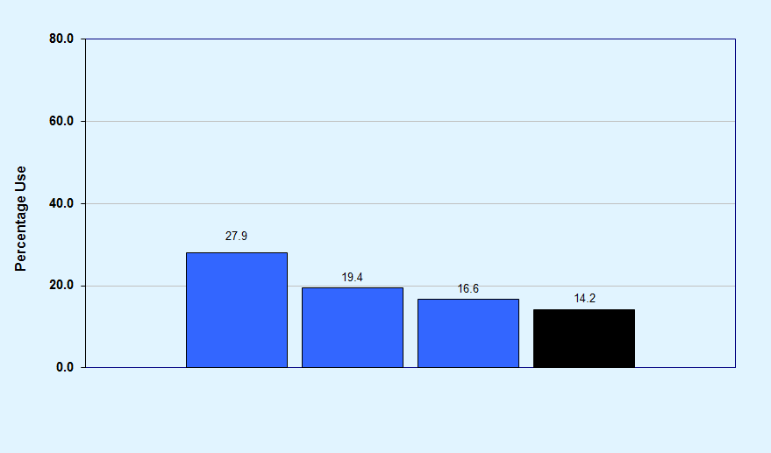
Graph 5
Blacking out from drinking, among high school students, Washington County 2014-2018 and Florida Statewide 2018
Washington County 2014-2018
Florida Statewide 2018

Slide 11
Graph 6
Alcohol trends summary for Washington County, 2008-2018

Slide 12
Graph 7
Usual source of alcohol within the past 30 days among high school drinkers, Washington County and Florida Statewide, 2018
Washington County
Florida Statewide

Slide 13
Graph 8
Usual drinking location within the past 30 days among high school drinkers, Washington County and Florida Statewide, 2018
Washington County
Florida Statewide

Slide 14
Graph 9
Past-30-day cigarette use, Washington County 2008-2018 and Florida Statewide 2018
Washington County 2008-2018
Florida Statewide 2018

Slide 15
Graph 10
Cigarette trends summary for Washington County, 2008-2018

Slide 16
Graph 11
Past-30-day vaporizer/e-cigarette use, Washington County 2016-2018 and Florida Statewide 2018
Washington County 2016-2018
Florida Statewide 2018

Slide 17
Graph 12
Past-30-day marijuana use, Washington County 2008-2018 and Florida Statewide 2018
Washington County 2008-2018
Florida Statewide 2018

Slide 18
Graph 13
Marijuana trends summary for Washington County, 2008-2018

Slide 19
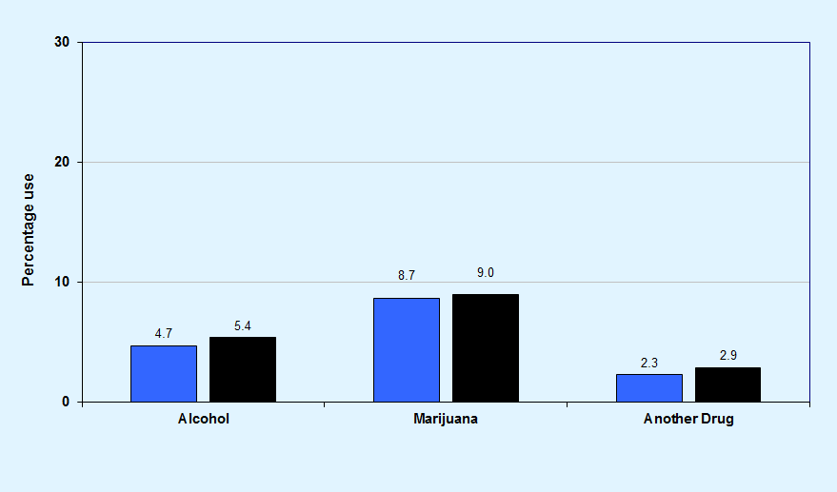
Graph 14
Substance use before or during school in the past 12 months, Washington County and Florida Statewide, 2018
Washington County
Florida Statewide

Slide 20
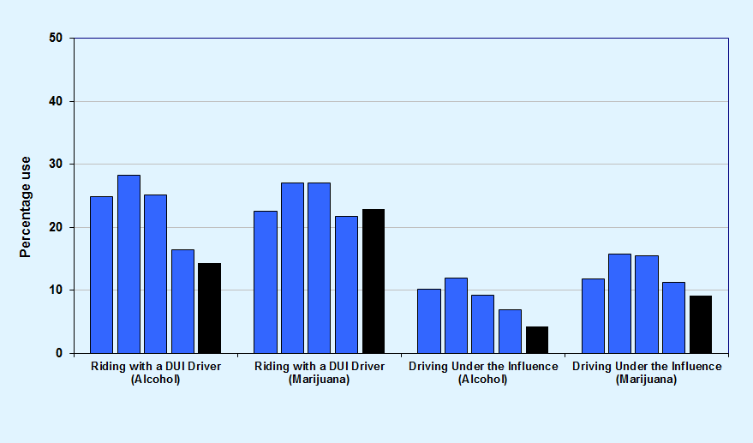
Graph 15
DUI or riding with a driver under the influence, among high school students, Washington County 2012-2018 and Florida Statewide 2018
Washington County 2012-2018
Florida Statewide 2018
Note: DUI does not imply intoxication but only indicates use prior to driving.

Slide 21
Key Findings
In Washington County, past-30-day alcohol use was reported at 15.1%, compared to 15.3% across the statewide sample.
Binge drinking declined from 17.9% in 2008 to 7.2% in 2018.
Past-30-day cigarette use declined from 16.0% in 2008 to 4.2% in 2018.
In the past 30 days, 16.4% of high school students have ridden in a car with a driver who was under the influence of alcohol, and 21.8% have ridden with a driver under the influence of marijuana.

Slide 22
Other Illicit,
Over-the-Counter, and
Prescription Drugs
2008-2018 Trends

Slide 23
Graph 16
Past-30-day inhalant use, Washington County 2008-2018 and Florida Statewide 2018
Washington County 2008-2018
Florida Statewide 2018

Slide 24
Graph 17
Past-30-day over-the-counter drug use, Washington County 2010-2018 and Florida Statewide 2018
Washington County 2010-2018
Florida Statewide 2018

Slide 25
Graph 18
Past-30-day depressants use, Washington County 2008-2018 and Florida Statewide 2018
Washington County 2008-2018
Florida Statewide 2018

Slide 26
Graph 19
Past-30-day prescription pain reliever use, Washington County 2008-2018 and Florida Statewide 2018
Washington County 2008-2018
Florida Statewide 2018

Slide 27
Graph 20
Past-30-day prescription amphetamines use, Washington County 2008-2018 and Florida Statewide 2018
Washington County 2008-2018
Florida Statewide 2018

Slide 28
Graph 21
Past-30-day drug combination rates for Washington County and Florida Statewide, 2018
Washington County
Florida Statewide

Slide 29
Key Findings
In Washington County, 6.1% of surveyed students reported the use of any illicit drug other than marijuana in the past 30 days, compared to 5.8% across the statewide sample.
Past-30-day illicit drug other than marijuana use decreased from 14.6% in 2008 to 6.1% in 2018.
Among high school students, past-30-day synthetic marijuana use decreased from 6.8% in 2012 to 1.0% in 2018.
Among middle school students, 2.6% reported the use of inhalants in the past 30 days, a rate higher than any other illicit drug.

Slide 30
Other Antisocial Behaviors, Bullying, Symptoms of Depression, and Gang Involvement
2018 Results

Slide 31
Graph 22
Comparisons of past-12-month delinquent behavior for Washington County and Florida Statewide, 2018
Washington County
Florida Statewide

Slide 32
Graph 23
Other antisocial behaviors trend summary for Washington County, 2008-2018

Slide 33
Graph 24
Bullying-related behaviors among Washington County middle and high school students, 2018
Middle School
High School

Slide 34
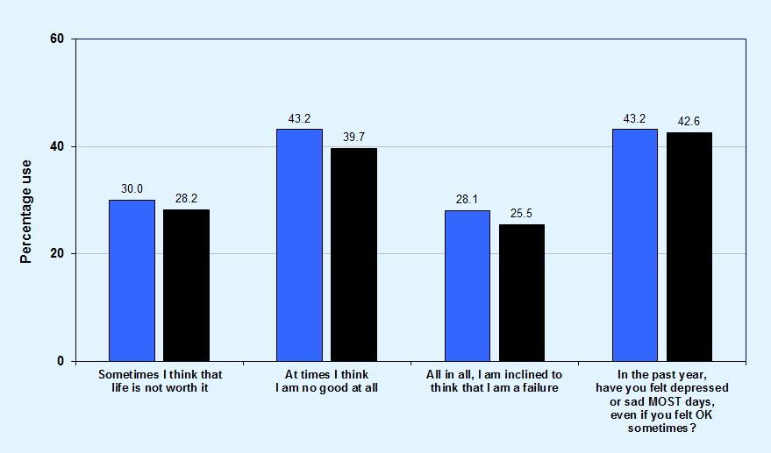
Graph 25
Comparisons of symptoms of depression for Washington County and Florida Statewide, 2018
Washington County
Florida Statewide

Slide 35
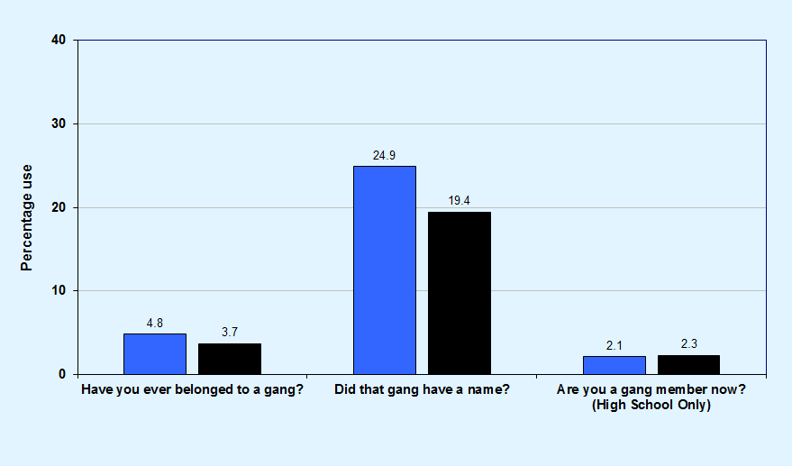
Graph 26
Gang involvement, Washington County and Florida Statewide, 2018
Washington County
Florida Statewide

Slide 36
Key Findings
In Washington County, prevalence rates for Attempting to Steal a Vehicle (1.3%), Being Arrested (2.7%), and Taking a Handgun to School (0.5%) are 3.0% or less.
Higher prevalence rates were reported for Getting Suspended (8.8%) and Carrying a Handgun (10.8%).
In Washington County, 56.3% of students have been socially bullied, 33.7% have been physically bullied, and 28.4% have been cyber bullied.
In Washington County, 43.2% of students reported feeling depressed or sad on most days in the past year.

Slide 37
Risk and Protective Factor Prevalence Rates for M.S. and H.S. Students
2018 Results

Slide 38
Graph 27
Protective factor prevalence rates for Washington County and Florida Statewide middle school students, 2018
Washington County
Florida Statewide

Slide 39
Community domain and family domain risk factor prevalence rates for Washington County and Florida Statewide middle school students, 2018
Graph 28
Washington County
Florida Statewide

Slide 40
School domain and peer and individual domain risk factor prevalence rates for Washington County and Florida Statewide middle school students, 2018
Graph 29
Washington County
Florida Statewide

Slide 41
Graph 30
Protective factor prevalence rates for Washington County and Florida Statewide high school students, 2018
Washington County
Florida Statewide

Slide 42
Community domain and family domain risk factor prevalence rates for Washington County and Florida Statewide high school students, 2018
Graph 31
Washington County
Florida Statewide

Slide 43
School domain and peer and individual domain risk factor prevalence rates for Washington County and Florida Statewide high school students, 2018
Graph 32
Washington County
Florida Statewide

Slide 44
Key Findings
Protective factor prevalence rates—opportunities for improvement:
Middle school students reported the lowest rates of protection for the School Rewards for Prosocial Involvement (42%), Family Rewards for Prosocial Involvement (53%), and School Opportunities for Prosocial Involvement (53%) scales.
High school students reported the lowest rates of protection for the Family Rewards for Prosocial Involvement (43%) and Family Opportunities for Prosocial Involvement (48%) scales.

Slide 45
Key Findings
Risk factor prevalence rates—opportunities for improvement:
Middle school students reported the highest rates of risk for the Lack of Commitment to School (59%) and Transitions and Mobility (54%) scales.
High school students reported the highest rates of risk for the Lack of Commitment to School (61%) and Transitions and Mobility (50%) scales.

