Slide 1
2018
FLORIDA YOUTH
SUBSTANCE ABUSE
SURVEY
Hardee County

Slide 2
Methodology
Survey was administered in February of 2018.
Sampling strategy: schools and classrooms were selected to generate statistically representative county-level estimates.
The final sample size was 355 across grades 6 through 8. Because no Hardee County students in grades 10 through 12 participated in the survey, only middle school results are included in this presentation.
The margin of error is less than 6.2 percentage points for prevalence rates for the middle school sample.

Slide 3
Substance Use
Prevalence Rates
2018 Results

Slide 4
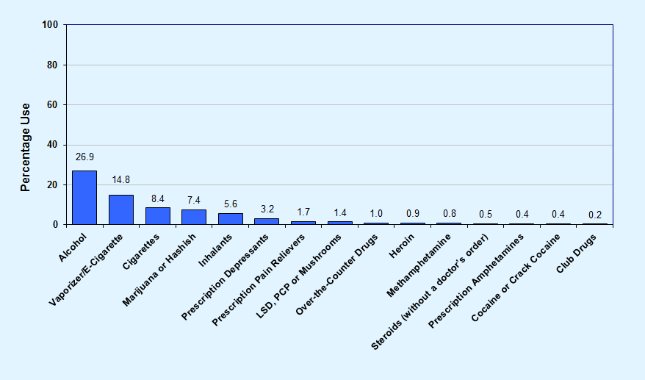
Graph 1
Lifetime use of alcohol, tobacco and other drugs among Hardee County middle school students, 2018

Slide 5
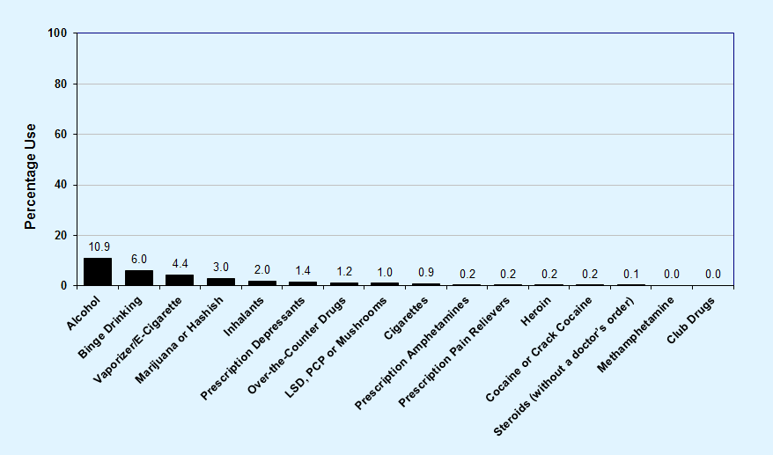
Graph 2
Past-30-day use of alcohol, tobacco and other drugs among Hardee County middle school students, 2018

Slide 6
Key Findings
With overall prevalence rates of 26.9% for lifetime use and 10.9% for past-30-day use, alcohol is the most commonly used drug among Hardee County middle school students.
After alcohol, students reported vaping/e-cigarettes (14.8% lifetime and 4.4% past-30-day) and marijuana (7.4% lifetime and 3.0% past-30-day) as the most commonly used drugs.
For other drug use categories, past-30-day prevalence ranges from 2.0% for inhalants to 0.0% for club drugs and methamphetamine.

Slide 7
Alcohol, Cigarettes
and Marijuana
2008-2018 Trends
Early Initiation and Risk of Harm

Slide 8
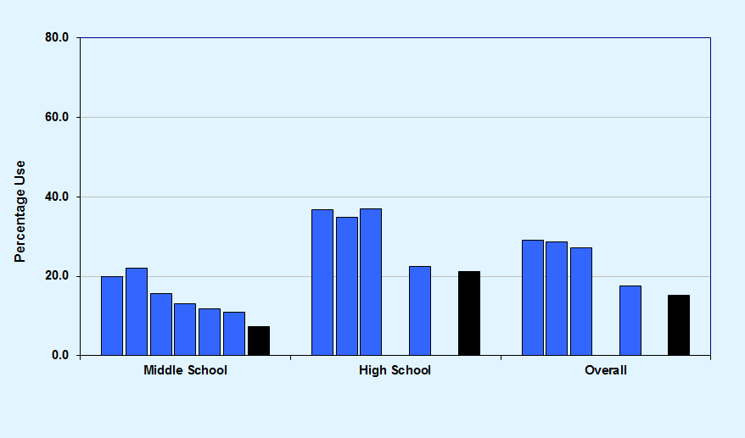
Graph 3
Past-30-day alcohol use, Hardee County 2008-2018 and Florida Statewide 2018
Hardee County 2008-2018
Florida Statewide 2018

Slide 9
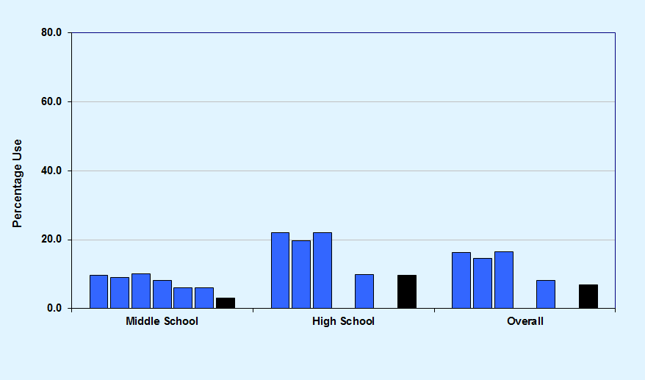
Graph 4
Binge Drinking, Hardee County 2008-2018 and Florida Statewide 2018
Hardee County 2008-2018
Florida Statewide 2018

Slide 10
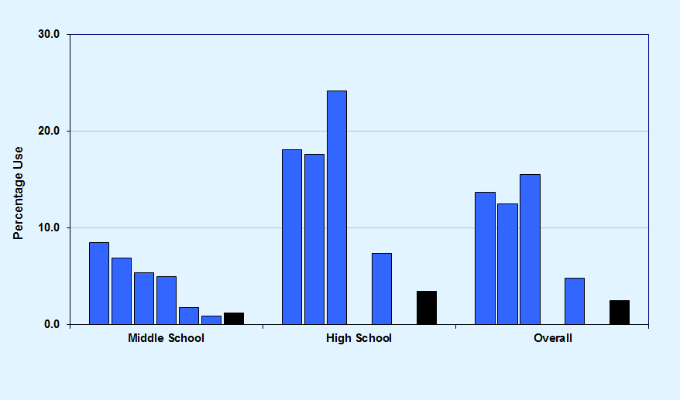
Graph 5
Past-30-day cigarette use, Hardee County 2008-2018 and Florida Statewide 2018
Hardee County 2008-2018
Florida Statewide 2018

Slide 11
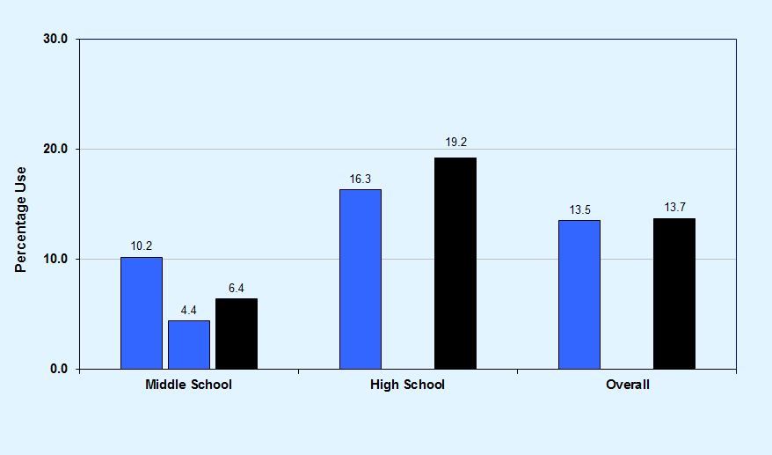
Graph 6
Past-30-day vaporizer/e-cigarette use, Hardee County 2016-2018 and Florida Statewide 2018
Hardee County 2016-2018
Florida Statewide 2018

Slide 12
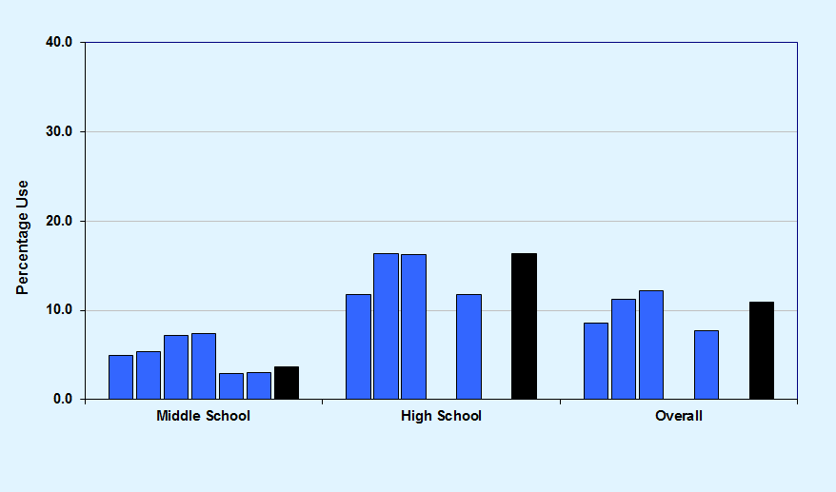
Graph 7
Past-30-day marijuana use, Hardee County 2008-2018 and Florida Statewide 2018
Hardee County 2008-2018
Florida Statewide 2018

Slide 13
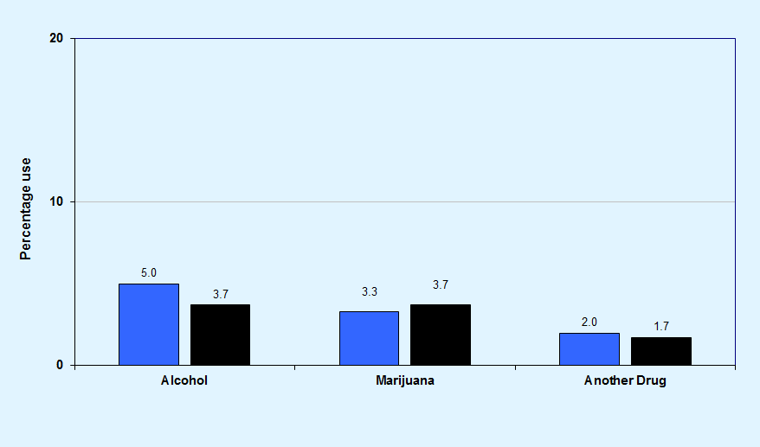
Substance use before or during school in the past 12 months, among middle school students, Hardee County and Florida Statewide, 2018
Graph 8
Hardee County
Florida Statewide

Slide 14
Key Findings
In Hardee County, past-30-day alcohol use was reported at 10.9%, compared to 7.3% across the statewide sample.
Binge drinking declined from 9.6% in 2008 to 6.0% in 2018.
Past-30-day cigarette use declined from 8.5% in 2008 to 0.9% in 2018.

Slide 15
Other Illicit,
Over-the-Counter, and
Prescription Drugs
2008-2018 Trends

Slide 16
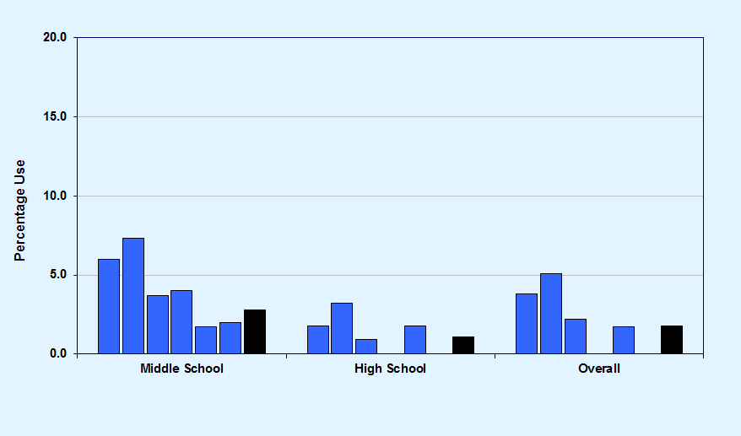
Graph 9
Past-30-day inhalant use, Hardee County 2008-2018 and Florida Statewide 2018
Hardee County 2008-2018
Florida Statewide 2018

Slide 17
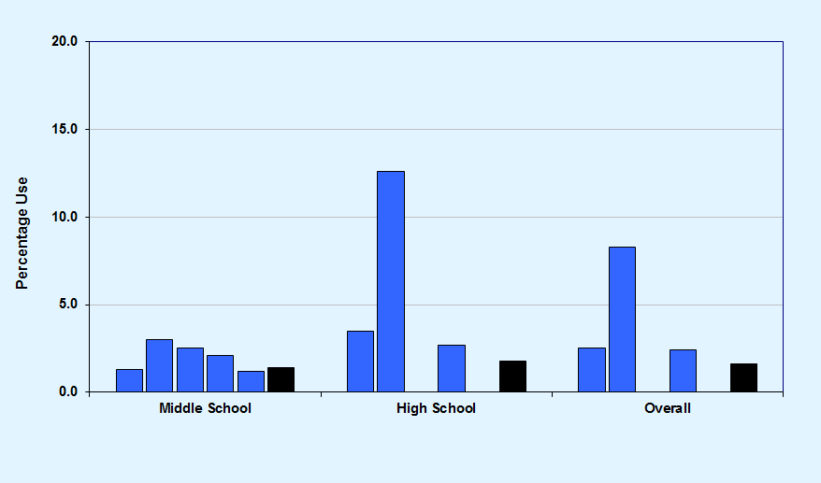
Graph 10
Past-30-day over-the-counter drug use, Hardee County 2010-2018 and Florida Statewide 2018
Hardee County 2010-2018
Florida Statewide 2018

Slide 18
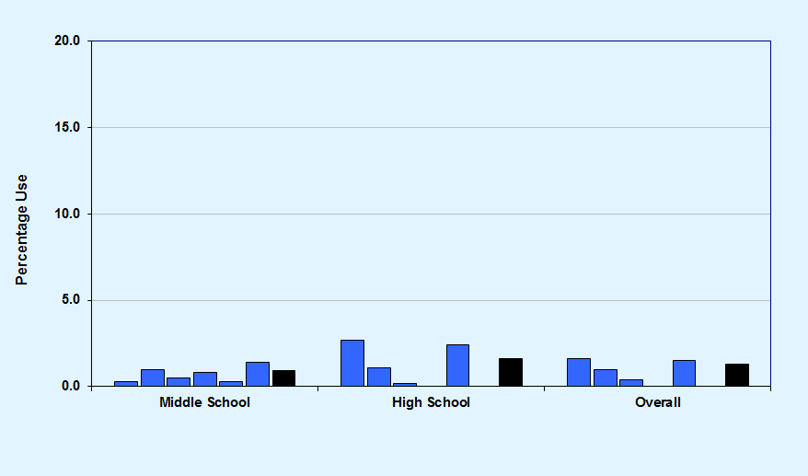
Graph 11
Past-30-day depressants use, Hardee County 2008-2018 and Florida Statewide 2018
Hardee County 2008-2018
Florida Statewide 2018

Slide 19
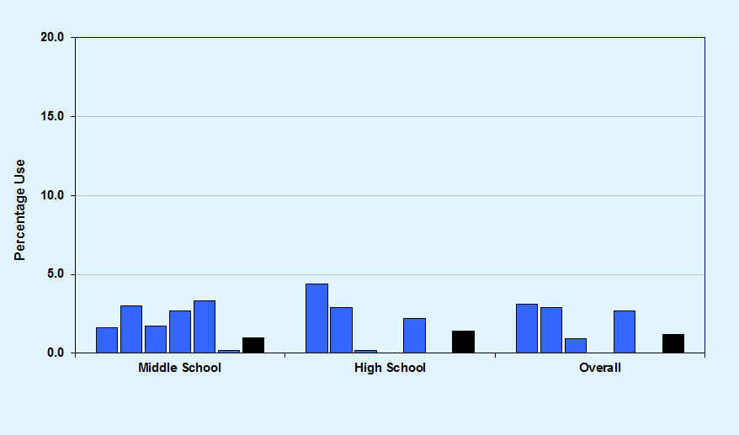
Graph 12
Past-30-day prescription pain reliever use, Hardee County 2008-2018 and Florida Statewide 2018
Hardee County 2008-2018
Florida Statewide 2018

Slide 20
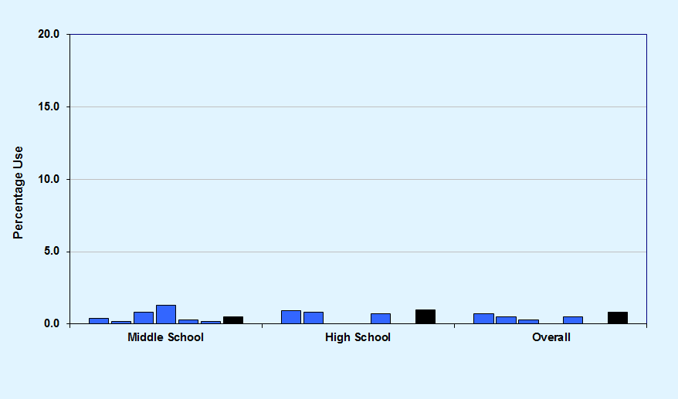
Graph 13
Past-30-day prescription amphetamines use, Hardee County 2008-2018 and Florida Statewide 2018
Hardee County 2008-2018
Florida Statewide 2018

Slide 21
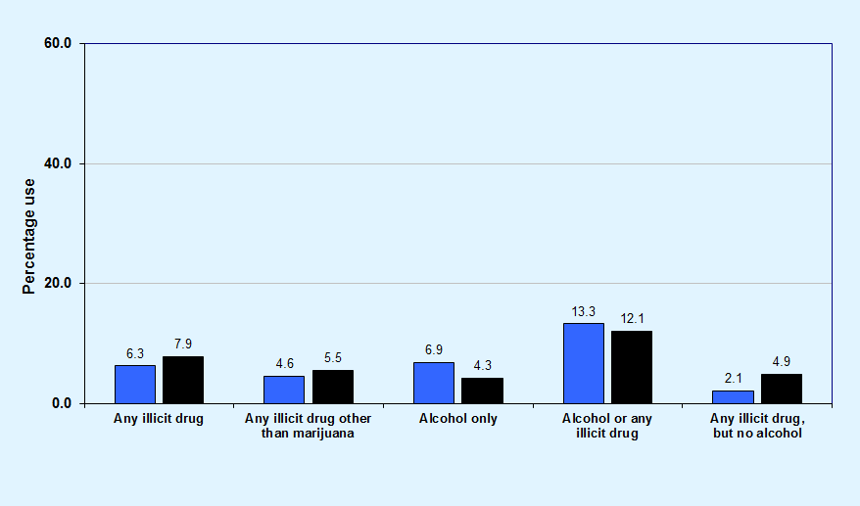
Graph 14
Past-30-day drug combination rates, among middle school students, for Hardee County and Florida Statewide, 2018
Hardee County
Florida Statewide

Slide 22
Key Findings
In Hardee County, 4.6% of surveyed students reported the use of any illicit drug other than marijuana in the past 30 days, compared to 5.5% across the statewide sample.
Past-30-day illicit drug other than marijuana use decreased from 8.2% in 2008 to 4.6% in 2018.
Among middle school students, 2.0% reported the use of inhalants in the past 30 days, a rate higher than any other illicit drug (except marijuana).

Slide 23
Other Antisocial Behaviors, Bullying, Symptoms of Depression, and Gang Involvement
2018 Results

Slide 24
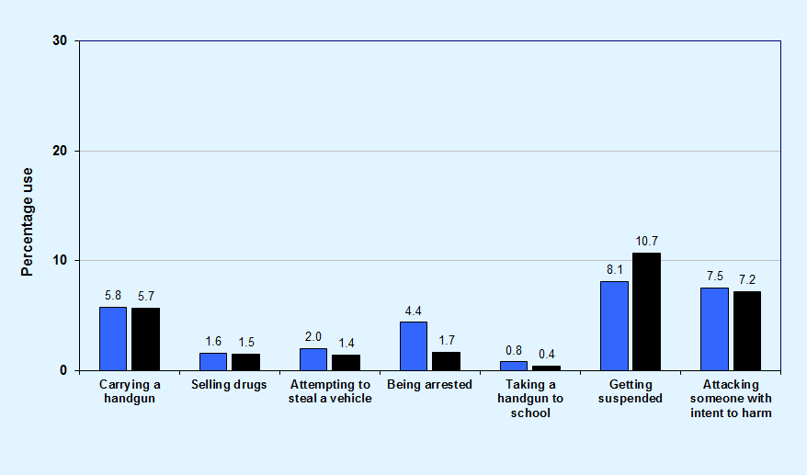
Comparisons of past-12-month delinquent behavior, among middle school students, for Hardee County and Florida Statewide, 2018
Graph 15
Hardee County
Florida Statewide

Slide 25
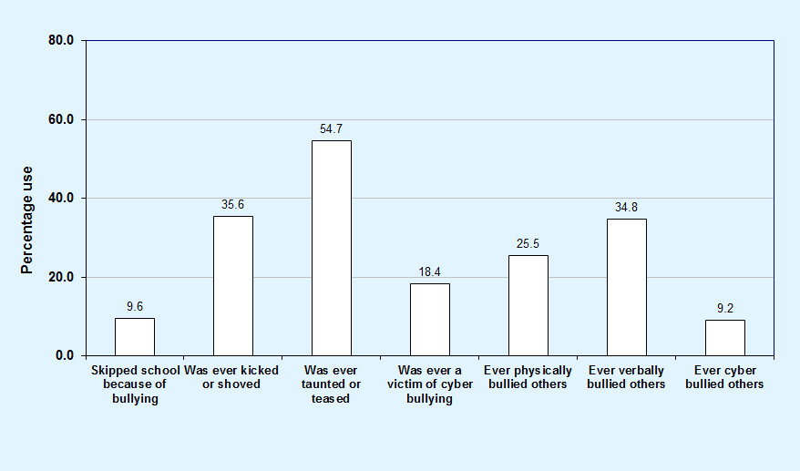
Graph 16
Bullying-related behaviors among Hardee County middle students, 2018

Slide 26
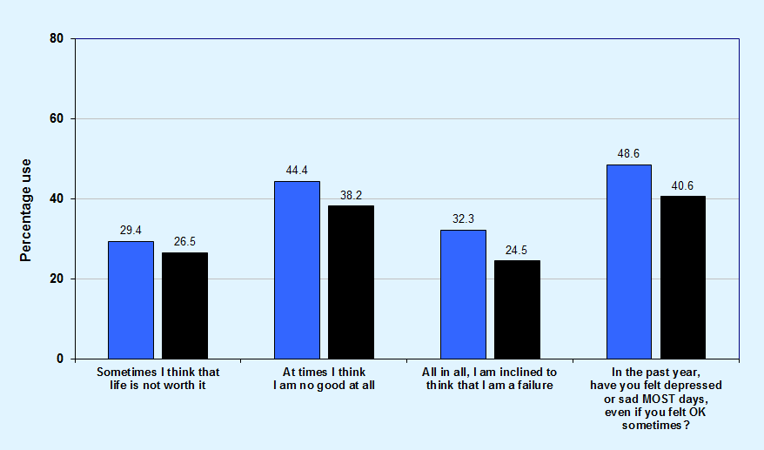
Graph 17
Comparisons of symptoms of depression, among middle school students, for Hardee County and Florida Statewide, 2018
Hardee County
Florida Statewide

Slide 27
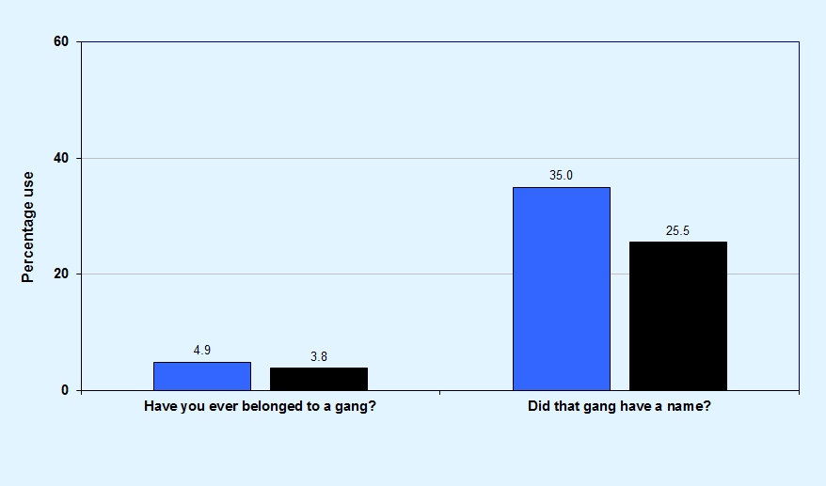
Graph 18
Gang involvement, among middle school students, Hardee County and Florida Statewide, 2018
Hardee County
Florida Statewide

Slide 28
Key Findings
In Hardee County, prevalence rates for Selling Drugs (1.6%), Attempting to Steal a Vehicle (2.0%), and Taking a Handgun to School (0.8%) are equal to or less than 2.0%.
Higher prevalence rates were reported for Getting Suspended (8.1%) and Attacking Someone with Intent to Harm (7.5%).
In Hardee County, 54.7% of students have been socially bullied, 35.6% have been physically bullied, and 18.4% have been cyber bullied.
In Hardee County, 48.6% of students reported feeling depressed or sad on most days in the past year.

Slide 29
Risk and Protective Factor Prevalence Rates for
M.S. and H.S. Students
2018 Results

Slide 30
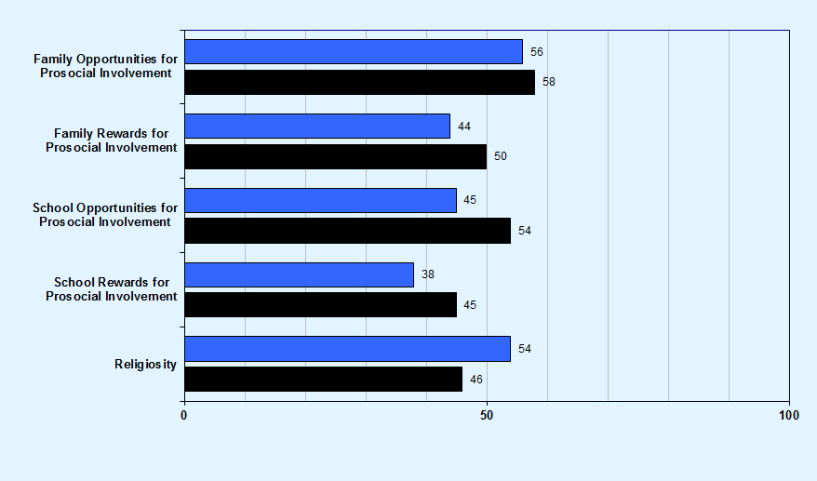
Graph 19
Protective factor prevalence rates for Hardee County and Florida Statewide middle school students, 2018
Hardee County
Florida Statewide

Slide 31
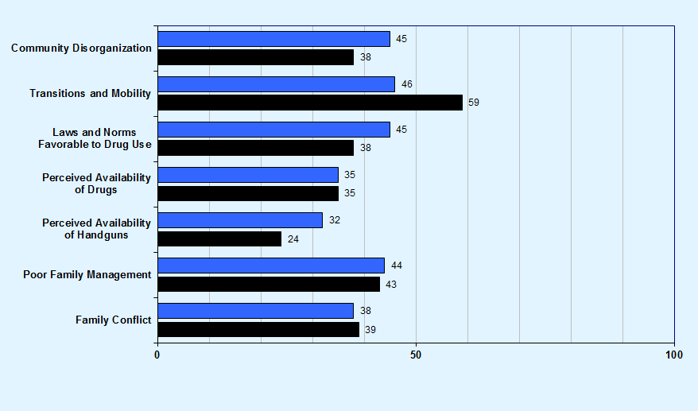
Community domain and family domain risk factor prevalence rates for Hardee County and Florida Statewide middle school students, 2018
Graph 20
Hardee County
Florida Statewide

Slide 32
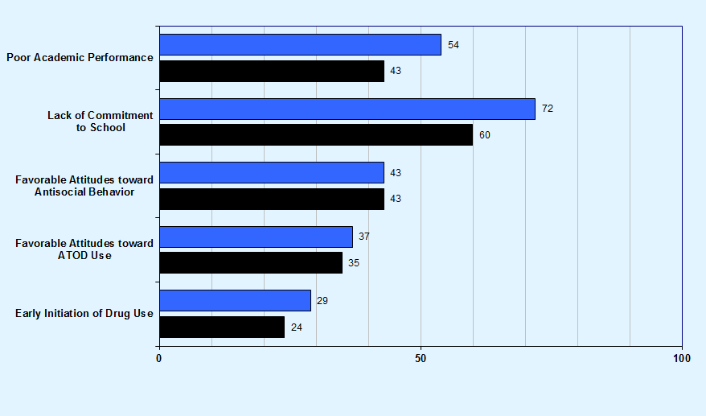
School domain and peer and individual domain risk factor prevalence rates for Hardee County and Florida Statewide middle school students, 2018
Graph 21
Hardee County
Florida Statewide

Slide 33
Key Findings
Protective factor prevalence rates—opportunities for improvement:
  Middle school students reported the lowest rates of protection for the School Rewards for Prosocial Involvement (38%) and Family Rewards for Prosocial Involvement (44%) scales.

Slide 34
Key Findings
Risk factor prevalence rates—opportunities for improvement:
  Middle school students reported the highest rates of risk for the Lack of Commitment to School (72%) and Poor Academic Performance (54%) scales.

