Slide 2
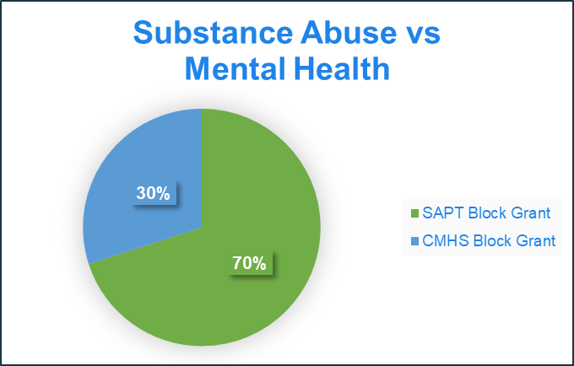
Base Block Grant Funding
2
Noncompetitive
Mandated by the U.S. Congress
The Substance Abuse and Mental Health Services Administration (SAMHSA) is responsible for two Block Grants:
  Substance Abuse Prevention and Treatment
  Community Mental Health Services

Slide 3
Block Grant Award and Expenditure Cycles
3
The block grants are awarded annually based on the federal fiscal year.
Once a two-year award cycle is complete and unspent funds are returned to SAMHSA, those funds are not eligible for carry forward.
It is important to note, while block grant budget authority may be reverted to the Department from the Managing Entities at the end of a state fiscal year, the funding may be reappropriated into the next fiscal year if they are in the first year of the two-year cycle.
Reverting budget authority at the end of the state fiscal year is not the same as reverting the funds back to SAMHSA at the end of the two-year expenditure cycle.
As the following slides show, over the last five years, the block grants have been fully expended each cycle.

Slide 4
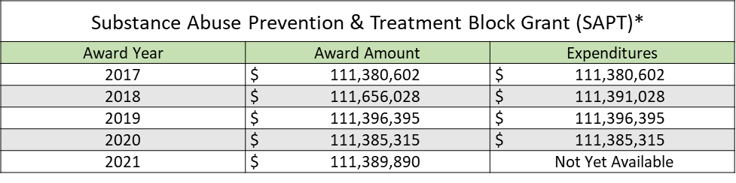
Substance Abuse Prevention and Treatment &
Community Mental Health Services
Block Grant Awards
4
Community Mental Health Services Block Grant (CMHS)*
Award Year | Award Amount | Expenditures
2017 | $ 36,710,162 | $ 36,710,162
2018 | $ 47,883,780 | $ 47,760,158
2019 | $ 44,999,189 | $ 44,999,189
2020 | $ 45,278,203 | $ 45,278,203
2021 | $ 47,760,557 | Not Yet Available
*Requires State Maintenance of Effort (MOE)

Slide 5
Required Set-Asides
5
*Both block grants are intended to serve individuals who are uninsured or under-insured.

Slide 6
Restrictions
6
No more than 5% of the award amount can be spent on administration
No inpatient hospital services (including state psychiatric hospitals)
No cash payments to intended recipients of health services
No land, building or medical equipment
No hypodermic needles/syringes
No substance abuse treatment services in penal or correctional institutions (assessments in jails or court settings are permissible)
Primary Prevention dollars cannot be used to fund the enforcement of alcohol, tobacco or drug laws.
Federal funds may not be used for lobbying

Slide 7
Supplemental Non-Recurring Grant Funding
7
In calendar year 2021, the Florida Department of Children and Families was awarded $344.2 million in federal supplemental funds by the U.S. Department of Health and Human Services, Substance Abuse and Mental Health Services Administration.
These non-recurring supplemental awards were funded through the Substance Abuse Prevention and Treatment, and the Community Mental Health Services Block Grants.

Slide 8
Covid-19 Relief Act
$159,285,189
8
The Covid-19 Relief Act was passed by Congress in December 2020.
$54.8 million was allocated as a supplemental to the Community Mental Health Services (CMHS) Block Grant.
$104.3 million was allocated as a supplemental to the Substance Abuse Prevention and Treatment (SAPT) Block Grant.
Expenditure period for use of the funds: 03/15/2021 – 03/14/2023
Initial state budget authority to begin spending funds was 07/01/2021
These funds were released to the Managing Entities in their schedule of funds on 08/06/2021.

Slide 9
Planning
9
Upon receipt of the initial supplemental awards through the Covid-19 Relief Act, the Department was required to draft a plan for use of the funds and submit to SAMHSA for approval.
This plan had to:
Follow the standard block grant requirements including eligible populations, set-asides and funding restrictions (unless otherwise stated in guidance documents specific to the supplementals)
Address existing needs and gaps exacerbated by the Covid-19 pandemic
Take into account the time-limited, non-recurring nature of the funds

Slide 10
Planning
10
Consideration was given to other funding that would be expiring during the expenditure period of the supplemental where continuation would be beneficial, specifically, the CARES Act, which was implemented in the Managing Entities Schedule of Funds on 01/29/2021.
Due to the CARES Act funding expiring on 12/31/2021, the Department determined Covid-19 Relief Funds would be used to continue the following activities from the CARES Act:
Neonatal Abstinence Syndrome (NAS)/ Substance-Exposed Newborn (SEN) Care Coordination
Adult Care Coordination
Children’s Care Coordination
Forensic Community Diversion
Short-Term Residential Treatment

Slide 11
American Rescue Plan (ARP)
$184,968,159
11
The American Rescue Plan was passed by Congress in March of 2021.
$94.8 million was allocated in a supplemental to the Community Mental Health Services (CMHS) Block Grant.
$90.1 million was allocated in a supplemental to the Substance Abuse Prevention and Treatment (SAPT) Block Grant.
Expenditure period for use of the funds: 09/01/2021 – 09/30/2025

Slide 12
Planning
12
Upon receipt of the American Rescue Plan supplemental in May 2021, the Department was again required to submit a plan to SAMHSA for approval.
This plan followed the same guidelines as the Covid-19 Relief supplemental (unless otherwise specified in the guidance specific to these funds.)
The Department built upon the foundation of the first supplemental plan, picking up the activities from the first plan as the Covid-19 Relief funds expire and adding an additional year to the following services/activities from the State Opioid Response Grant as it expires:
Behavioral Health Consultants (BHCs)
Recovery-Oriented Quality Improvement Specialists (ROQIS)
Recovery Community Organizations (RCOs)
Narcan Distribution

Slide 13
Planned Activities
13
The following statewide activities were identified to be funded by the supplemental block grant funds:
Statewide Suicide Prevention Activities
988 Suicide Hotline
Workforce Development Training
Peer Certification Scholarships
Information Technology
First Responder Crisis Support Line

Slide 14
State Targeted Response (STR) and
State Opioid Response (SOR) Grants
14
STR – Year 1 (May 2017 – April 2018) – $27,150,403
STR – Year 2 (May 2018 – April 2019) – $27,150,403
SOR I – Year 1 (September 2018 – September 2019) – $76,186,527
SOR I – Year 2 (September 2019 – September 2020) – $50,056,851
SOR II – Year 1 (September 2020 – September 2021) – $100,170,437
SOR II – Year 2 (September 2021 – September 2022) – $100,170,437
Examples of Opioid Grant Activities
  Medication Assisted Treatment (MAT) Services (including Hospital Bridge Programs and Vivitrol Assisted Treatment)
  American Society of Addiction Medicine’s Continuum Software Licenses
  MAT, Opioid, and Stimulant Use Disorder Training (Behavioral Health, Courts, Corrections, Jails, Physicians)
  Harm Reduction Training
  Primary Prevention Services
  Recovery Community Organizations / Peer Support
  Behavioral Health Consultation (BHC)
  Recovery Oriented Quality Improvement Specialists (ROQIS)
  Naloxone Distribution
  Oxford House – Recovery Residences
  Mobile Buprenorphine Pilot
  Addiction Training Curricula Development for Medical Schools

Slide 15
Use Across Fiscal Years
Grant | SFY 20-21 |  |  |  | SFY 21-22 |  |  |  | SFY 22-23 |  |  |  | SFY 23-24 |  |  |  | SFY 24-25
SAPT | $27.8 M | $83.5 M |  |  | $27.8 M | $83.5 M |  |  | $27.8 M | $83.5 M |  |  | $27.8 M | $83.5 M |  |  | $27.8 M | $83.5 M
Recurring Base
CMHS | $11.9 M | $35.8 M |  |  | $11.9 M | $35.8 M |  |  | $11.9 M | $35.8 M |  |  | $11.9 M | $35.8 M |  |  | $11.9 M | $35.8 M
Recurring Base
Opioid | $12.5 M | $75.2 M |  |  | $25.0 M | $75.2 M |  |  | $25.0 M
09/30/21 – 09/29/22
CARES |  |  | $18.6 M |  | $1.9 M
12/11/20 - 12/31/21
COVID Relief |  |  |  |  | $108.7 M |  |  |  | $50.6 M
07/01/21 - 03/14/23
American Rescue Plan |  |  |  |  |  | $12 M |  |  | $58.1 M |  |  |  | $57.4 M |  |  |  | $57.4 M
09/01/21 - 06/30/25
TOTAL | $265.3 M |  |  |  | $381.8 M |  |  |  | $292.7 M |  |  |  | $216.4 M |  |  |  | $216.4 M
*SAPT and CMHS recurring base appropriations are for illustrative purposes only. Future State Fiscal Year appropriations are based on the Federal Fiscal Year 2021 grant award amount.
*American Rescue Plan – SFY 23-24 and SFY 24-25 appropriations are for illustrative purposes only. These amounts are estimates based on half of the remaining federal grant balance being used in each state fiscal year.

Slide 16
Questions?

