Slide 1
Baker Act Reporting Center Overview
Annette Christy, Ph.D.
Associate Professor
Director of the Baker Act Reporting Center (https://www.usf.edu/cbcs/baker-act/)
Department of Mental Health Law & Policy
University of South Florida
achristy@usf.edu
Presented at the November 2021 Meeting of the Florida Commission on Mental Health and Substance Abuse

Slide 2

History
Established in 1996 after a statutory change requiring submission of Baker Act initiation forms to AHCA
In 2012 statutory change led to DCF being the agency designated to receive the forms
Since 1996 the Baker Act Reporting Center at USF has received forms, entered data, and produce reports from those data
We have entered data for more than 3 million Baker Act exams
Note that only forms for involuntary exams are submitted. Nothing is submitted to us for voluntary exams

Slide 3
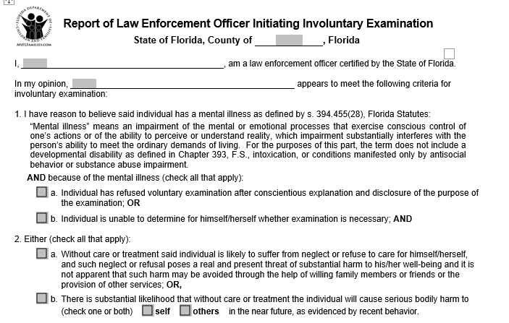
3052a
Form is contained in F.A.C. 65E-5
Partial view of form to the left
Forms available at:
https://www.myflfamilies.com/service-programs/samh/crisis-services/baker-act-forms.shtml

Slide 4
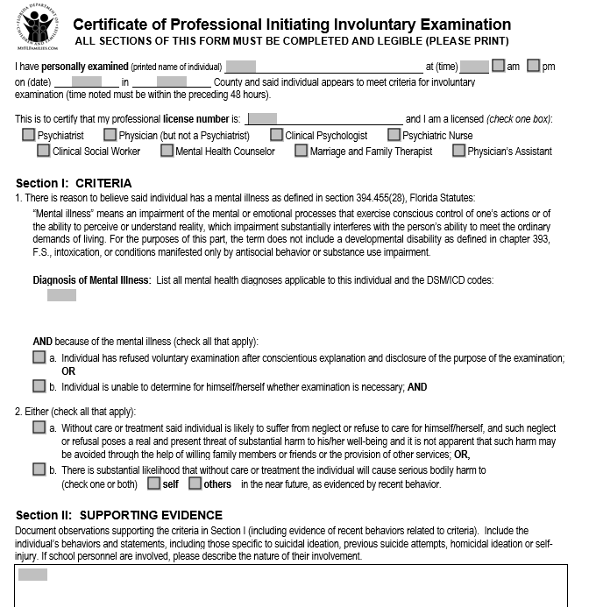
3052B
Form is contained in F.A.C. 65E-5
Partial view of form to the left
Forms available at:
https://www.myflfamilies.com/service-programs/samh/crisis-services/baker-act-forms.shtml

Slide 5
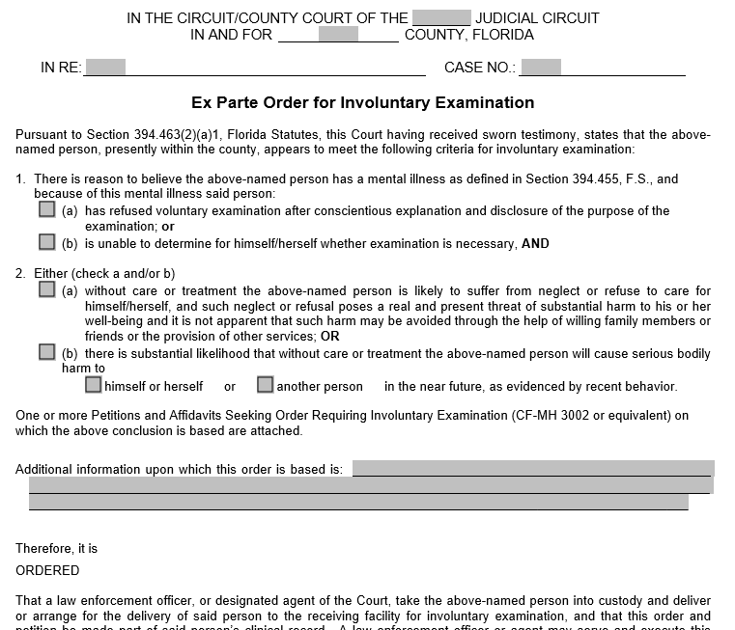
3001
Form is contained in F.A.C. 65E-5
Partial view of form to the left
Forms available at:
https://www.myflfamilies.com/service-programs/samh/crisis-services/baker-act-forms.shtml

Slide 6
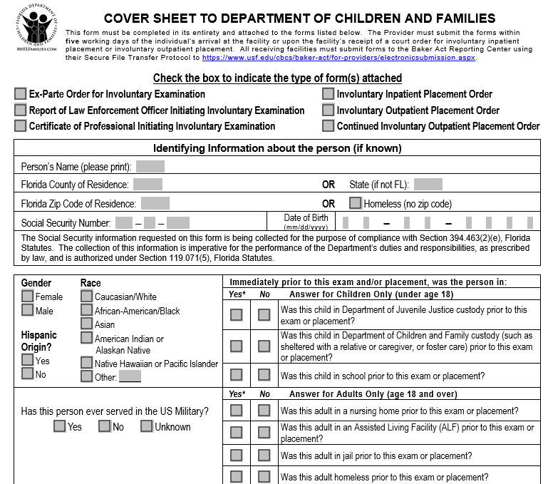
3118
Form is contained in F.A.C. 65E-5
Partial view of form to the left
Forms available at:
https://www.myflfamilies.com/service-programs/samh/crisis-services/baker-act-forms.shtml

Slide 7
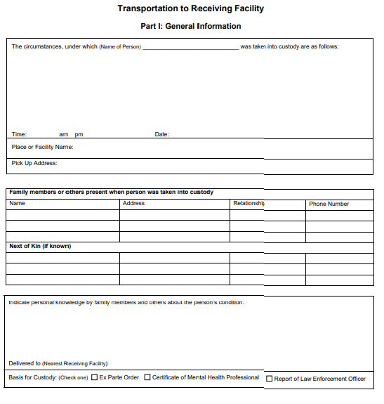
Form Of Interest
3100
Form is contained in F.A.C. 65E-5
Partial view of form to the left
Forms available at:
https://www.myflfamilies.com/service-programs/samh/crisis-services/baker-act-forms.shtml

Slide 8
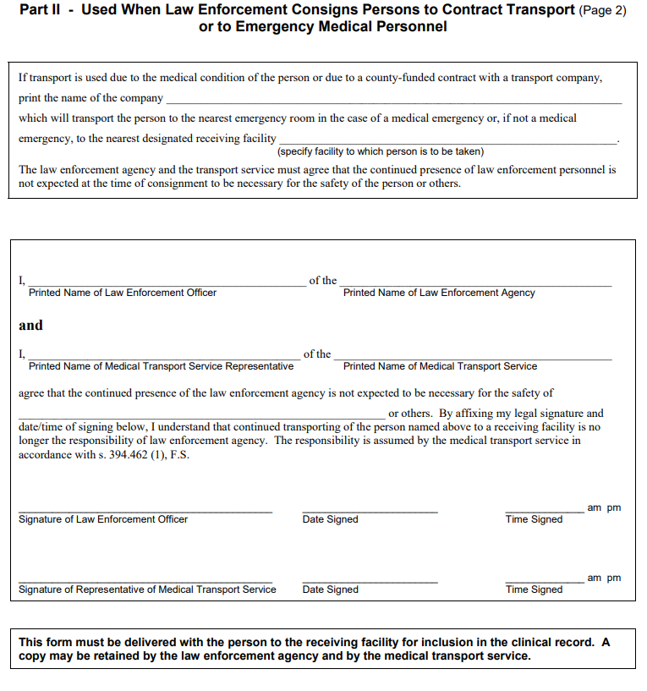
3100 Page 2
Form is contained in F.A.C. 65E-5
Partial view of form to the left
Forms available at:
https://www.myflfamilies.com/service-programs/samh/crisis-services/baker-act-forms.shtml

Slide 9

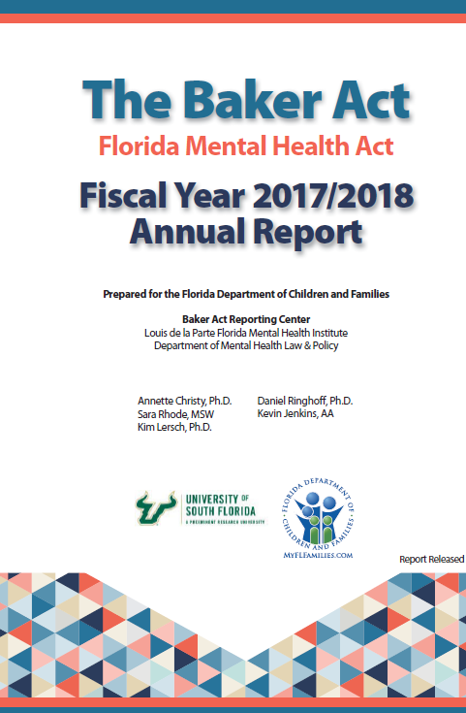
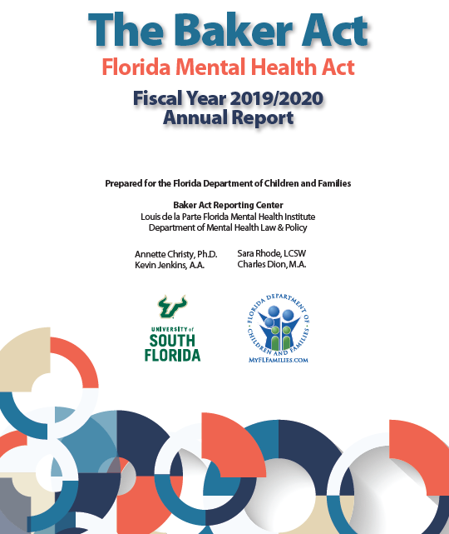
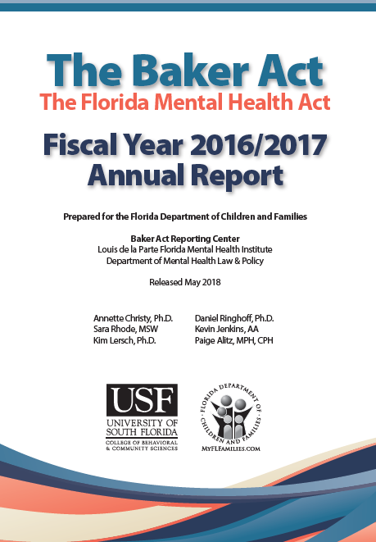
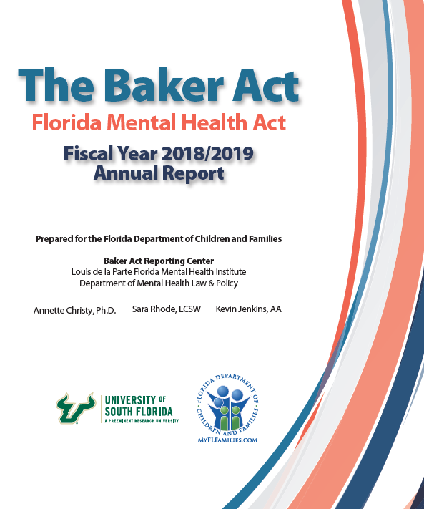

Slide 10
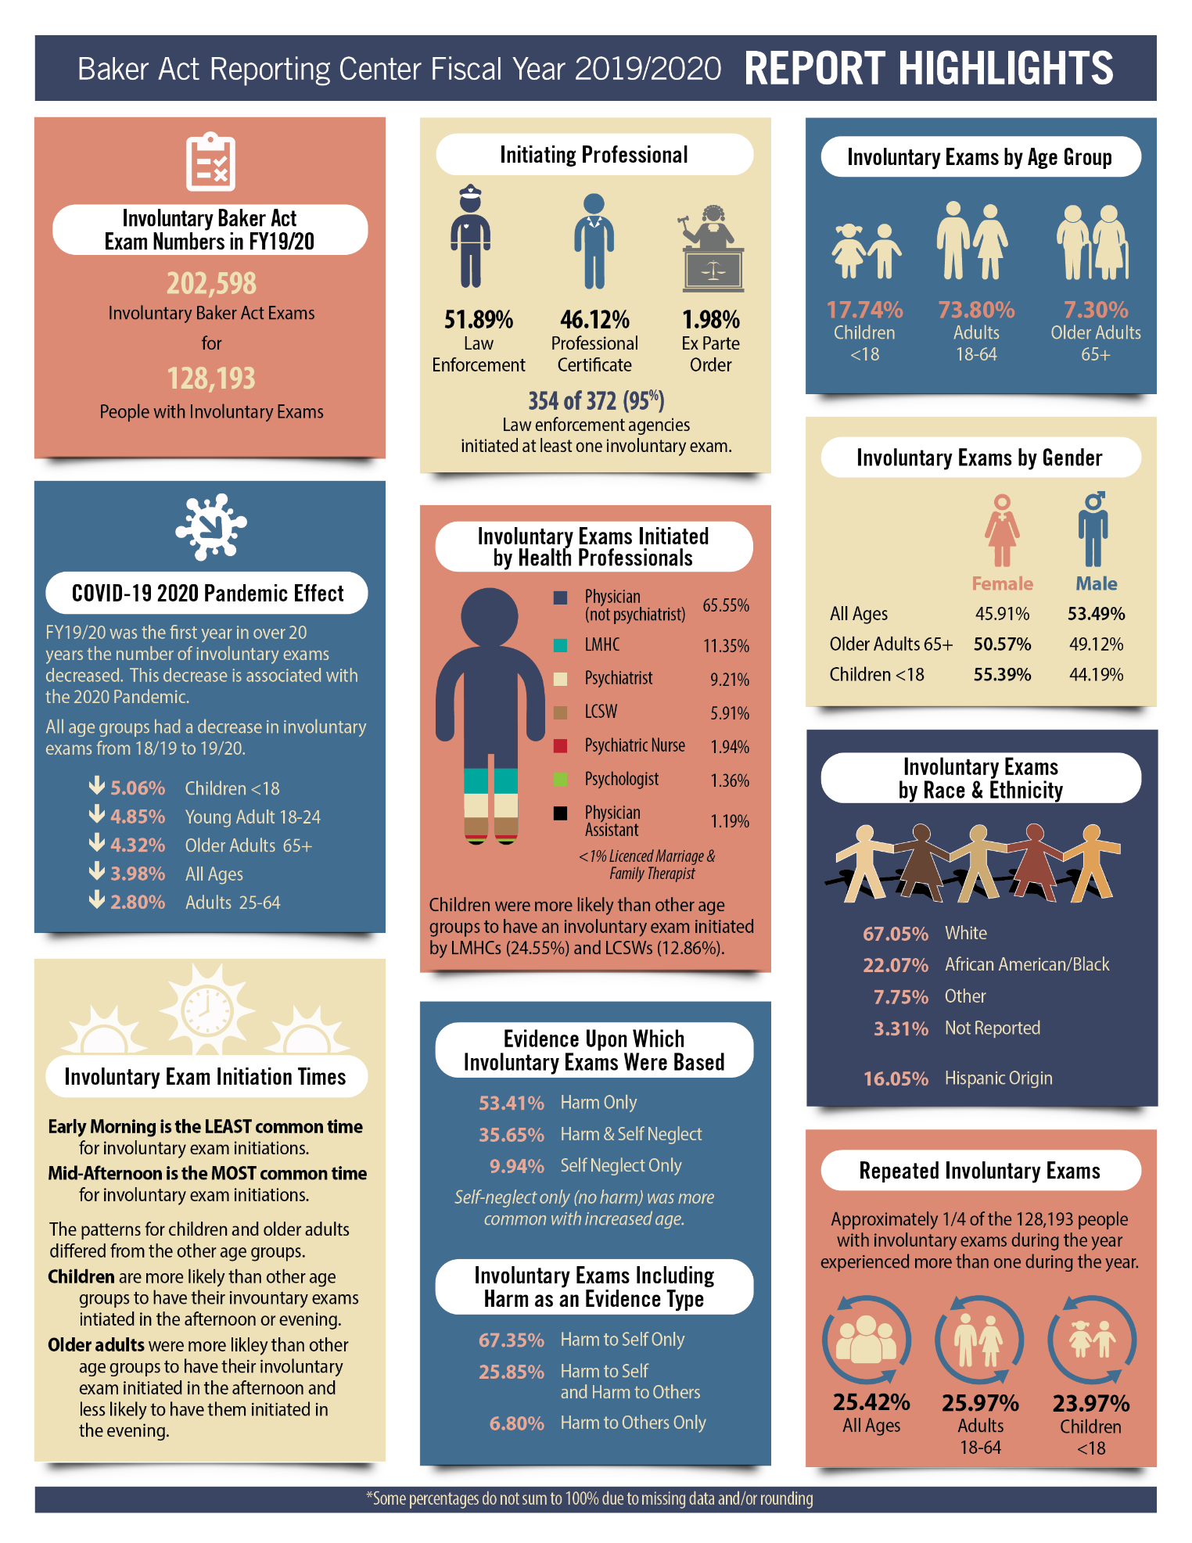
Initiation Type for FY19/20

Slide 11
Involuntary Exams Comparing Months Across Years: All Ages

Slide 12
Summary of Issues & Considerations
Baker Act Data
Form revision
  Avoid repetition of items
  Increase chances of complete & accurate information
Receipt of additional forms
Form of reporting (report documents, dashboarding)
Focus of analysis and reporting (including with collaborators)
Collaborate with FL DOE on how our data relates to their Baker Act data reporting requirements

Slide 13
Summary of Issues & Considerations
Marchman Act Data
Developing a Marchman Act Data System is More Complex Than for Baker Act
  Two stage court process
  Protective custody in jail
  Brought to a substance abuse treatment facility/detox
  Brought to an Emergency Department
Such a system is possible
  One idea is to develop it in stages

Slide 14
Questions?

Slide 15


Commission on Mental Health and Substance Abuse Meeting
November 17, 2021

