Slide 1

Dayspring Village
Forensic Mental Health
Douglas Adkins, Dayspring Village
August 24, 2022

Slide 2

Forensic Redesign
Discussion started in 2005
Phoenix Program started in Jan 2007
Forensic Redesign has worked
Expanded with new programs
Creates a bridge that ends conditional release
Provides movement in the forensic system

Slide 3

Let’s talk about PHOENIX
Care Coordination Services
Access to Onsite Care
Resident Engagement – Day #1
Benefit Restoration
On site groups
Weekly Staffing
Discharge Planning

Slide 4
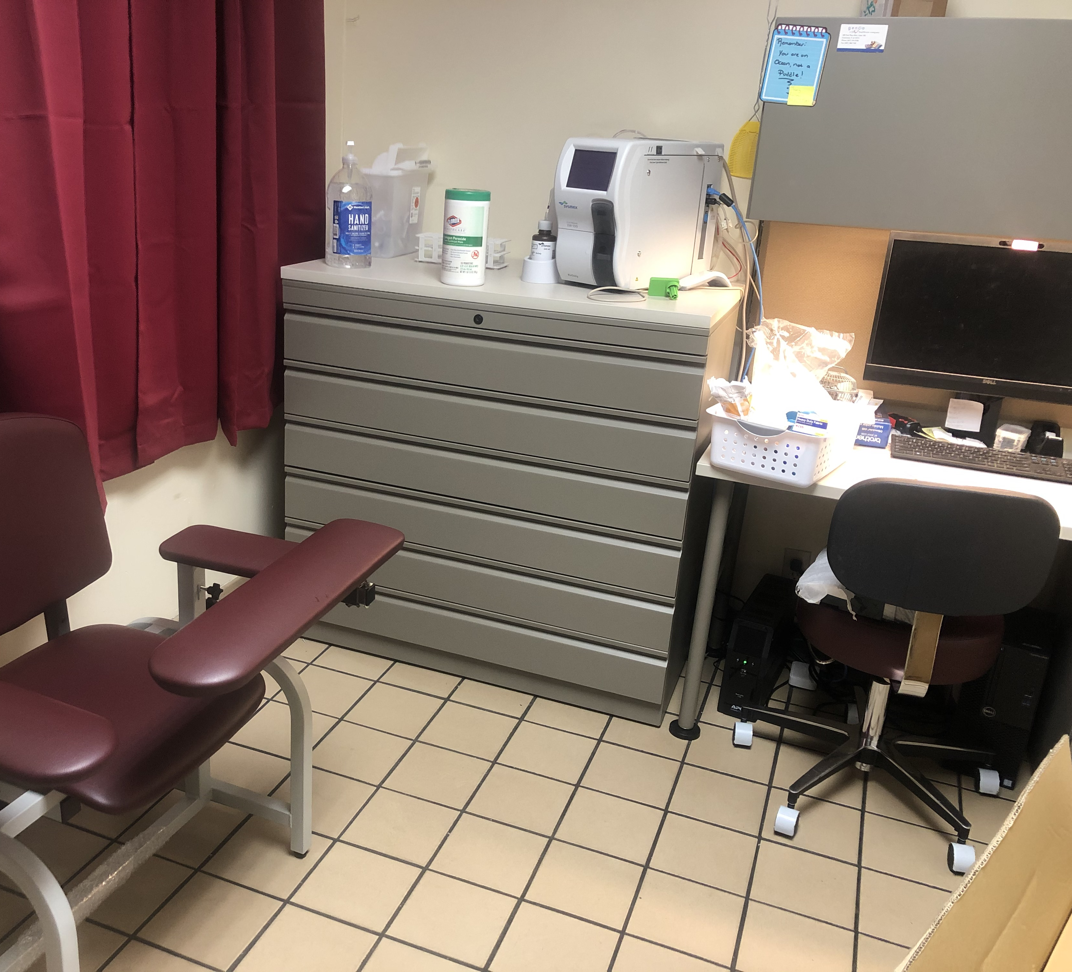
Let’s Get into Specifics
There are three designated Care Coordinators who meet with the residents daily
The Psychiatrist comes onsite twice a week for clinic.
There is a CLIA waived CBC Sysmex Hematology analyzer that will allows us to test onsite.
DSV has med techs with phlebotomy certification.

Slide 5
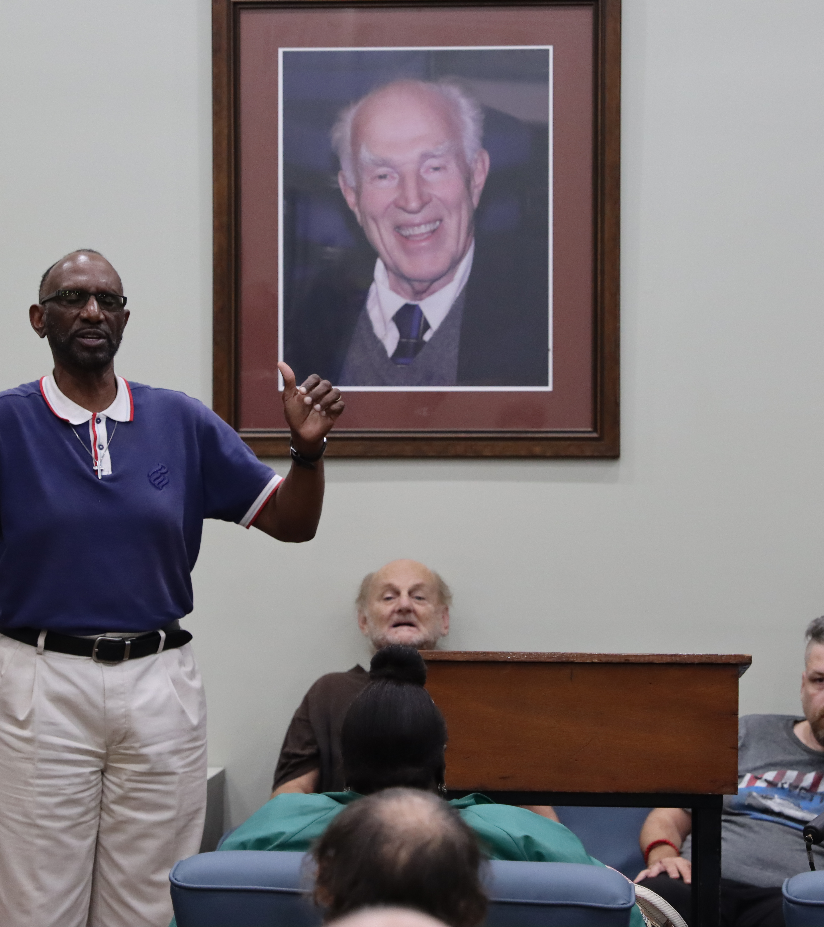
Resident Engagement Mobility = Community
Resident Engagement
Money Management Program (Pex)
Cigarette Management
Excursions in community
Events on the campus
Substance Abuse Education Classes
Volunteer Program
Gift Card Incentives – they work!

Slide 6
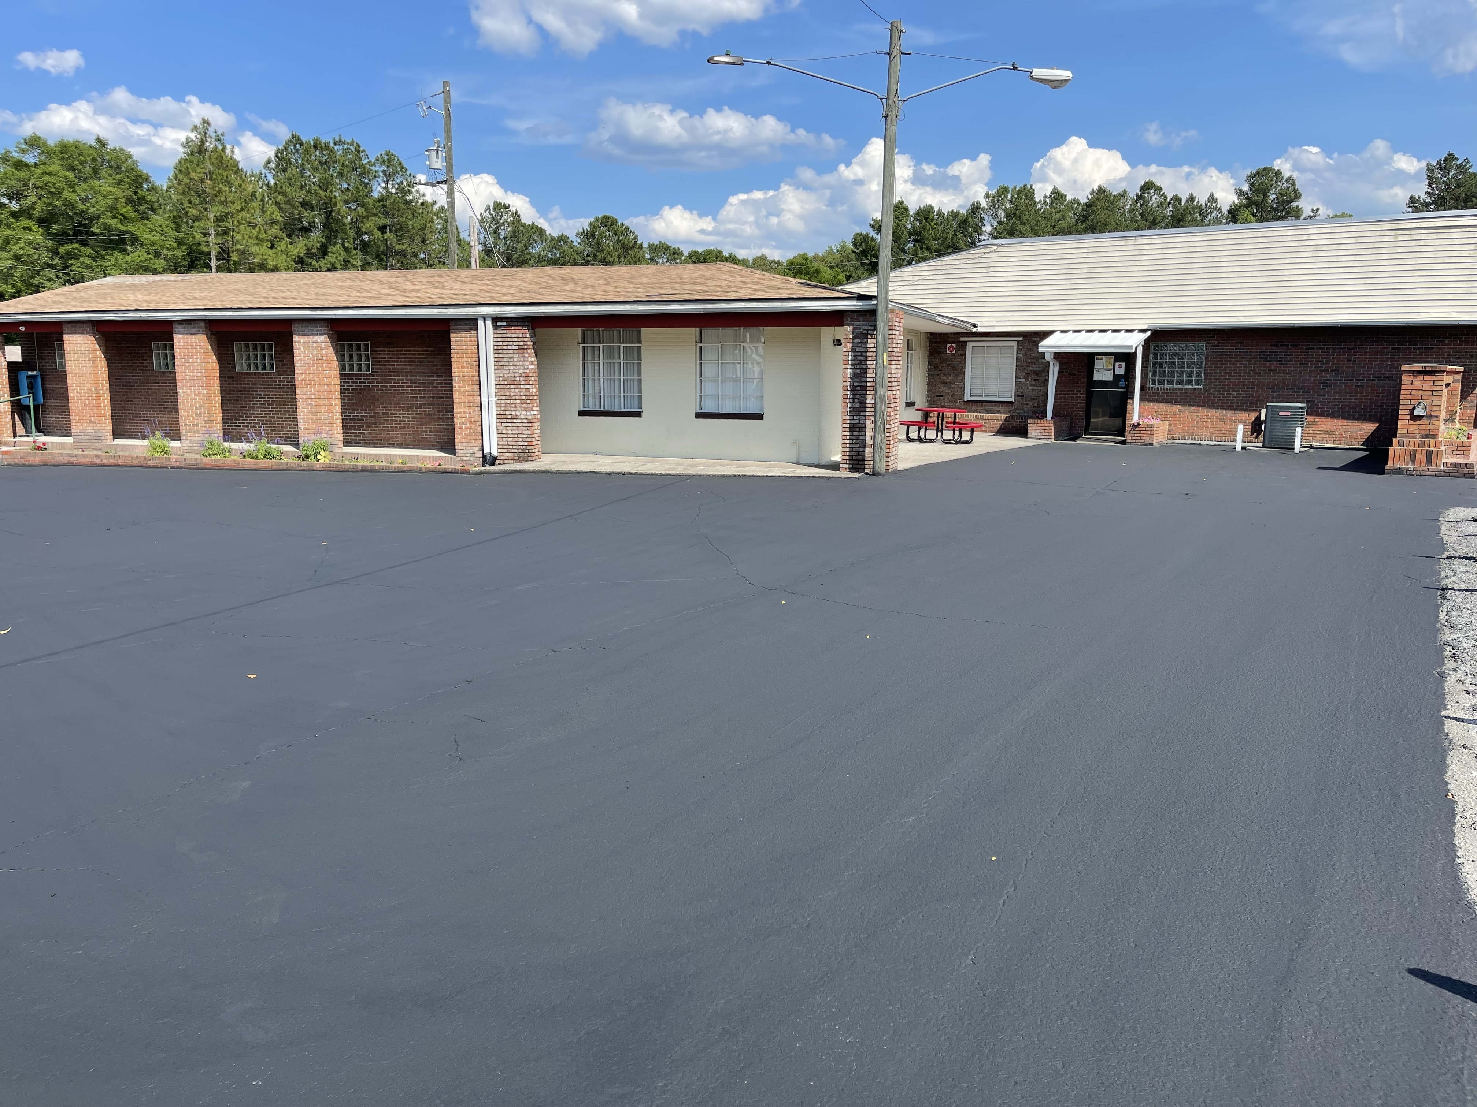
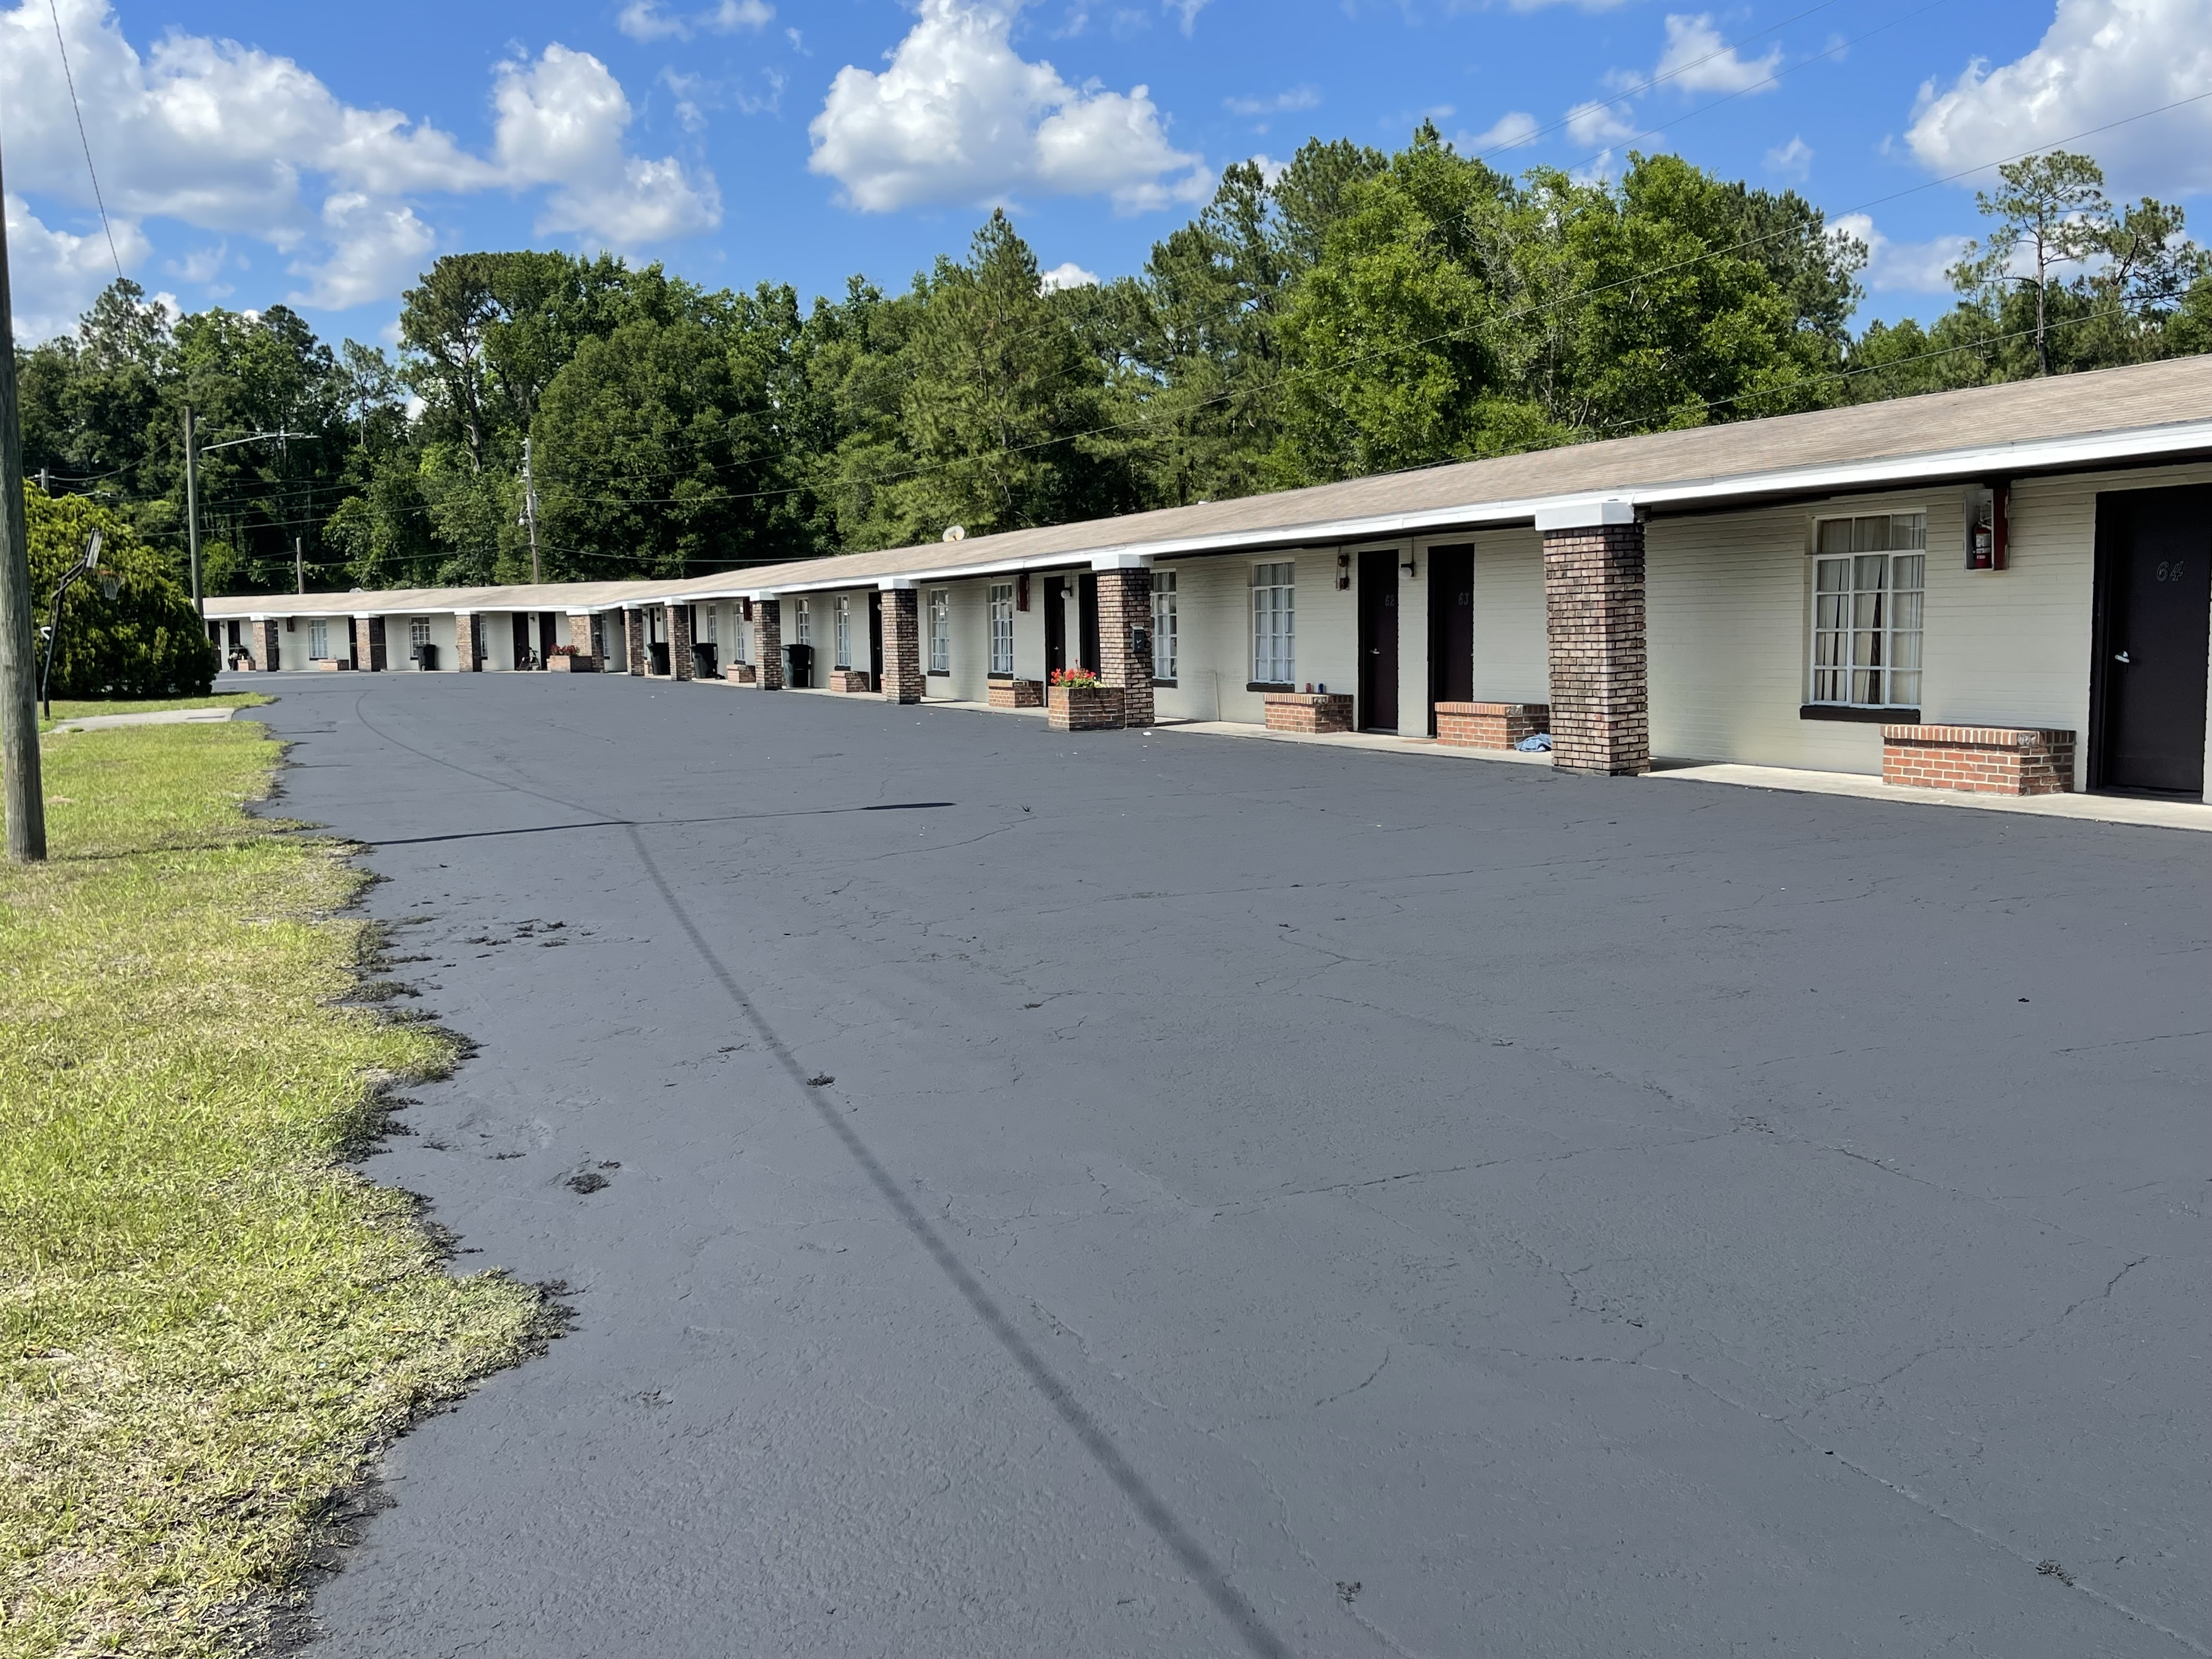
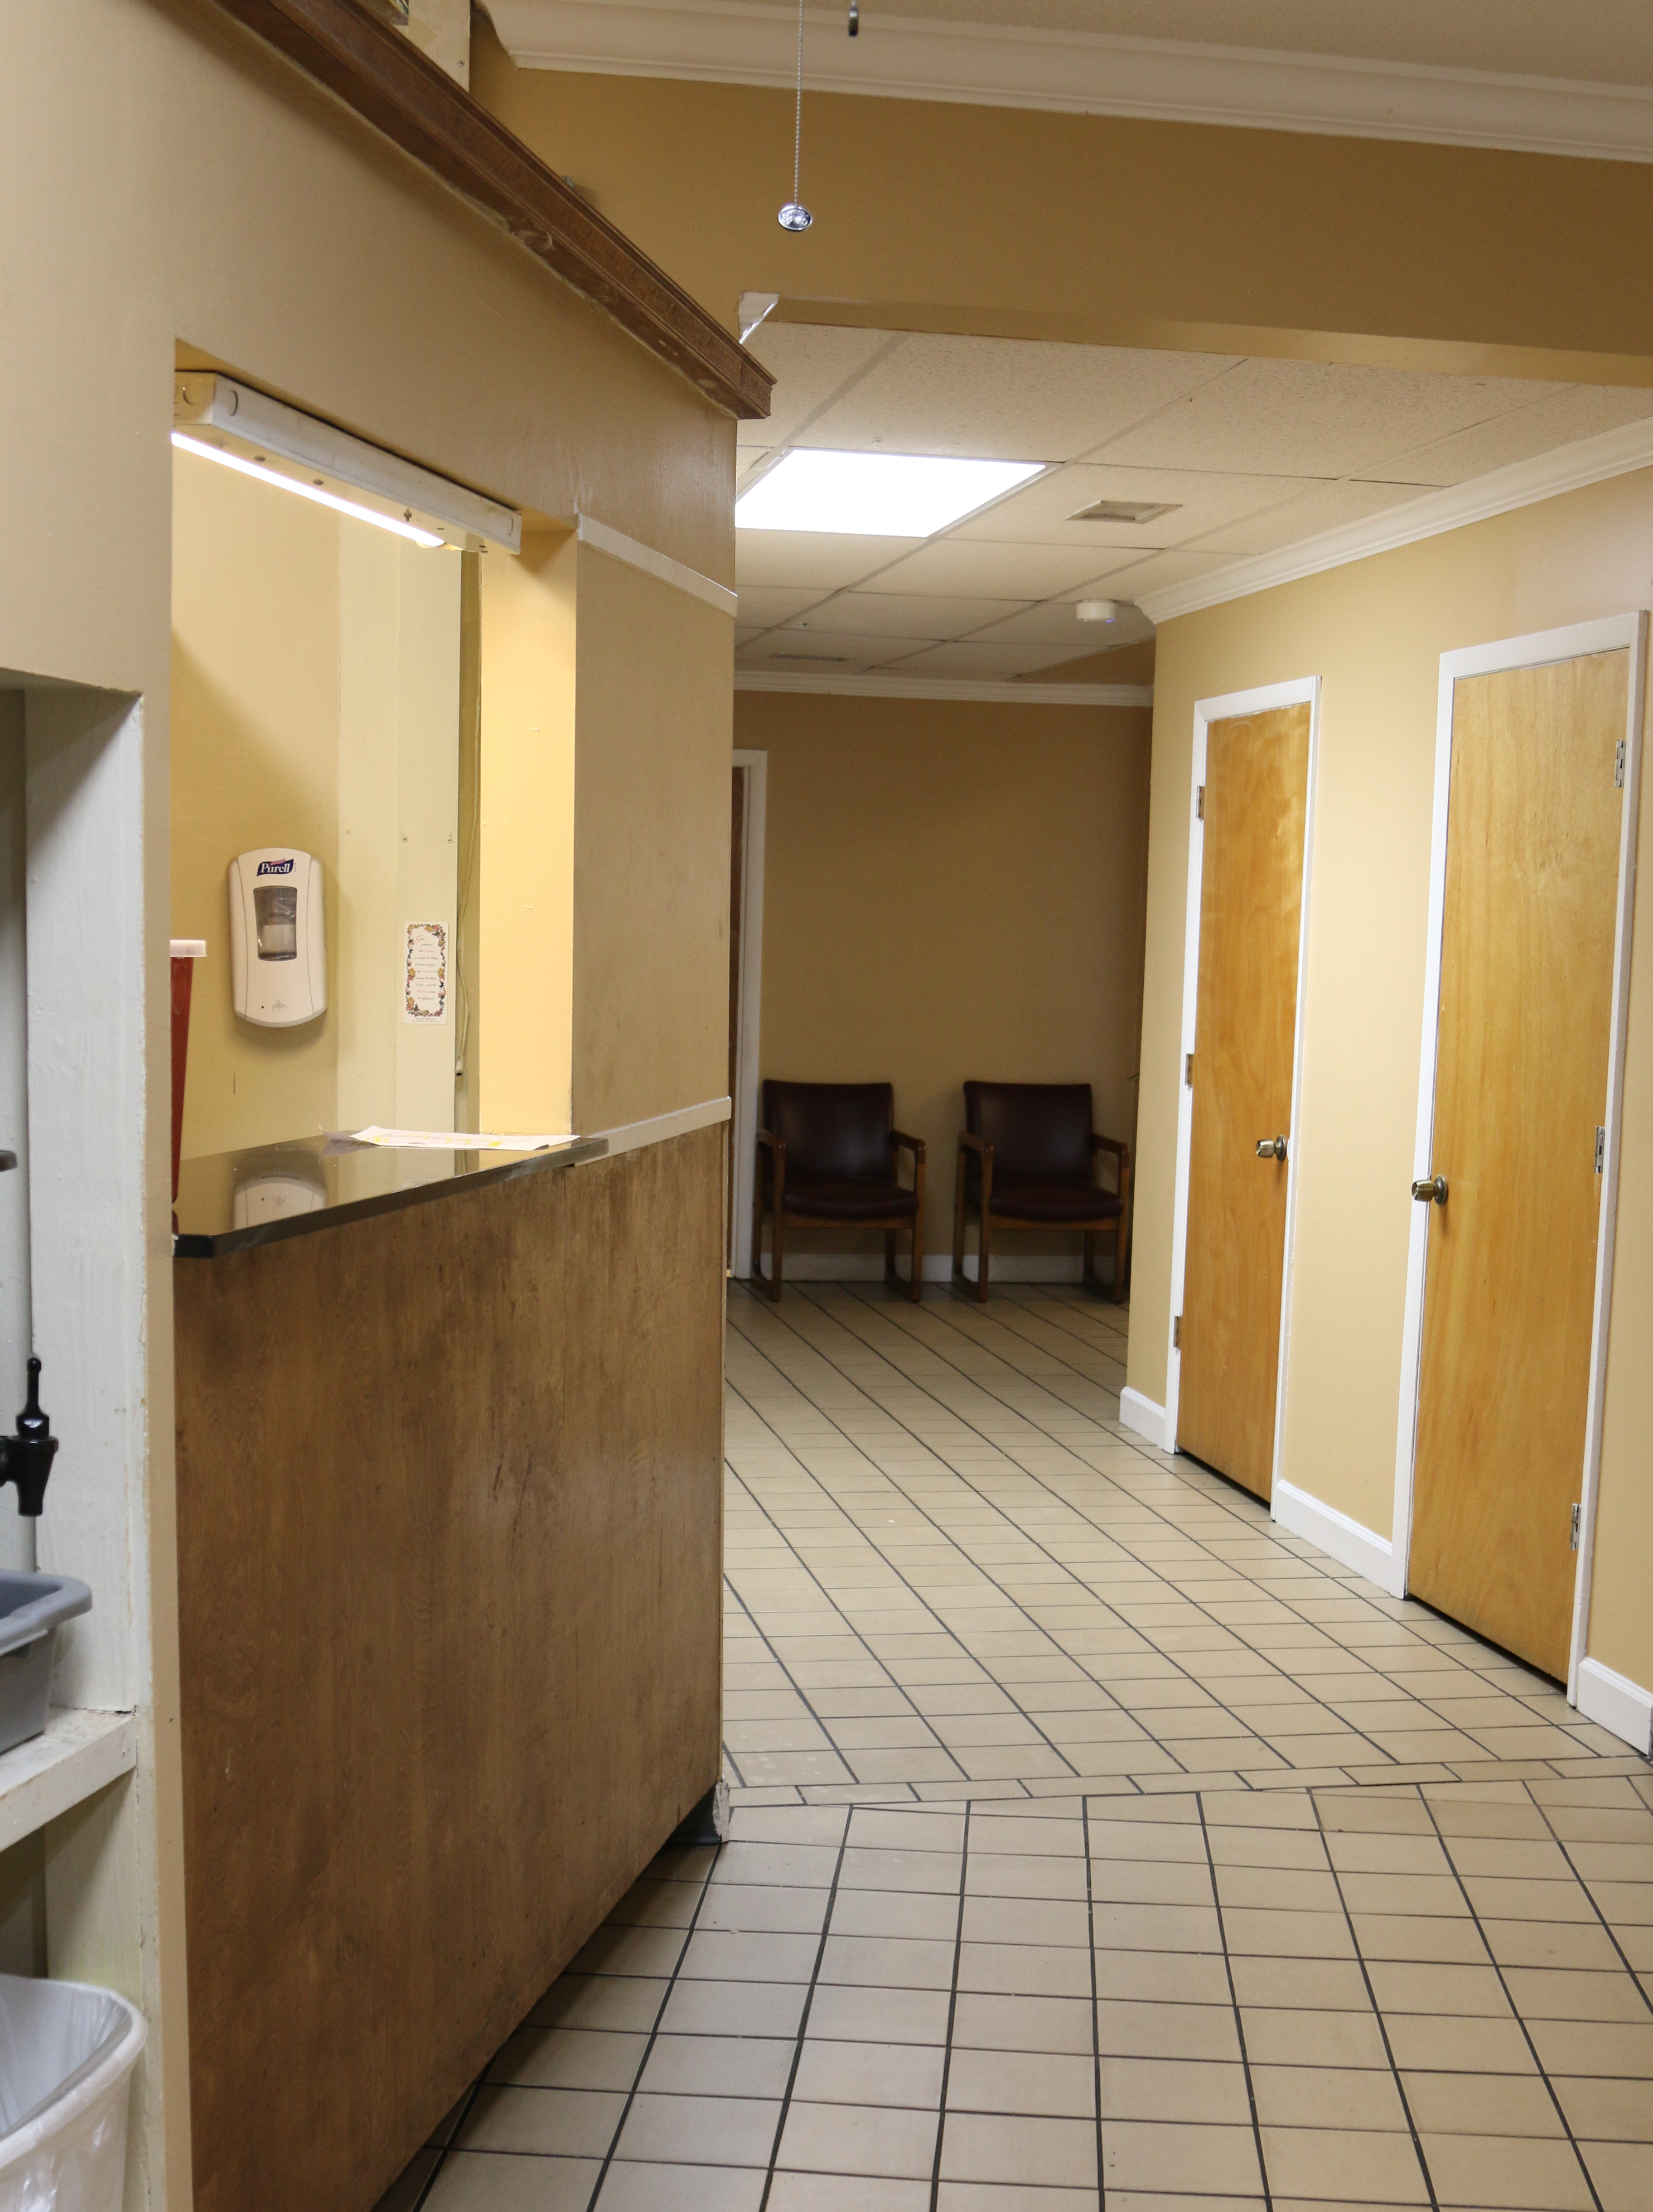
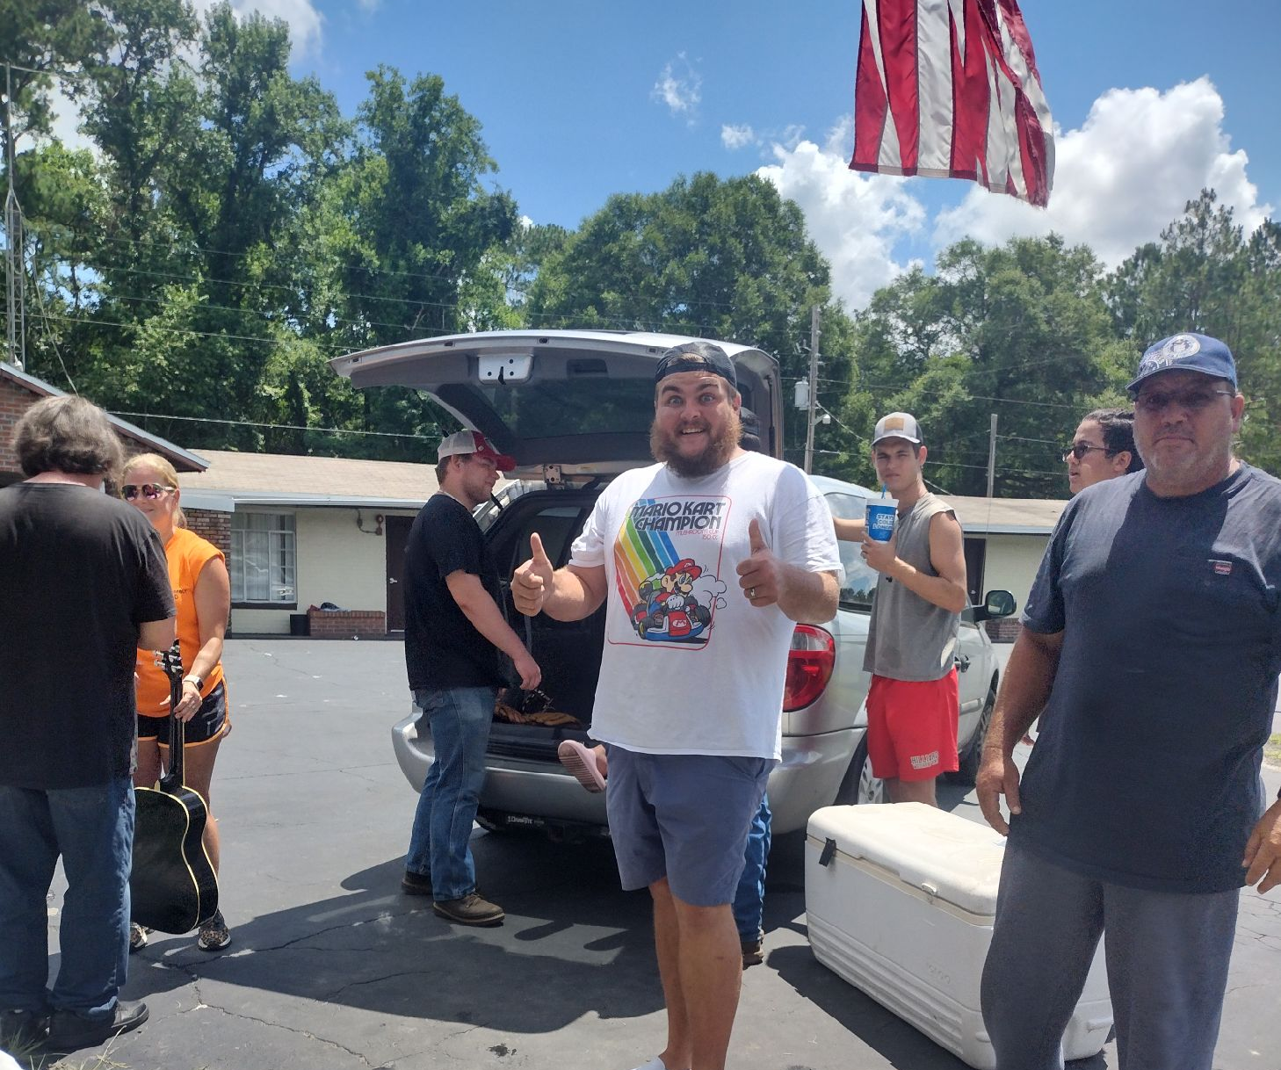
PHOENIX Program at DAYSPRING VILLAGE

Slide 7
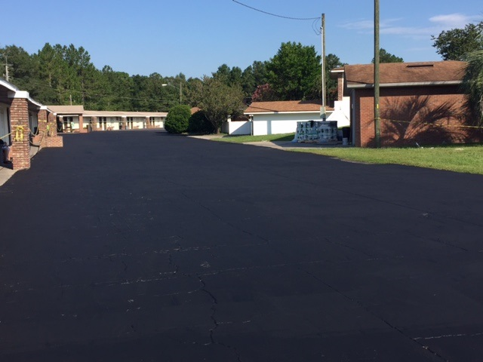
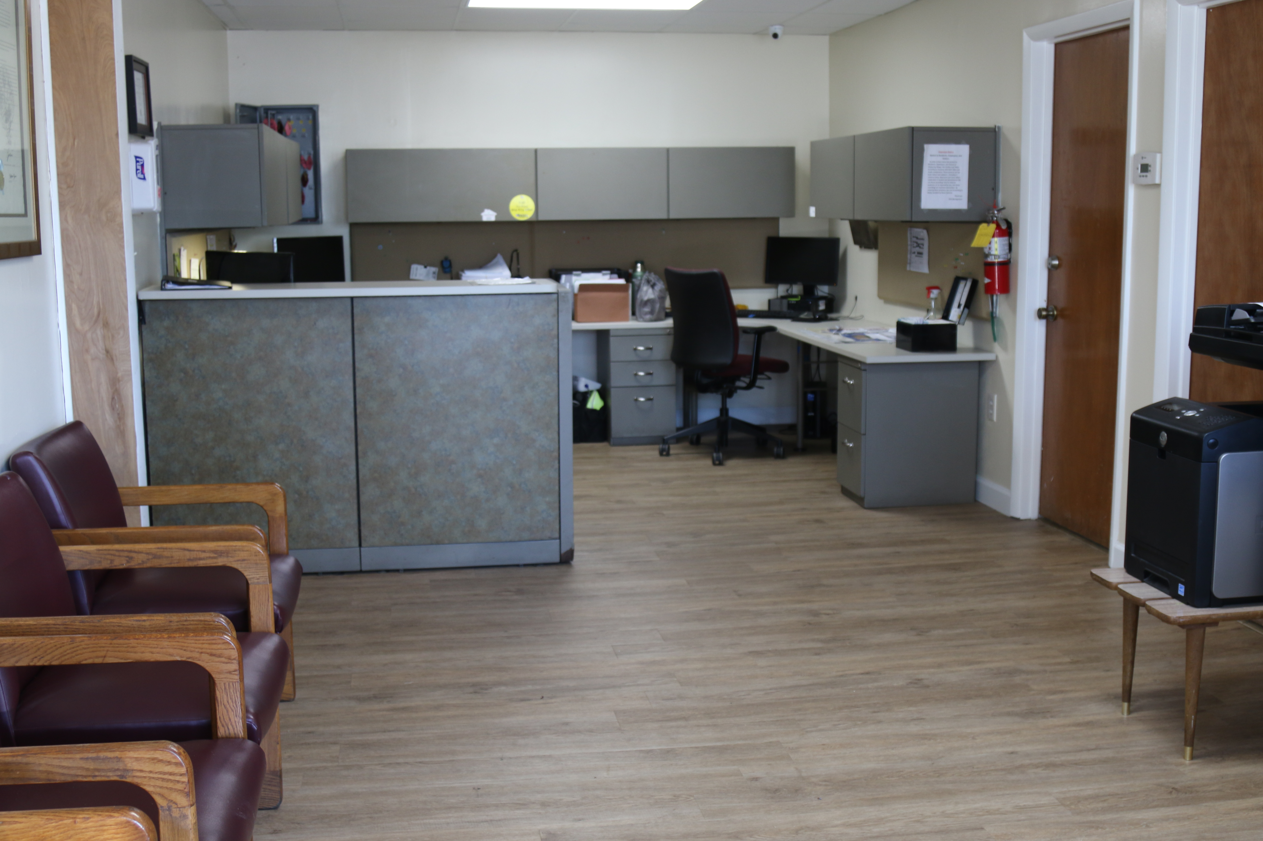
15 Acrea Campus Hilliard, Florida

Slide 8
There are 51,010 adults with Schizophrenia hospitalizations 2020
The report found that Clozapine was more effective in treatment of Schizophrenia than all other antipsychotics.
It is estimated only 9% of the adult population with Schizophrenia in Florida are being prescribed Clozapine. http://www.medicaidmentalhealth.org

Slide 9

POINT CLICK CARE - electronic health record
We implemented Point Click Care in 2017
This new technology has revolutionized our operational platform
The ability to track data points is powerful and accurate with point of care technology.
This platform is 100% HIPPA secured

Slide 10
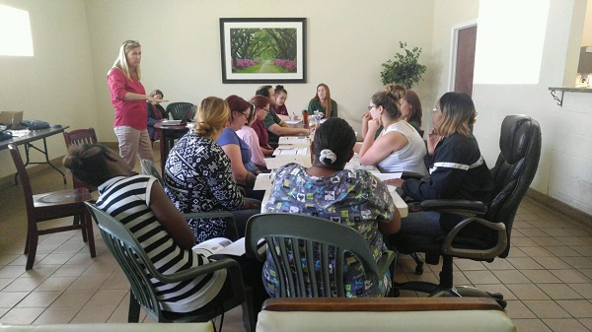
FUNDING – blended methodology
The base is the LSF funding – monthly amount
The social security benefits when restored help meet the program needs.
Optional State Supplementation will provide the resident $54 personal needs allowance.
Medicaid – Assistive Care Services
VA – Aid and Attendance

Slide 11
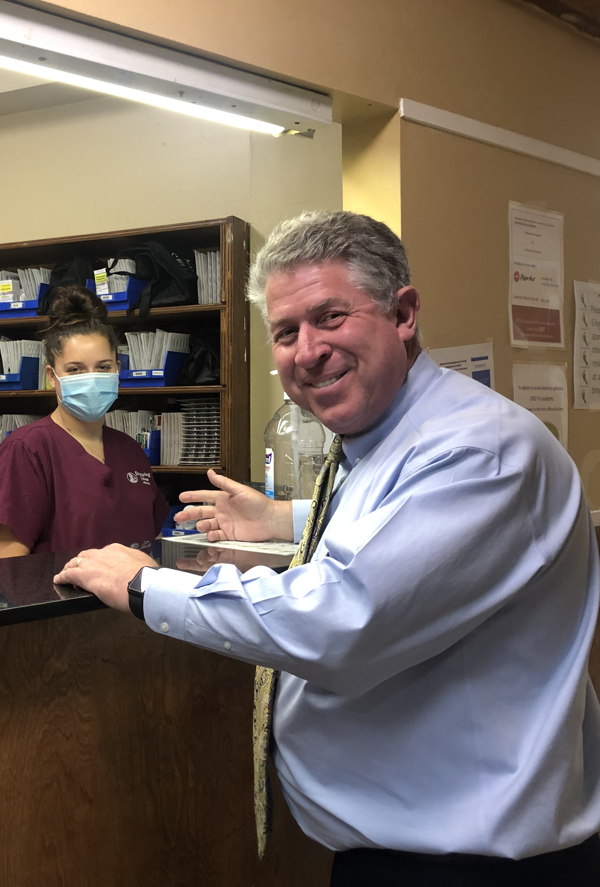
Phoenix Data – what is happening?
45 Residents in program today
73 Discharged from program
Average Length of Stay 26 Months
( COVID19 PHE impacts )

Slide 12
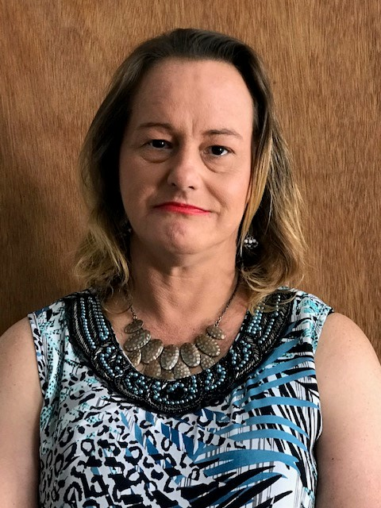
DISCHARGE PLANNING – team effort
There is a weekly team meeting to discuss discharge planning.
The team will include the mental health provider ( Starting Point Behavioral Health) and the DSV Care Coordinators.
Court approved passes – 3 day – 5 day and 10 day help us examine placement options for safety.
We will examine the “pattern of conduct” and look for supportive environments that align with consumer choices.

Slide 13
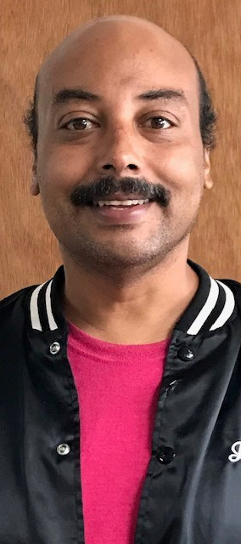
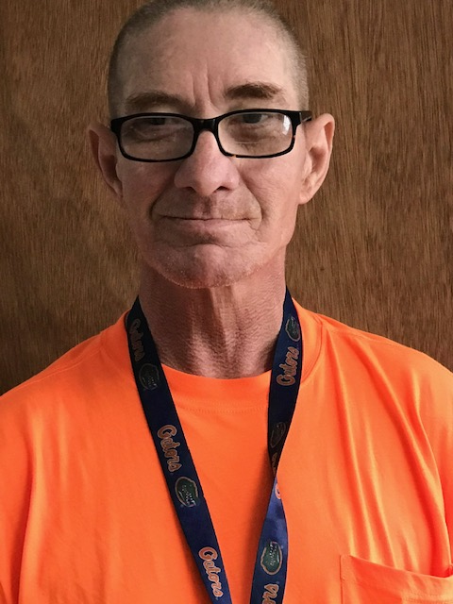
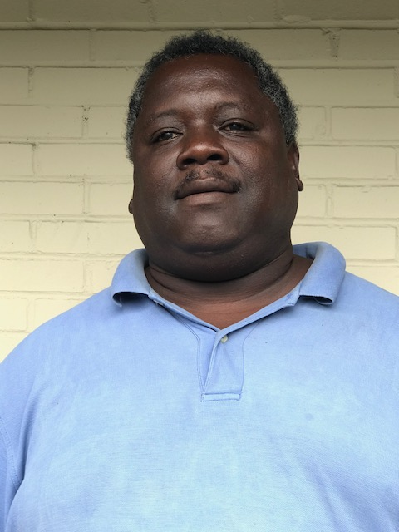
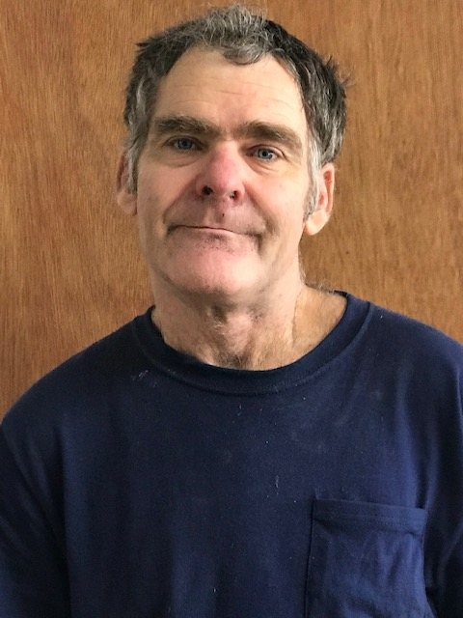
The faces Phoenix

Slide 14
QUESTIONS?
Douglas D. Adkins
Executive Director
Dayspring Village
www.DayspringVillage.org
904-845-2362 office
904-583-0134 cell

